Slide 1
2022 GAR
CONTRACT CHANGES
Continuing Education Class
https://www.campbellandbrannon.com/2022garchanges/

Slide 2
AGENDA
Section 1 – Brokerage Agreements & Case Study
Section 2 – Purchase and Sale Agreement & Exhibits
Section 3 –Disclosures & Case Study

Slide 3
2022 Contract Changes
Brokerage Agreements & Case Study
Section 1

Slide 4
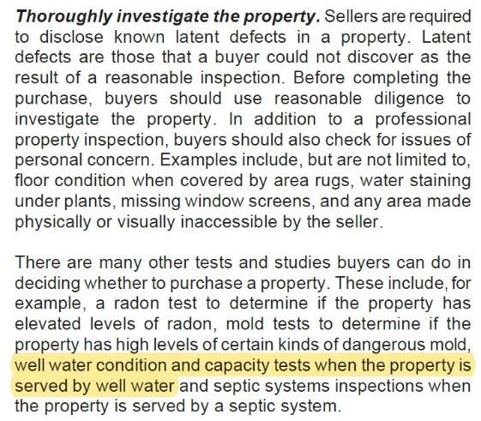
Consumer Brochures (CB04 and CB13)
The Consumer Brochures are well written and informative. These educational pamphlets are prepared courtesy of the Georgia Association of REALTORS® to help parties buy, sell, or lease real estate and should be used!
CB04 Lead Based Paint Pamphlet
Updated to the most recent EPA brochure
CB13 Protect Yourself When Buying Real Property
Added language about the types of testing under Thoroughly investigate the property

Slide 5
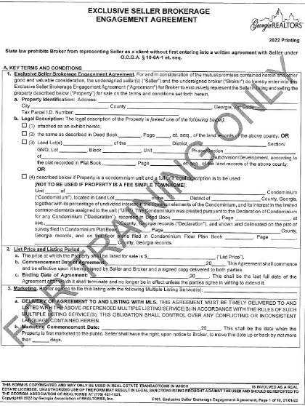
Exclusive Seller Brokerage Engagement Agreement (F101)
Establishes the duties of seller and broker for a set period.

Slide 6
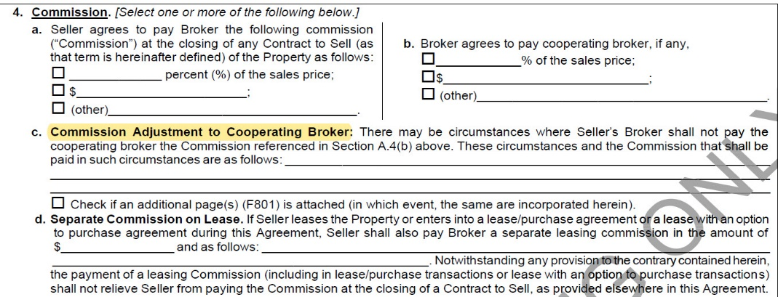
F101- Commission
New subsection (A(4)(c)) adds circumstances under which Seller’s Broker shall not pay cooperating broker the Commission listed in section A(4)(b)

Slide 7
F101- Commission
New subsection (B(4)(c)) clarifies commission in a lease purchase.

Slide 8
F101 – Agency and Brokerage
New: Broken out into two subsections and added language about Seller consenting to dual agency (A(6))

Slide 9
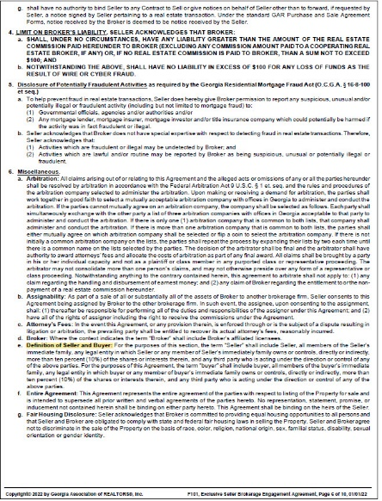
F101
Limits Broker liability: seller has a duty to warn Buyers of hazardous conditions on the property and agrees to hold Broker harmless against claims if Buyer is injured on the property.
New: definition of Buyer and Seller moved to subsection C(6)(e)

Slide 10
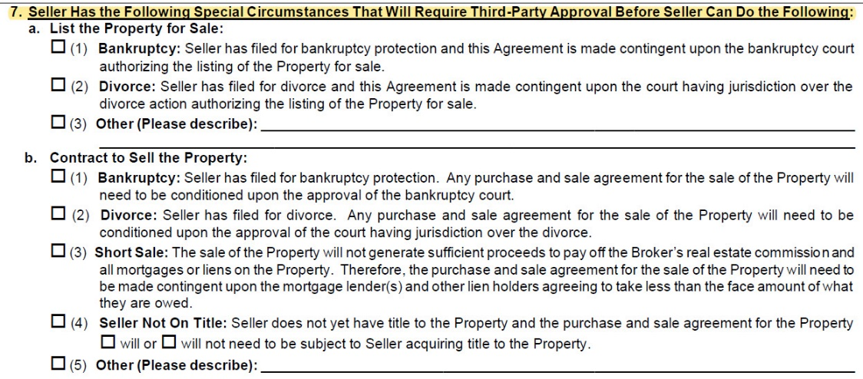
F101 – Section A(7) Special Circumstances

Slide 11
Special Circumstances – F101: Case Study
At the Listing Appointment, the prospective client gave the Agent a tour of the home. The Agent noticed that some of the house was unfurnished, but it seemed normal given the intent to sell.
While touring the bedroom, she further noticed that it was only half-filled… the Agent felt this was odd and was concerned that the spouse had moved out, but never followed up on it. Importantly she had checked the deed and the client was the only one listed.
The Listing Agreement was signed, pictures were scheduled, and the property was marketed for sale a short time later.
Two weeks into a binding agreement being signed, the Closing Attorney called the Agent and asked, “Can you tell me about the divorce and how that is being handled?” Dreading this very call, the Agent called her client and reality set in – the property was not going to close on time, if at all.

Slide 12
Issues (F101 Case Study)
Seller has filed for a divorce;
Seller did not disclose the divorce;
Will Seller’s spouse approve the sale? Does that matter?
Spouse is not on the title to the property.

Slide 13
Analysis (F101 Case Study)
F101 A(7)(b)(2) Seller has filed for Divorce: “Any purchase and sale agreement… will need to be conditioned upon the approval of the court having jurisdiction over the divorce”
2. Georgia is an "equitable distribution state" which means that all marital property acquired during the marriage is subject to division. Property brought into the marriage is not subject to division in a divorce. ... Gifts from one spouse to another are marital property if they were purchased with marital funds.

Slide 14
Conclusion (F101 Case Study)
Seller cannot convey clear title by closing;
Must delay closing or allow contract to terminate;
Buyer receives Earnest Money and Broker Remedies are not available!

Slide 15
Conclusion (F101 Case Study)
Stop and ask the tough questions!
Divorce, bankruptcy, delinquency on mortgage, liens or short sale
Don’t be afraid to turn down a listing! In this case study, the broker spent hundreds of dollars listing the property, several months marketing and coordinating showings, and ultimately lost the closing with no recourse.
Call an Attorney or specialist prior to accepting offers. Attempting to solve the issue while under contract with a buyer further complicates the process and increases the costs or concessions due to the timelines.

Slide 16
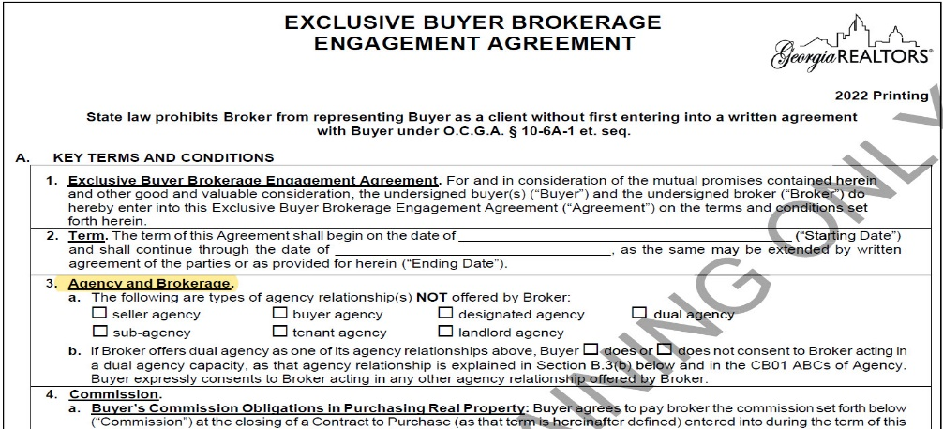
Exclusive Buyer Brokerage Engagement Agreement (F110)

Slide 17
F110 - Commission

Slide 18
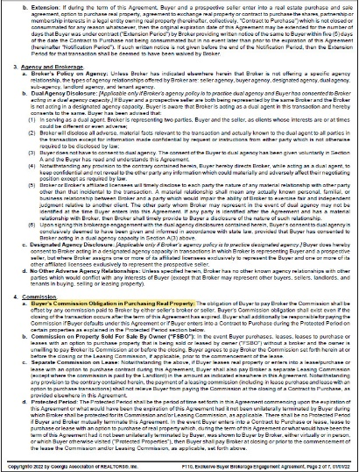
F110 - Commission
Broker’s Entitlement to Commission retitled “Buyer’s Commission Obligations in Purchasing Real Property” (B.4a) and language was changed
Seller Normally Pays Commission subsection was eliminated.

Slide 19
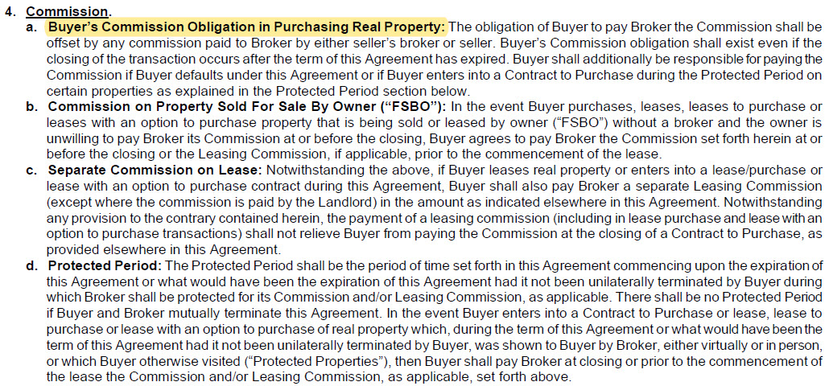
F110 - Commission

Slide 20
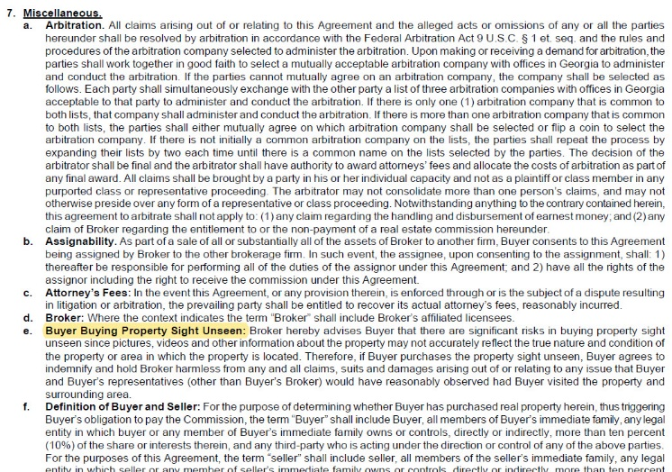
F110
New subsection C(7)(e): Buyer Buying Sight Unseen

Slide 21
F110
Buyer Default C(8)
Added language regarding unpaid portions and added subsection (d)

Slide 22
2022 Contract Changes
Purchase and Sale Agreement &
Exhibits
Section 2

Slide 23
Purchase & Sale Agreement (F201)
F201 is divided into three main sections
Key Terms and Conditions
Further explanations for Section A
Other Terms and Conditions

Slide 24
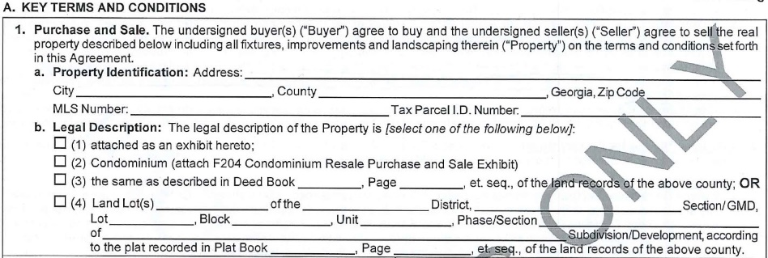
F201 – Purchase and Sale
Identify the property
Practice Tip! when attaching the vesting deed or legal description make sure you list it as an exhibit and actually attach it

Slide 25
F201 – Purchase and Sale

Slide 26
F201- Purchase and Sale
Surveys:
Not required but a survey may reveal issues which a title exam cannot. These issues may impact marketability of title
Title Insurance: Buyer directs lender to quote the cost of an enhanced owner’s policy

Slide 27
F201 – Purchase Price
Contract is by default a cash closing UNLESS a financing exhibit is attached
Practice Tip! Be sure to attach the proper financing contingency exhibit or include a special stipulation for financing

Slide 28
F201- Closing Costs

Slide 29
F201- Closing Costs
B(3)(c)

Slide 30
F201- Closing Costs
How we handle tax prorations is based on the closing date!
Jan – May:
Estimate based on previous year
May – August:
Estimate based on Tax Assessment
August – December:
Prorate actual bill
This can be modified based on learning new information!
Seller moved prior to January 1 (i.e. Homestead)
New Construction
Significant remodel in prior year

Slide 31
F201 – Closing Date & Possession
Exchange all keys, door openers, codes, etc. AT CLOSING even if there is a temporary occupancy
Temporary Occupancy(F219) should not be for more than 60 days.

Slide 32
F201 – Closing Date & Possession
Extending the Closing Date
Unilaterally Extending for 8 days (F270): can only be used ONCE for only one of three reasons
Seller cannot satisfy title objections
Lender, even in all cash transactions (see cash exhibit for exception), or closing attorney cannot close due to no fault of the buyer
Lender did not disclose on time

Slide 33
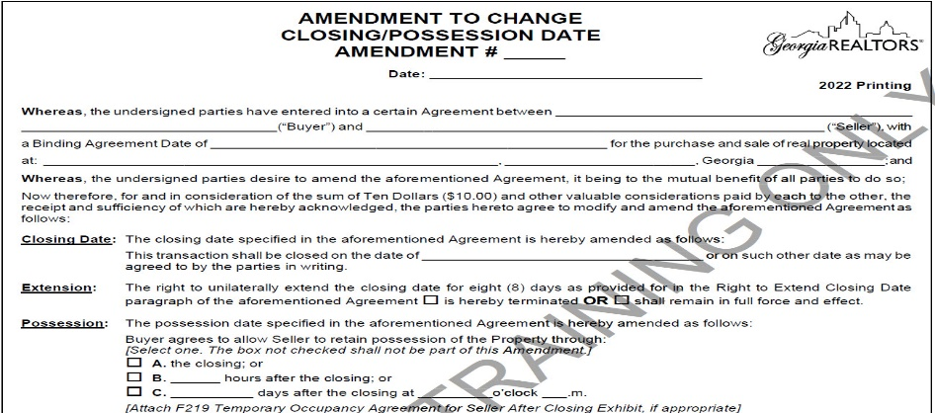
F201 – Closing Date & Possession
Extending the Closing Date
2. Mutual Extension (F716)

Slide 34
F201- Closing Law Firm
NEW: Changed spots with the Holder of Earnest Money & added phone number

Slide 35
F201- Holder of Earnest Money
Must deposit earnest money within 5 banking days of Binding Agreement Date or 5 banking days after receipt if that is after the Binding Agreement Date
If check bounces or earnest money is not received buyer has 3 banking days to cure or seller may terminate. If the buyer cannot cure seller has 7 calendar days to terminate.
If attorney is holding EM you must use F510 and F511

Slide 36
F510 and F511
F510: agreement between the parties
F511: the closing attorney agreeing to hold the earnest money
Must be delivered to closing attorney along with the Purchase & Sale within 2 days of the binding agreement date, closing attorney then has 3 days to sign
Closing attorney’s duties as holder of earnest money don’t start until receipt of the contract and funds

Slide 37
F201 – Earnest Money
Practice Tip!
Be cautious using ACH. ACH transfers cannot be accepted for Closing and a Buyer could make that mistake, causing delays.

Slide 38
F201 – Earnest Money
Reasons for buyer to receive Earnest Money:
No Binding Agreement
Failure of unexpired contingency or condition
Seller default
Specific right to terminate

Slide 39
F201 – Earnest Money
When holder can disburse Earnest Money:
At closing
Agreement of the parties
Court order or arbitrator
No binding agreement
10 day letter

Slide 40
F201 – Inspection and Due Diligence
Buyer must give Seller notice prior to inspecting the property
Buyer may terminate for ANY reason

Slide 41
F201 – Inspection and Due Diligence
Buyer Beware!
Property is sold “as-is” unless terminated during due diligence
Remember: even with due diligence or property being sold “as-is” seller must disclose any latent or hidden defects that they are aware of which could not be discovered by the Buyer

Slide 42
F201 – Inspection and Due Diligence
Option Money : Payment to the seller for giving Buyer option to terminate in due diligence
NEW! Clarified that option money shall be paid directly to Seller

Slide 43
F201- Lead Based Paint
Pre 1978 vs Post 1978
Must disclose known information on lead-based paint exhibit (F316)

Slide 44
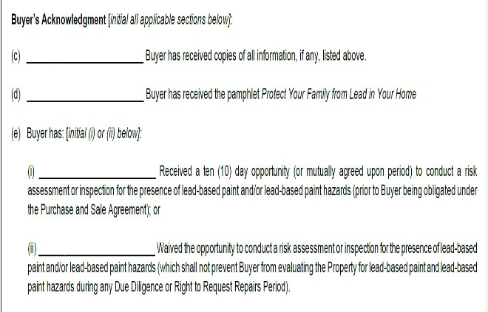
Lead Based Paint Exhibit (F316)
Most agents make offers before doing an inspection. For that reason, the form now allows buyer to waive that opportunity of inspection before going under contract but retains the opportunity during inspection of contract.

Slide 45
F201- Brokerage Relationship
Disclose the scope of representation
Disclose any material relationships

Slide 46
F201 – Time Limit of Offer
Date and time that offer expires unless accepted AND notice of acceptance is given to the offering party
You MUST have Acceptance AND delivery of Acceptance

Slide 47
F201- Other Terms
Notice
Must be signed by the party giving notice
Party giving notice must prove delivery: actual receipt, delivery service, or date & time sent via fax or email

Slide 48
F201 - Other Terms
Notice
New! Notice occurs via email even if not opened C(1)(b)

Slide 49
F201 - Other Terms
New! Notice occurs via email even if email is not opened also added to C(1)(c)
Practice Tip! Notice must be sent to the address, phone number, email, or fax on the contract

Slide 50
F201- Other Terms
Default
Seller’s Remedies: retain earnest money
Buyer’s Remedies: specific performance or terminate and receive earnest money
Defaulting party shall pay liquidated damages to the brokers
Non-prevailing party to pay prevailing party attorney’s fees

Slide 51
F201- Other Terms
Risk of Damage to Property (Risk of Loss)

Slide 52
F201- Other Terms
Risk of Loss- Storms!
In the event of a storm: Prior to Closing = Seller obligation; Post Closing = Buyer Obligation
Recommend Buyer hire an inspector to come back for final walk through.

Slide 53
F201- Other Terms
Other Provisions:

Slide 54
F201- Other Terms
NEW SECTION: Objection to Binding Agreement Date C(4)(k)

Slide 55
F201- Other Terms
NEW SECTION: Rules for Interpreting This Agreement C(4)(l)

Slide 56
F201- Other Terms
FHA and VA Exhibit
Amendments
Boilerplate Language
Special Stipulations
Handwritten and Initialed Changes
Exhibits and Addenda

Slide 57
F201 - Other Terms
Other Provisions
Practice Tip! Add survival language to any special stipulation requiring the seller to perform repairs.
“… This shall survive closing.”

Slide 58
F201 - Other Terms
NEW Definition! C(5)(e)

Slide 59
F201 - Other Terms
Special Stipulations - who, what, when, where, how
Contingency vs. obligation to perform
New! Removed language regarding priority as it is now in C(4)(l)

Slide 60
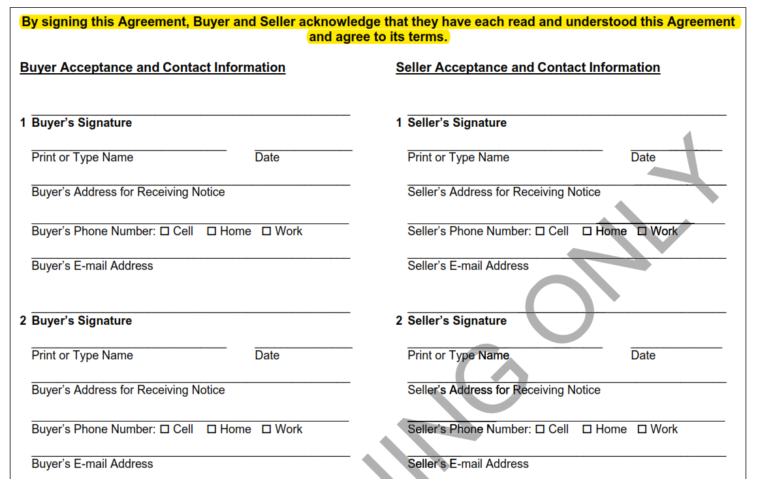
F201- Signatures
Practice Tip! Include contact information to ensure Closing Attorney can contact the parties directly. This also ensure that notices can be delivered effectively.

Slide 61
Counter Offer (F249)
Practice Tip! if you decide to counter an offer or counteroffer you may run the risk that the seller won’t agree to their original offer!
Practice Tip! signing the counteroffer incorporates all of the previously included exhibits. If an exhibit is being modified, include that in the counteroffer to also be signed.

Slide 62
Counter Offer (F249)
Practice Tip! The counteroffer incorporates by reference all terms of the original offer so only the counteroffer needs to be signed to be legally binding

Slide 63
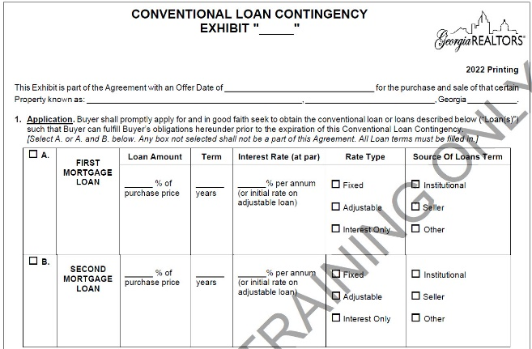
Financing Contingencies
Describe the loan with realistic terms
The buyer must apply with one of the lenders listed BUT they don’t have to use that lender
Denial letter must be from lender listed

Slide 64
Financing Contingencies
If there is no lender listed than then denial may be from any Georgia licensed institutional lender.
The letter may not be SOLELY based on:
Lack of funds to close
Buyer not having leased or sold other property (unless there is a contingency)
Buyer not providing required information to lender is timely manner
Buyer adversely affecting their debt-to-income
Property not appraising (unless there is a contingency)
Lender not completing underwriting

Slide 65
Financing Contingencies
Seller’s Right to Terminate
Once financing contingency expires seller MAY request evidence of ability to purchase property
Buyer has 7 days to provide evidence (seller cannot make the request within 7 days of closing)
If evidence is not provided seller shall notify buyer and give 3 days to cure default
After the 3 days pass with no cure, seller has 7 days to terminate

Slide 66
Appraisal Contingency
Must provide Amendment to Reduce Sales Price (F713) and Copy of Appraisal
Seller has 3 days to accept or reject.
If seller says no, buyer has 3 days to terminate.

Slide 67
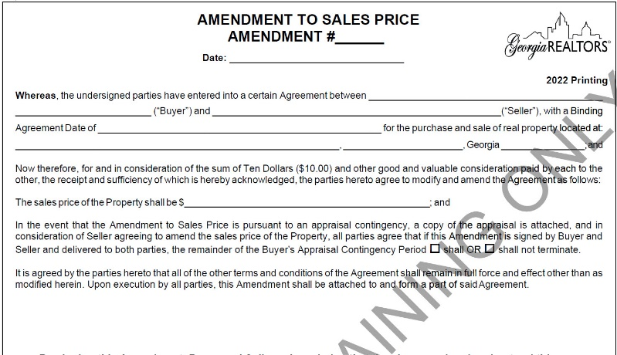
Amendment to Reduce Sales Price (F713)

Slide 68
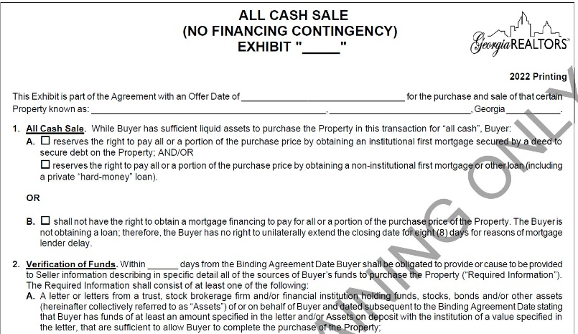
All Cash Exhibit (F401)

Slide 69
F401
Seller can request verification of funds
If the Buyer does not provide proof in 7 days they are in default and Seller must give them 3 days to cure.
Seller may terminate within 7 days of Buyer’s failure to cure default.

Slide 70
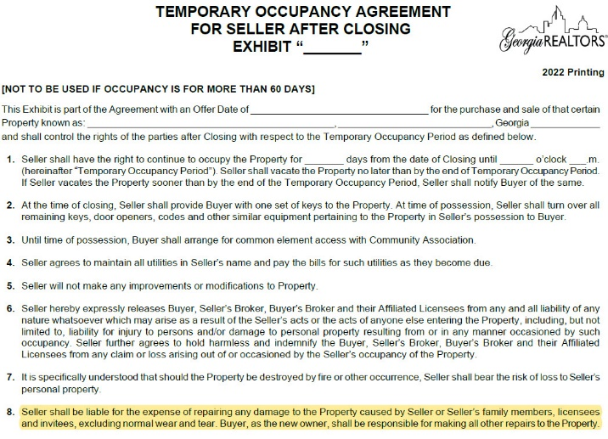
Temporary Occupancy (F219)
NEW! Added language that buyer is responsible for repairs

Slide 71
Option Agreement (F240)
NEW! Added the option for option money to be credited towards purchase price and that broker’s option fee is in addition to commission that may be paid on the sale.

Slide 72
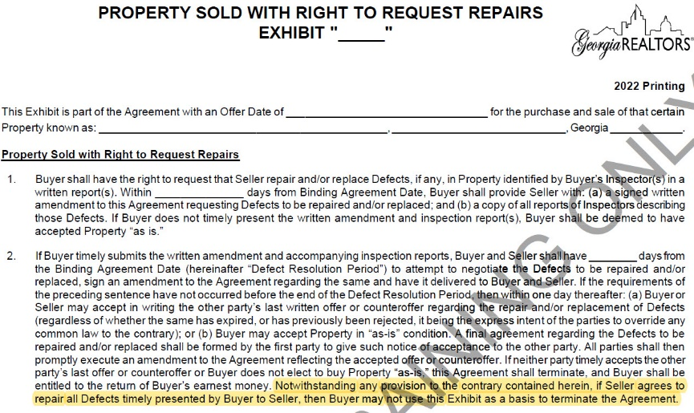
Right to Request Repairs (F273)
New! Buyer unable to use exhibit to terminate if seller agrees to repairs.

Slide 73
Lot and Land Purchase and Sale (F210 and F213)
Same changes as F201, so what’s different about these sales?
Things we think about:
Houses:
Termites / Warranties / Encroachments
Improvements
Building or zoning violations
Keys and openers (i.e. possession)
Land & Lots:
Zoning / utilities / sewer & water access
Permitting
Environmental studies
Surveys

Slide 74
Land Purchase and Sale (F213)
New section regarding preferential tax rollbacks B(4)(c).
This update is only in F213

Slide 75
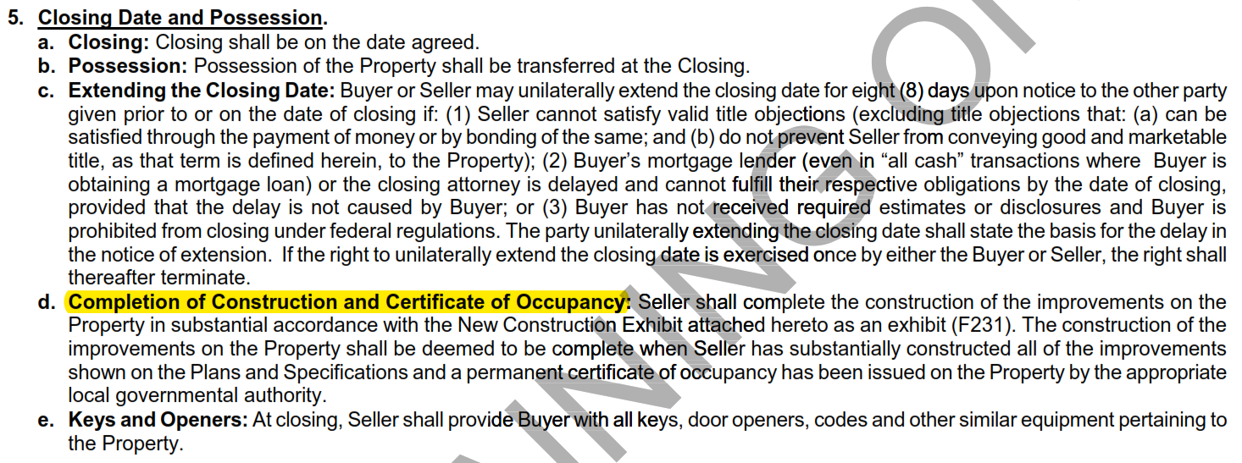
New Construction PSA F228
Completion Dates & Certificate of Occupancy
Construction Deposits

Slide 76
New Construction PSA F228
Punch List Items

Slide 77
Mutual Termination (F519)
Used when BOTH parties want to terminate
Addresses disbursement of earnest money
Must be signed by both parties

Slide 78
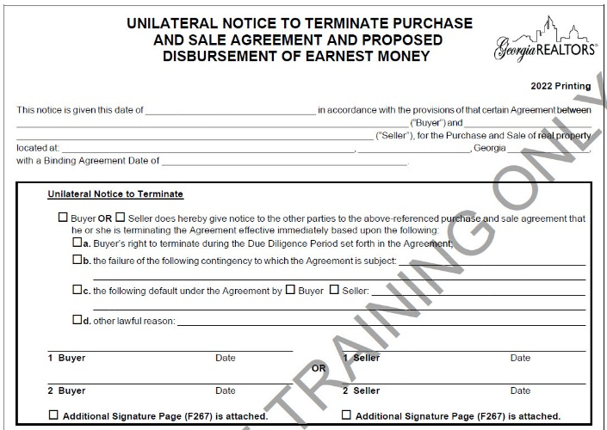
Unilateral Termination (F522)
Two Sections:
First section terminates the contract and is signed by only the buyer or the seller

Slide 79
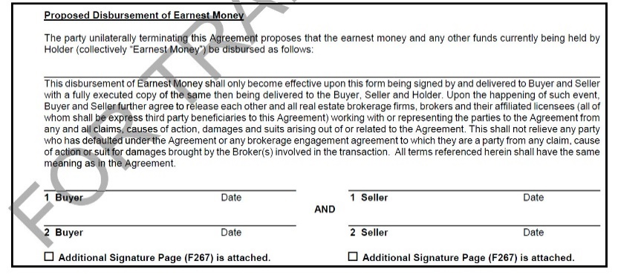
Unilateral Termination (F522)
Two Sections:
Second section proposes the disbursement of earnest money and requires signature of both parties

Slide 80
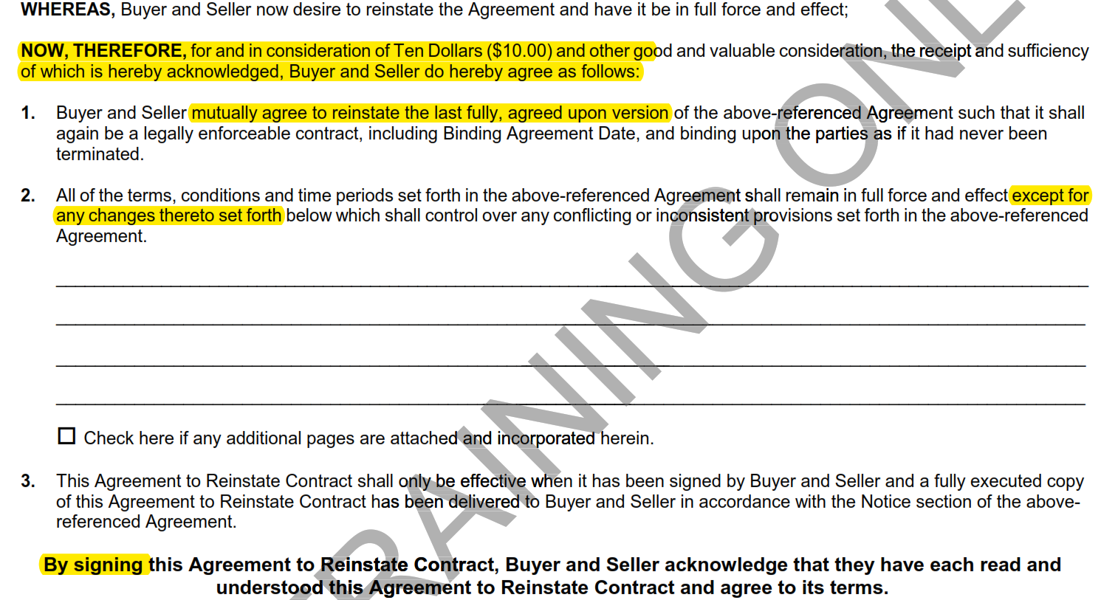
Agreement to Reinstate Contract F290
This form properly reinstates a contract and can be used if the parties are able to resolve their previous differences or reasons the contract first failed.
BE CAREFUL! If not recently terminated you may want to do a new contract entirely.

Slide 81
2022 Contract Changes
Disclosures & Case Study
Section 3

Slide 82
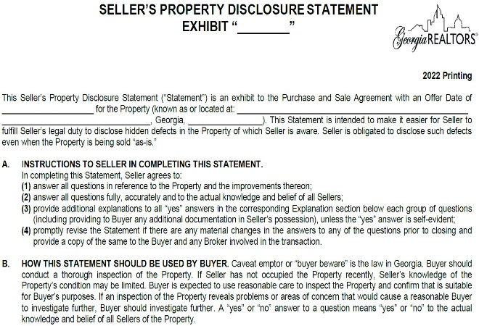
Seller’s Property Disclosure (F301)
“When in doubt… disclose disclose disclose!” – Mike Campbell
Generally, all properties should be sold with an attached Seller’s Disclosure – no excuses!

Slide 83
Seller’s Property Disclosure (F301)
Remember, the obligation to disclose known material and latent hidden defects survives closing (F201) so make sure it is listed as an exhibit to the contract.

Slide 84
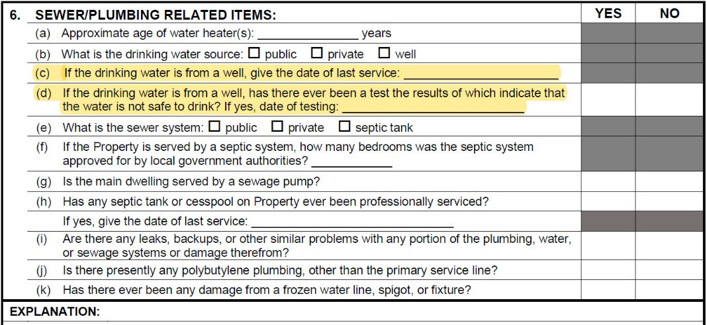
Seller’s Property Disclosure (F301)

Slide 85
Seller’s Property Disclosure (F301)

Slide 86
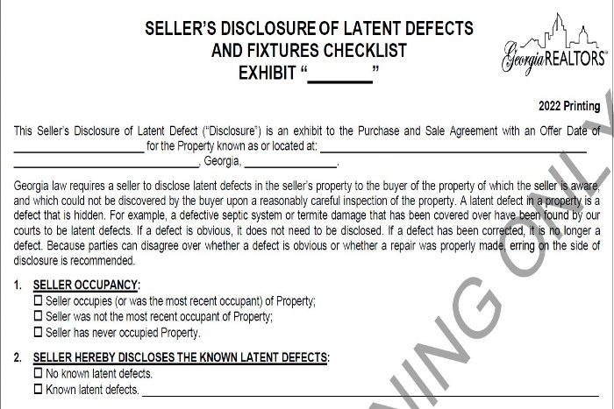
Seller’s Disclosure of Latent Defects (F302)
In the event the Seller does NOT want to fill out a seller’s disclosure use F302.
Discloses Latent Defects and Fixtures checklist
Disclose – Disclose – Disclose!

Slide 87
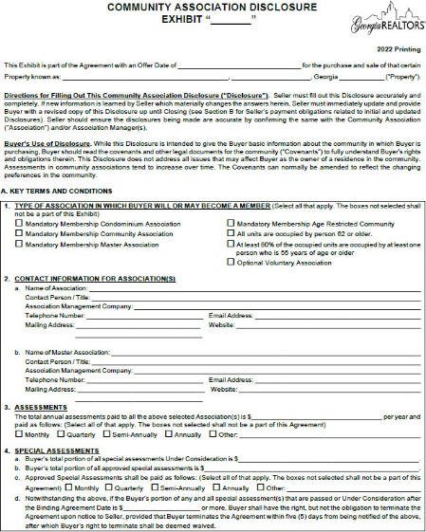
Community Association Disclosure(F322)
New Format!

Slide 88
Community Association Disclosure(F322)
Disclosure Regarding Fees

Slide 89
Community Association Disclosure(F322)

Slide 90
Community Association Disclosure(F322)

Slide 91
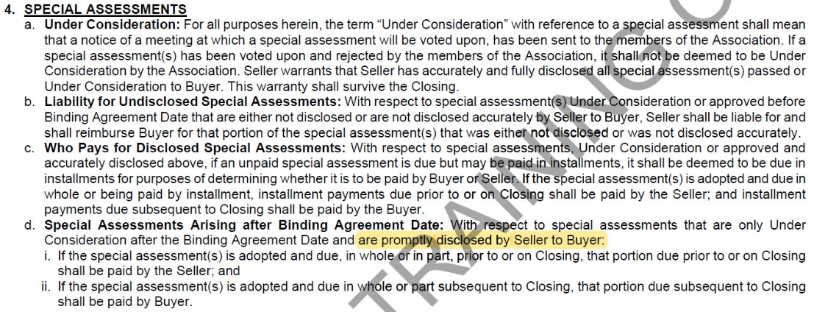
Community Association Disclosure(F322)
NEW! Added that seller must notify buyer if special assessments pass.

Slide 92
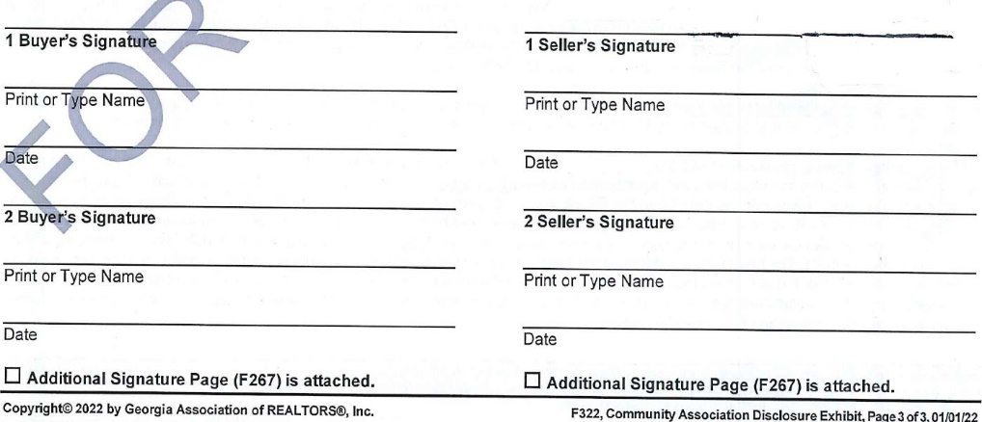
Community Association Disclosure(F322)
NEW SIGNATURE BLOCKS!

Slide 93
Fee Disclosure Timelines – F322: Case Study
Prior to the Binding Agreement Date, the Seller contacts his HOA in preparation of listing the Property on FMLS. The HOA states that there is (a) not an Initiation Fee and (b) the Closing Letter is $300.
The Seller fills out F322 and discloses the information as provided by the HOA when a binding contract is signed shortly thereafter, putting $300 in A(5) in regards to the Closing Letter.
After Binding Agreement Date but before the end of Due Diligence, Seller texts and emails the Buyers when they discover the additional fees. The Buyers acknowledge receipt and the Agreement continues without a termination.
At closing, Seller is irate when the HOA discloses $650 Initiation Fee, $300 Buyer move-in fee, and a $150 Elevator Deposit. The Closing Attorney places these fees (in addition to the Closing Letter) on the Seller and Seller refuses to Close unless they are rectified.

Slide 94
F322 Case Study
“Owners living in a mandatory membership community association have to pay certain recurring fees, charges and assessments (collectively “Fees”) to the association. Fees can and do increase over time and, on occasion, there may be the need for a special assessment. The risk of paying increased Fees is assumed by the Buyer in living in a community with a mandatory membership association.” “Owners living in a mandatory membership community association have to pay certain recurring fees, charges and assessments (collectively “Fees”) to the association. Fees can and do increase over time and, on occasion, there may be the need for a special assessment. The risk of paying increased Fees is assumed by the Buyer in living in a community with a mandatory membership association.”
- F322 B(3) (a)

Slide 95
Rules (F322 Case Study)
F301 (Sellers Disclosure) – C(2)(b) Seller to complete and provide with a “Community Association Disclosure Exhibit” GAR F322.
F322 (CAD) –
B(3)(d) – Seller to pay for Clearance Letter and anything requiring be pre-paid, and shall not be reimbursed.
B(3)(c) and B(5)(b) – Seller to pay all fees due prior to Closing, seller move-out fees, and anything not fully disclosed.
B(5)(a) – Buyer to pay EVERYTHING ELSE as long as its disclosed
B(3)(b) – pre-paid assessments and move-in fees / elevator security deposits shall be Buyer fees, even if not disclosed.
F322 is used when disclosing HOA or Condo fees, and details who pays for each fee regarding Closing.

Slide 96
Question (F322 Case Study)
The Seller disclosed $300 in fees, however the HOA reported $1400 ($300 Closing Letter, $650 Initiation Fee, $300 Buyer move-in fee, and a $150 Elevator Deposit). The Closing Statement shows the Seller paying for all but $300… is that right??

Slide 97
Analysis (F322 Case Study)
$300 Closing Letter
Seller shall pay the Closing Letter per section 3B and shall not be reimbursed.
Alternative Solution – Add a stip!
“Buyer shall reimburse Seller for Closing Letter.”
$300 Buyer Move-in Fee & $150 Elevator Deposit
3(E) Buyer move-in fees and elevator deposits are Buyer fees – always! This is not required to be disclosed.
Practice Tip! Disclose it anyways!

Slide 98
Analysis (F322 Case Study)
Result!
Seller shall pay Closing Letter ($300) and not be reimbursed.
Buyer shall pay Move-in and Deposit, even though not disclosed.
Buyer shall pay $300 due to $300 being disclosed.
Seller shall pay remaining $350 for difference not disclosed about the Initiation Fee.
$650 Initiation Fee
Buyer shall pay the Initiation Fee if it is disclosed. If only partially disclosed, Seller shall pay the difference above what was disclosed.

Slide 99
Question (F322 Case Study)
But the Seller re-disclosed after Binding Agreement Date and Buyer didn’t refuse. Doesn’t this change the form??

Slide 100
Analysis (F322 Case Study)
No! A subsequent re-disclosure, though required per the form, does not change the disclosure at BAD and who is responsible for its payment. (B(5)(b))

Slide 101
Thoughts (F322 Case Study)
We strive for open communication regarding fees, costs, expenses, and timing. If you notice another agent making a mistake or failing to disclose, we recommend speaking up in advance! Even if this would save your client money, avoid a last-minute blowup and get it right up front.
Note – If the Seller never would have agreed to pay the initiation fee when negotiating, sometimes the Listing Agent ends up paying it!
Or use a stip!
“Due to difficulty defining the exact costs of the HOA, Buyer shall pay and reimburse Seller for any and all HOA costs at Closing, including undisclosed fees, Closing Letters, move-in fees and Special Assessments.”
Or even better… add a stip or put a very large amount in 3(C).

Slide 102
2022 GAR Contract Changes
Questions?

Slide 103
2022 GAR Contract Changes
The End!

