Slide 1
Hot Topics in 2022
Continuing Education Class
WWW.CAMPBELLANDBRANNON.COM/HOTTOPICS

Slide 2
GAR Mid-Year Changes

Slide 3
Top Mid-Year Changes
Exclusive and Non-Exclusive Seller Brokerage Agreements (F101 and F104) – B(4)(b). The last sentence was added to clarify that if the agreement doesn’t show the Seller’s Broker paying the cooperating broker there is no obligation on the Seller to pay the cooperating broker.

Slide 4
Top Mid-Year Changes
Exclusive and Non-Exclusive Buyer Brokerage Agreement (F110 and F113) – B(4)(a) - Added that if offered by Seller or Seller’s Broker, Buyer’s Broker may be paid more than the commission agreed upon in Section A(4)(b); and that the closing attorney will collect and disburse commission.

Slide 5
Top Mid-Year Changes
Purchase and Sale Agreement (F201) – B(3)(a). Seller’s contribution can cover Buyer’s commission obligations.

Slide 6
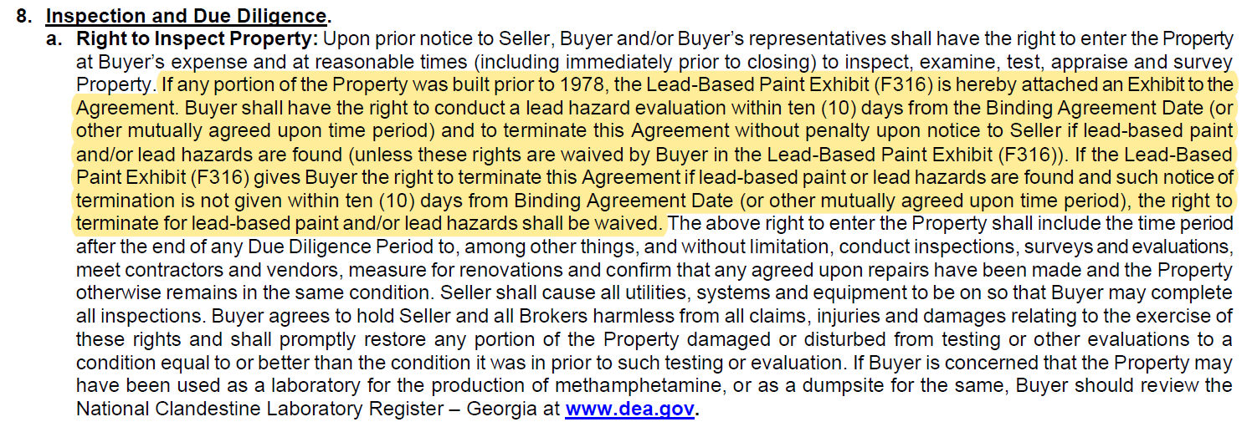
Top Mid-Year Changes
Purchase and Sale Agreement (F201) – B(8)(a). If the home was built prior to 1978 and the Lead-Based Paint (“LBP”) Exhibit is NOT attached to the contract, then Buyer has a 10 day right to terminate if LBP is found even if DD is less than 10 days. Watch Out!

Slide 7
Top Mid-Year Changes
Lead Based Paint Best Practices
The LBP Exhibit needs to be executed prior to the contract being signed and attached as an exhibit to the contract.
On the LBP Exhibit, section (e):
(e)(i) – Should RARELY be selected (initialed) as it states the Buyer has already received a ten-day inspection period for LBP PRIOR TO GOING BINDING. THIS NEVER HAPPENS!
(e)(ii) – Recommended – Buyer waives the right to inspect for LBP and this new GAR provision in the body of the contract included no longer applies. Buyer cannot terminate for the presence of LBP.

Slide 8
Top Mid-Year Changes
FHA and VA Financing Contingencies (F407 and F410). Paragraph 11. Clarified that the amendatory clause applies even after the financing contingency expires.

Slide 9
Top Mid-Year Changes
Instructions to Closing Attorney – F255. Paragraph 3 NEW subsection C.

Slide 10
Top Mid-Year Changes
NEW Special Stipulation – SS110. No Commission Owed by the Buyer. This would be added to the Exclusive Buyer Brokerage Engagement Agreement in situations where a Buyer insisted upon additional language confirming Seller would pay any commission to Buyer’s agent.

Slide 11
Top Mid-Year Changes
NEW Special Stipulation – SS528. Contingency for Receiving Condo Questionnaire.
Stay tuned for more on this later!

Slide 12
Seller’s Right to Terminate?

Slide 13
Seller Contingency
Homeowners are hesitant to list their house because they are afraid they will not find a new house. Do they have any recourse?
“All parties acknowledge and agree that Seller shall have a contingency period for their benefit for the purpose of allowing Seller to identify a suitable new property, go under contract and clear due diligence. If Seller does not clear the due diligence period on a new property of Seller’s choosing within ______ days from Binding Agreement Date, Seller may terminate this Agreement without penalty upon written notice to Buyer. Seller shall notify Buyer in writing upon going under contract on the suitable new property and any due diligence timeline associated with the new property contract. Should Seller exercise this right to Terminate, Buyer shall have ten (10) days after such notice is provided to submit to Seller receipts for reimbursement for any inspection, appraisal, survey, and/or any other purchase-related costs incurred by Buyer. Seller shall reimburse Buyer within ten days of delivery of such request for reimbursement with receipts. Notwithstanding this right to request reimbursement, the total amount reimbursed to Buyer from Seller for various inspections shall not exceed $___________. In the event Buyer did not incur any such purchase-related costs, there shall still be consideration for this Seller contingency given the shortage of homes available in the market and Buyer expressly acknowledges such value received in this Agreement. If Seller does not terminate this Agreement in writing prior to the contingency deadline stated above, such right to terminate shall expire and Seller shall be bound to sell the Property to Buyer. During the time period of this seller contingency, Buyer may terminate this Agreement without penalty for any reason and with full refund of Earnest Money. In the event Buyer terminates under this provision, Buyer shall be deemed to have waived Buyer’s right to any reimbursements.”

Slide 14
Seller Termination
It is a Sellers’ market and some Sellers feel like they can do and ask for anything they want.
A Seller may not want to make required repairs, fix certain title defects, etc. and they threaten that if they don’t get their way they will walk.
Sellers don’t have an earnest money deposit so they think they can walk away from the table with no consequences. In their mind they have nothing to lose.
What can a Buyer do?

Slide 15
Seller Termination
Specific performance
Commission
Any other solutions?

Slide 16
Seller Termination
If the Seller terminates, Buyer can receive the returned earnest money or seek specific performance but not both!

Slide 17
Seller Remedies

Slide 18
Seller Remedies
If the Buyer terminates, under the GAR contract the only remedy available to the Seller is retaining the earnest money.
But what if the Sellers want to force the Buyer to follow through on their offer?

Slide 19
Seller Remedies
“In the event this Agreement fails to close due to the default of the Buyer, Seller may either seek the specific performance of this Agreement or terminate this Agreement upon notice to Buyer and Holder, in which case all earnest money deposits shall be disbursed to the Seller as full liquidated damages following the procedures set forth elsewhere herein. The parties expressly agree that the earnest money is a reasonable pre-estimate of Seller’s actual damages, which damages the parties agree are difficult to ascertain. The parties expressly intend for the earnest money to serve as liquidated damages and not as a penalty.”

Slide 20
No Due Diligence

Slide 21
No Due Diligence – Risk to Seller
Buyers are submitting offers with no due diligence. Once the deal goes binding, despite no due diligence the Buyers are trying to get out of the contact by not submitting the earnest money.

Slide 22
No Due Diligence – Risk to Seller
Sellers receive multiple offers on their property.
One offer stands out above the rest – all cash, no due diligence, no appraisal contingency, and $60,000 earnest money due within 3 days.
Sellers accept the offer and the contract goes binding Friday afternoon.
Over the weekend the Buyer gets cold feet and sends a unilateral termination.
The Buyer did not have a right to terminate and is now in default. Sellers are entitled to the earnest money.
The earnest money wasn’t due until Monday so the holder does not have earnest money to disburse to the Sellers.
What can the Sellers do?

Slide 23
No Due Diligence – Risk to Seller
What Can a Seller Do?
A shorter time for submitting the Earnest Money is helpful to avoid this situation.
If the Buyer never submits Earnest Money the Seller’s only recourse is to file a lawsuit to collect the Earnest Money. This claim can be made in small claims or Magistrate Court. You can strengthen the Seller’s position by using a special stipulation for the very limited cases where there is no due diligence. Although this makes the Seller’s position stronger it does not eliminate the need for the lawsuit.
When there is an offer with no due diligence and the Seller is going to accept the offer, the Seller’s agent could require the Buyer’s agent to provide proof of delivery of Earnest Money to the Buyer’s agent’s escrow account prior to accepting.

Slide 24
No Due Diligence- Risk to Seller
“All parties acknowledge and agree that the Earnest Money recited herein shall immediately be irrevocably due upon all parties signatures hereto. Seller has justifiably relied on Buyer’s offer (including the material term of no due diligence) in accepting Buyer’s offer while foregoing other competing offers. Accordingly, should Buyer fail to deliver Earnest Money as provided herein, Buyer shall be liable to Seller for the Earnest Money and all costs and attorney’s fees of Seller in pursuing Earnest Money. Buyer’s failure to deliver Earnest Money shall NOT be a valid reason for Buyer to terminate this agreement and shall not absolve Buyer of any and all obligations hereunder.”
The above stipulation is already what exists at law. However, without the stipulation there isn’t a clear directive to the Buyer that the Seller can point to in case of default.

Slide 25
No Due Diligence – Risk to Buyer
If your Buyer wants to waive due diligence explain the risks to them fully.
Protect yourself by documenting via email that you advised them of these risks.
Even with no due diligence an inspection is still very important!

Slide 26
No Due Diligence – Risk to Buyer
Due Diligence for a Specific Concern
“All parties agree that Buyer will have ____ days from the Binding Agreement Date to conduct an inspection of the property for the following limited item______________. Should the inspection reveal a repair is needed for the above referenced item, Buyer will have the right to terminate the Purchase and Sale Agreement without penalty.”
Example: Buyer wants to purchase with no Due Diligence but due to the age of the house is concerned with the safety of the electricity. Buyer submits an offer with no Due Diligence but right to conduct an inspection for the electricity. The inspection shows that some of the outlets in the house are not grounded properly. Due to the findings of the inspection Buyer terminates within the time set forth in their contract and earnest money is disbursed back to Buyer.

Slide 27
No Due Diligence – Risk to Buyer
Right to Request Repairs for a Specific Concern
“This property is sold with the right to request repairs (F273) as outlined on Exhibit___. Said right to request repairs shall be limited to the following defects______________[insert particular concern].”
Example: Buyer wants to purchase with no Due Diligence but due to the age of the house is concerned with the safety of the electricity. Buyer submits an offer with no Due Diligence with the right to request repairs for the electricity. The inspection shows that some of the outlets in the house are not grounded properly and the roof has some missing shingles. Buyer cannot ask for the Seller to repair the missing roof shingles but submits an amendment for the defective outlets to be repaired and a copy of the inspection report. The Seller refuses to repair the defective outlets. Buyer terminates within the time set forth in the Right to Request Repairs Exhibit and earnest money is disbursed back to Buyer.

Slide 28
Survey Due Diligence
Broad Survey Stipulation
“Should Buyer obtain a recent survey of the property, Buyer shall have the right to terminate the Purchase and Sale Agreement without penalty and with full refund of all Earnest Money if in Buyer’s sole discretion any matters revealed by said survey are objectionable to Buyer. Buyer shall notify Seller of such termination for matters revealed by said survey no later than ___ days from Binding Agreement Date.”
Survey Stipulation for a Specific Concern
“All parties agree that Buyer will have until _________ to conduct a survey on the property. Should the survey show ___________Buyer will have the right to terminate the Purchase and Sale Agreement without penalty.”
Narrow Survey Stipulation
“To the best of Seller’s knowledge, there are no encroachments, easements, sewer lines, storm drainage lines, other utility lines not serving only the subject property, water buffers, flood zones, setback issues, shared driveways, areas of overlapping claims of ownership with neighbors, claims of adverse possession, vehicular access issues or boundary line disputes impacting the Property. Should the Buyer obtain a recent survey of the Property which reveals any such item, Buyer shall have the right to terminate the Purchase and Sale Agreement without penalty. Buyer shall notify Seller of such termination no later than ___ days from Binding Agreement Date.”

Slide 29
Repairs

Slide 30
Repairs
What can you request be repaired under the Right to Request Repairs Exhibit?
What if the Seller already disclosed the defect?

Slide 31
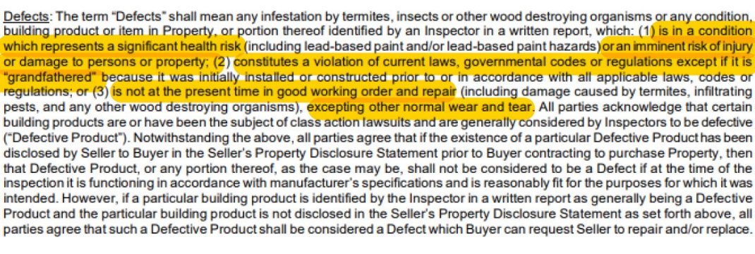
Repairs
What can you request be repaired under the right to request repairs?

Slide 32
Repairs
What if the Seller already disclosed the defect?
A defective product does not give the Buyer the right to request repairs if:
The defective product is disclosed in the Seller’s disclosure;
The Seller’s disclosure is provided to Buyer before the acceptance date of the contract; and
The defective product is functioning according to the manufacturer’s specifications and is reasonable fit for the purpose for which it was intended.

Slide 33
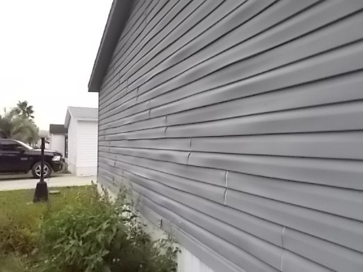
Repairs- Case Study
Facts:
An inspector discovers the siding is part of a class action lawsuit. Seller was unaware of the defect and therefore didn’t disclose it. The siding on one side of the house is swelling and delaminating but the rest is in good shape. What can the Buyer request of the Seller?*
*Seth Weissman & Ned Blumenthal, The Red Book on Real Estate Contracts in Georgia 516 (6th ed. 2021)

Slide 34
Repairs- Case Study
Answer:
If siding is defective, as defined by the contract, and was not disclosed, the Buyer could request that Seller repair or replace all siding.
If the Seller disclosed the condition, the Buyer could only request the repair or replacement of the siding that is not functioning in accordance with the manufacturer’s specifications.*
*Id.

Slide 35
Repairs
Don’t obligate yourself to perform a repair you can’t realistically complete.
Supply Chain
Labor Shortages
“Seller shall use best efforts to complete the listed repairs at least __ days prior to Closing. Buyer shall have the right to have such repairs re-inspected to confirm all repairs are completed in a good and workmanlike manner as agreed upon. Moreover, should any repairs not be completed prior to Closing, (the “Remaining Repairs”) such Remaining Repairs shall survive Closing and Seller shall remain obligated to insure the timely completion of such Remaining Repairs. Should Seller fail to reasonably pursue the timely completion of the Remaining Repairs, Seller shall be liable for the Buyer’s costs in completing such Remaining Repairs and attorney’s fees and costs associated with pursuit of reimbursement thereof.”
Depending on the transaction you may or may not want to include the portion in italics. It is a balancing act between not being seen as overboard by the listing agent but also giving your Buyer a remedy if the Seller goes MIA.
Notes:
Example: the stove needs a new light, the seller orders the part but it doesn’t come in on time and may take 6 months. Buyer says I want a new stove.

Slide 36
Repairs
Dealing with Walk Through Issues
Buyers do their walkthrough day before/morning of closing
Buyers discover a new issue such as a water leak or an unfinished repair
Buyer’s agent calls closing attorney and says there is not enough time to fix issue prior to closing, so what can we do??
Not always a great solution and answer depends on what sort of issue and severity of issue

Slide 37
Repairs
Option 1: Delay Closing Until Fixed
Pros
Buyer has issue resolved before closing
With minor cosmetic issues or cleaning, perhaps closing can get pushed back a few hours so seller can remedy the issue
With a major issue (big water leak, tree on house, etc.), we have seen closing get pushed back days or weeks – Buyer can rely on item C3 on page 5 of GAR P&S agreement for new conditions.
Cons
Inconvenience! Buyers want to move in, Seller may be buying and needs the funds (often back-to-back closing(s) with no sale contingency!), rate lock issues, scheduling issues

Slide 38
Repairs
Option 2: Escrow money from Seller Funds (usually not an option with a loan)
Pros
Parties do not have to delay closing
Third Party holding money and creating Escrow Agreement
Escrow Agreement will give Seller deadline for addressing issue, and if not done by then, money goes to vendor (or possibly the Buyer in a cash closing)
This sounds good in theory, but………
Cons
Need Lender approval - can send the loan back into underwriting, often making this an unworkable solution
Lender may also require pre/post-closing inspection of repair or delay closing
Disputes can arise over what amount of $ to be held and under what terms
Disputes at the end of the escrow period (i.e. - was work done to Buyer’s satisfaction) may lead to interpleading funds with the court
Cost parties $ for Escrow Agent to prepare Escrow Agreement and hold $

Slide 39
Repairs
Stipulation Example for Repair Escrow
“All parties agree and acknowledge that $_______ of Seller proceeds shall be held in escrow by closing attorney for ____ days after closing to allow for (vendor name) to address water intrusion in basement. Once vendor has repaired any damage and sealed the basement against further water intrusion, and vendor’s invoice has been paid in full from escrowed funds by closing attorney, any excess escrowed proceeds shall be returned to Seller. Should the repair be incomplete at the expiration of the aforementioned escrow period, all escrowed funds shall be tendered to Buyer, or to a vendor of Buyer’s choosing, to complete the repairs.”

Slide 40
Repairs
Option 3: Pay Vendor to Fix Issue from Seller Proceeds as part of Closing
Pros
Parties do not have to delay closing
Still need Lender approval, but Lenders are often ok with this solution because issue is being fixed and they have a receipt for the work*
Cons
Timing – how quickly can vendor assess situation and provide invoice?
This option still requires Lender approval, and if issue is significant enough, could raise red flags on Lender end
Seller must agree to this plan
*We list this payment on the closing statement. In some cases, the lender may say this has to be completed before closing. We had lender delay closing over a plumbing invoice on the closing statement for a leaking toilet. Lender then required an appraiser to verify the toilet was fixed prior to closing. Yikes!

Slide 41
Repairs
Option 4: Increase Seller Paid Closing Costs
Pros
Does not spook Lenders with unfinished repairs/property issues
Cons
Lenders have to approve the increase – does it mess up the ratios?
Timing – can cause loan to back through underwriting to get approval
Practice tip – if a Lender is involved, never adjust sales price to account for walkthrough issues, and never use the phrase “in lieu of repairs” on an amendment!!!!

Slide 42
Repairs
Option 5: Prepare Amendment that Seller’s Obligation Survives Closing
Pros
Parties don’t have to delay closing
Puts Seller on hook after closing
Cons
If Seller does not follow through, it is worth taking Seller to court?
If Lender is aware of amendment, could raise red flag
“The Purchase and Sale Agreement requires that the Seller complete the following prior to closing:_______________________________________________ . For and in exchange of ten dollars and other good and valuable consideration, the receipt and sufficiency of which is hereby acknowledged, it is agreed that these items may be completed within _____days after closing. It is the intent of the parties that these items shall survive closing until such time as said conditions are performed or fulfilled. Seller shall be liable to Buyer for any costs incurred in enforcing this provision.”

Slide 43
Repairs/Maintenance in Temporary Occupancy
What happens if an appliance breaks during temporary occupancy?
However, most Buyers expect when they take possession that the property will be in substantially the same condition as the Binding Agreement Date.
Special Stipulation for Property Condition at Possession
“Seller warrants that at the time of transfer of possession as stated in the Temporary Occupancy Agreement all items remaining with the Property will be in substantially the same condition (including conditions disclosed in the Seller’s Disclosure Statement) as the Offer date. This stipulation shall control over the normal wear and tear language include in the Temporary Occupancy Agreement Exhibit.” For example, if the ice maker breaks during the temporary occupancy period (even if due to normal wear and tear) Seller shall be obligated to repair such item.

Slide 44
Repairs/Maintenance in Temporary Occupancy
Other issues that may need to be addressed by special stipulations in a Temporary Occupancy Agreement include:
Who maintains the yard and lawn maintenance?
Who maintains the pool?
Who pays for mosquito, insect treatment, yard fertilization treatments etc.?
The Temporary Occupancy Exhibit only addresses utilities. There are many other services and vendors involved with a maintaining a single-family home.
If the occupancy extends beyond a few weeks, we recommend considering these and addressing them in writing.

Slide 45
Escalation Clauses

Slide 46
Escalation Clauses
Things to consider when using an escalation clause:
Is your offer stronger if you offer your highest possible purchase price right out of the gate?
Does your Buyer truly have the assets to purchase the property if it reaches the cap on their escalation clause?
If the escalation clause pushed the purchase price above the appraised value, will your Buyer cover the appraisal gap?
When the seller calls for “Highest and Best” they are not obligated to accept the offer with the highest purchase price. Other terms can make an offer “best”.

Slide 47
Escalation Clauses
Escalation Clause with a Cap
“Up until the time that Buyer’s offer is accepted in writing, Buyer hereby offers $_______ more than the next highest bona fide, arm’s-length offer received by Seller net of Seller concessions in excess of the concessions being sought by Buyer herein, up to a maximum purchase price of $___________________. If it is determined that a competing offer is not a bona fide, arm’s-length offer and that there was some collusion between the Seller and the competing offeror, this Agreement may be terminated immediately by Buyer upon notice to the Seller in which case Buyer shall be entitled to the return of Buyer’s earnest money. If Buyer’s offer and a competing offer both reach the same cap, Buyer’s cap shall be increased by $____________________. Upon request, Seller shall provide Buyer with a copy of the next, highest, bona fide offer with the name and telephone number of the Buyer redacted.”
Notes:
Contemplate: the escalation amount needs to be enough to make an impact. For example if you have $1,000 in the escalation clause and the seller receives a $550k cash offer is your client’s offer of $551k with a loan contingency going to be enough to win? The escalation amount may need to be higher to make an impact.

Slide 48
Escalation Clauses
You and your Seller are reviewing all the offers received and spot multiple offers with escalation clauses to the purchase price. Two of those escalation clauses have no cap on the escalated purchase price.
Offer 1: Buyer shall pay $7,000.00 over the highest offer.
Offer 2: Buyer shall $5,000.00 over the highest offer.
On its face, with no other variables considered, we would take Offer 1.
However, it is not that simple. How do you corral Offer 1 into a specific number? After all, if the highest offer is $750,000.00, then Buyer 2 would have agreed to pay $755,000.00, to which Offer 1 would escalate to $762,000.00 to which Offer 2 would have agreed to purchase at $767,000.00 and on and on.
How do you decide which offer to accept and at what price?

Slide 49
Escalation Clauses
Practically speaking, there is always a cap.
If I have $850,000 in liquid assets and I am not obtaining a loan and the purchase price is $750,000, then I cannot make an escalated offer for $101,000 over the purchase price. That number is much lower for the average purchaser obtaining financing.
You need to ensure your Seller is not chasing down a Buyer (or Buyers) with insufficient funds.
Notes:
Something to think about: do you want to limit the definition of liquid assets? What if the buyer has funds in an investment account right now but the market drops 20% overnight so the buyer no longer has the funds to close?

Slide 50
Escalation Clauses
One option:
In the event of multiple offers with no ceilings on escalation clauses, each Buyer should provide Seller an amended, highest and best offer with proof of funds or loan approval at the time of the amended offer and no appraisal contingency.
Second option:
Before sending the amended, highest and best offer, skip to the proof of funds request and/or documentation of a pre-approved or fully approved loan if financing is involved.
Example: Ask everyone who submitted an offer to submit their highest and best with no escalation clauses, no appraisal contingency, and proof of funds. Before asking for highest and best you could ask for proof of funds to determine if the competing escalation clauses are even viable.

Slide 51
Escalation Clauses- Case Study
Your clients received multiple offers on their house listed for $500,000.
One offer includes a $10,000 escalation clause and another includes a $12,000 escalation clause - neither escalation clause includes a cap.
You go back to all agents who submitted offers and call for highest and best.
One offer stands out above the rest: $100,000 over asking, no appraisal contingency, with loan pre-approval and proof of funds attached. You go binding.
Two weeks later the Buyer gets a loan denial letter. Although there is no appraisal contingency and Buyer has the funds to cover the appraisal gap, the funds Buyer brings to closing will deplete their liquid assets so much that lender denies the loan. Buyer terminates under their financing contingency and your Seller has to list the property again.

Slide 52
Escalation Clauses - Reminders
You want to ask for proof of funds and loan approval regardless of the situation. You do not want to run the risk of accepting a non-capped offer only for said offer proving to be a unicorn where the Buyer did not and would never have had the means to reach that purchase price.
Be mindful where lenders are involved. No different than with no appraisal contingency issues, lenders may need to ensure that Buyers are not exhausting all assets with the no-cap situation. They may very well not qualify. Check funds and if necessary, require the Buyers provide an amended, highest and best offer.
Remember, the offer with the highest purchase price is not always the strongest!

Slide 53
New Construction Material
and Labor Costs
Escalation Clauses

Slide 54
New Construction
To combat the rising cost of materials and labor more and more new construction contracts are including an escalation clause allowing the final price to be adjusted in accordance with rising costs.
When looking at these escalation clauses look for limits on the escalation, escalation based on the cost of materials only (labor is much more variable and harder to quantify), and what happens if the cost exceeds the limit.

Slide 55
New Construction
These are two escalation clauses we’ve seen in new construction contracts.
Limits escalation to material costs and sets an upper limit
Much broader with no upper limit

Slide 56
New Construction
Things to think about:
Is there an upper limit to the escalation?
Do the costs have to increase beyond a certain point before the escalation clause is triggered?
How is the escalation determined?
Is it based on material costs, labor costs, a % of the contract price, etc.?
What happens if the escalation would exceed the upper limit?
Do the parties have the right to terminate or are they obligated to close at the upper limit of the escalation?
What happens to the construction deposit and earnest money deposit?
What if the cost increase is due to a builder delay?
Is the Builder obligated to provide an invoice with a line item for the increased costs?

Slide 57
Waiving Financing/Appraisal
Contingencies

Slide 58
Financing/Appraisal Contingencies
Section 2 of the All Cash Sale Exhibit (F401) provides that within “X” days the Buyer shall provide in detail all the sources of Buyer’s funds to purchase the property. If the Buyer fails to provide Seller with the required information Seller shall notify Buyer of the default and give Buyer three (3) days from the date of delivery to cure. If Buyer does not cure, Seller may terminate this Agreement within seven (7) days thereafter due to Buyer’s default.
A Buyer without cash to fund the purchase is not covered simply because they reserved the right to obtain a mortgage. If the Buyer can obtain a loan but is unable to provide proof of funds to purchase, the Seller can terminate.
Bottom line…. A Buyer without the available funds to close a cash purchase should NOT make an all-cash offer.

Slide 59
Financing/Appraisal Contingencies
If a Buyer has the Cash to buy but their intention is only to use the funds from the sale of their home, they have ZERO intention of using the cash and are not willing to liquidate the funds in their investment account to purchase the home then do not use the All-Cash Exhibit.
We have seen an ethics complaint filed against an agent in this scenario when it was proven that the intention was to never use the cash on hand but only close if the first home sold.
Match facts to reality in all you do acting in good faith!

Slide 60
Financing/Appraisal Contingencies
Section 5 of the Conventional Loan Contingency Exhibit (F404) provides that Buyer shall have “X” days from the Binding Agreement Date to determine if Buyer has the ability to obtain the Loan. Buyers are placing a zero (0) in this section to indicate their offer is not contingent on financing.
However, Section 7 provides that once the Financing Contingency period expires, the Seller can request the Buyer
provide written evidence of Buyer’s financial ability to purchase the Property. Because the Buyer placed a zero (0)
in the Financing Contingency period, the Seller has the right to request a copy of the loan commitment upon
Binding Agreement Date. If the Buyer defaults on this request the Section 8 gives the Seller the right to terminate.

Slide 61
Financing/Appraisal Contingencies
If your buyer wishes to waive the Financing Contingency while preserving the right for an Appraisal, instead of placing the zero (0) in Section 5 write “N/A”. This also preserves the listing agent’s right to communicate with the Buyer’s lender.

Slide 62
Financing/Appraisal Contingencies
Even if the Buyer has the right to obtain a mortgage, the All Cash Sale Exhibit (F401) does not give the Seller or Brokers authorization to communicate with the lender.
When using the Cash Exhibit use the special stipulation below to incorporate the release authorization into your contract.
“Buyer does hereby authorize Seller and the Brokers identified herein to communicate with the lenders with whom Buyer is working to determine and receive from said lenders any or all of the following information: (a) the status of the loan application; (b) Buyer’s financial ability to obtain the loan(s) or other loans for which Buyer has applied; (c) whether and when Buyer provided the lenders with Required Information; (d) whether and what conditions may remain to complete the loan application process and issue of a loan commitment; and (e) the basis for any Loan Denial Letter.”
Note this is the same language found is Section 9 of the Conventional Loan Contingency Exhibit (F404).

Slide 63
Multiple Offers

Slide 64
Multiple Offers
Code of Ethics requires agents to present ALL offers to their sellers, regardless of when the offer is received!
To save time, send one notice to the agents whose offers weren’t accepted by “bcc-ing” all buyer’s agents who lost out.
Backup contracts are becoming more and more common!

Slide 65
Condos

Slide 66
Condo Questionnaire
In the wake of the condo collapse in Florida, Fannie and Freddie added questions about deferred maintenance and condo reserves to their condo questionnaire
While it is natural that all buildings have some level of deferred maintenance, underwriters are scrutinizing condo records in much greater detail to try to identify at-risk buildings.
Lenders may not discover this information or review the condo questionnaire until after the financing contingency expires. It could cause significant delays in closing or prevent closing altogether.

Slide 67
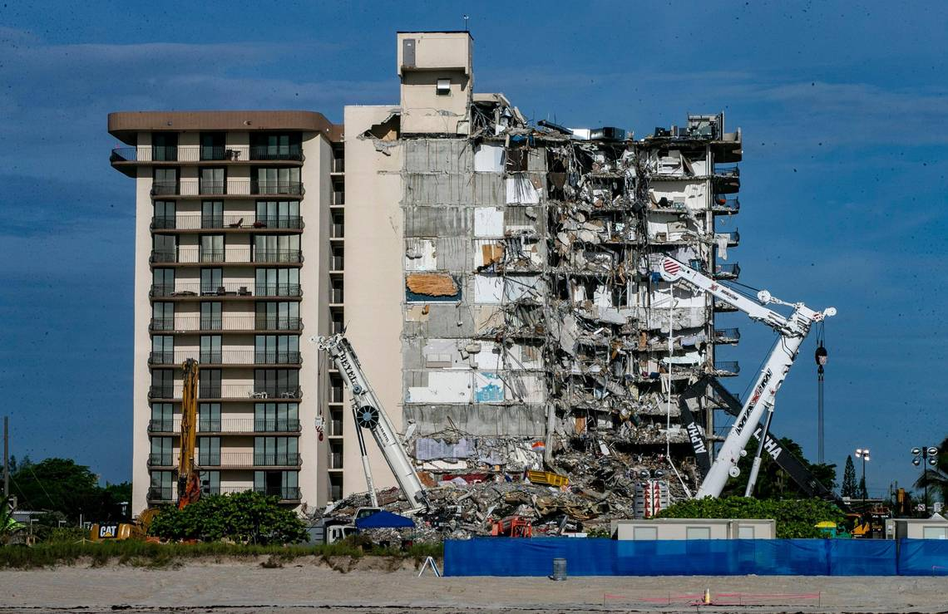
Condo Questionnaire
What Can Parties Do?
Sellers:
Sellers and their agents can request the management company’s post January 1, 2022 standard response to the condo questionnaire in advance.
Sellers should request condo association bylaws, covenants, financial statements, and most recent meeting minutes (past 3-4 board meetings) prior to listing.

Slide 68
Condo Questionnaire
What Can Parties Do?
Buyers:
Buyers in the market for condos can ask their loan officer in advance whether their underwriter(s) have standard language or documentation they request from condo associations.
Buyers should also request copies of the condo association by-laws, covenants, financial statements, notices of special assessments, and most recent meeting minutes.
Even in a cash transaction, buyers should request this information as part of their due diligence.

Slide 69
Condo Questionnaire
Special Stipulations
“All parties acknowledge that lender, as part of the condominium approval, requires appropriate documentation including but not limited to the condo association bylaws and covenants and any amendments thereto, notices of special assessments, financial statements including the most recent budget, and meeting minutes from the most recent [insert number] board meetings. As time is of the essence, Seller shall provide Buyer with any and all such aforementioned documentation and information within ___ days of binding agreement date. Should Seller fail to provide ALL of the above referenced documentation within ___ days of binding agreement date, Buyer shall have the right to terminate this Agreement with no penalty and a refund of all Earnest Money.”
“All parties agree that should the lender not obtain lending approval of condominium (as to the condominium project as a whole and unrelated to Buyer’s loan qualification) by [INSERT CONTINGENCY DATE], Buyer may terminate with no penalty and buyer shall be entitled to earnest money.”

Slide 70
Condo Questionnaire
Special Stipulations
“This Agreement shall be contingent upon the condominium in which the unit is located being eligible for financing and approved by Buyer’s lender. If Buyer obtains written notice from Buyer’s lender indicating that (1) it is declining Buyer’s loan application because the condominium in which the unit is located is ineligible for financing or (2) Buyer’s lender is unable to determine whether the condominium in which the unit is located is eligible for financing because the association or management company for the condominium has not provided sufficient information (documents) for the lender to make such a determination, then Buyer may terminate this Agreement by providing written notice to Seller, along with the notice from Buyer’s lender, within ____ days from receipt of documents. If Buyer timely provides such notice, then the Earnest Money shall be returned to Buyer. If Buyer does not timely provide such notice, then the contingency contained in this paragraph shall be waived and of no further force or effect. This contingency is applicable irrespective of whether there is any loan, financing, or all cash, contingency exhibit attached hereto and shall survive the expiration, wavier, or satisfaction of the same.”

Slide 71
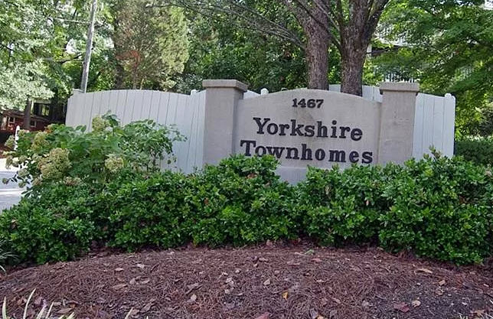
Is it a Condo or a Townhouse?
Even though a property may look like a fee simple townhouse don’t assume that it is!
A condo will always reference a declaration of condominium in the legal description.
Even if “Townhomes” is in the name you can’t assume it is a fee simple townhouse!

Slide 72
Is it a Condo or a Townhouse?

Slide 73
Forbearance and Modification at the Closing Table

Slide 74
Forbearance
Sellers often don’t realize that forbearance doesn’t “pause” their mortgage – it only pauses their obligation to make their monthly payments.
Interest continues to accrue during forbearance so the payoff is often much higher than the Sellers expect!

Slide 75
Forbearance and Divorce
The combination of forbearance and divorce can wreak havoc on a closing:
Divorce Settlement Agreement says Party A shall be responsible for all mortgage payments from xx/xx/xxxx (date) until the house is sold. Net proceeds are to be split at closing.
Loan has been in forbearance so Party A has not made any payments during that time.
Payoff is much higher because of the deferred payments from the forbearance, which reduces the net proceeds to be split between A & B.
Party B says the deferred loan payments should come from Party A’s proceeds
Party A says that since no payments were due during forbearance, he/she did not violate the Settlement Agreement.
Our hands are tied and we can only follow the terms of the settlement agreement, including how “net proceeds” are defined.
To avoid breaching their contract, Party B agrees to close with the full payoff coming from the “net proceeds” and then sues Party A for reimbursement after closing.

Slide 76
Modification
Lenders will modify a mortgage by moving the deferred/delinquent payments to a 2nd mortgage held by HUD.
This is a “silent” mortgage which doesn’t require payment until maturity or sale of the property .
The 2nd HUD mortgage often doesn’t accrue interest.
Sellers forget about these because: 1) they don’t understand the difference between a refinance and a modification; and/or 2) they haven’t had to make payments

Slide 77
Reinstating Contracts

Slide 78
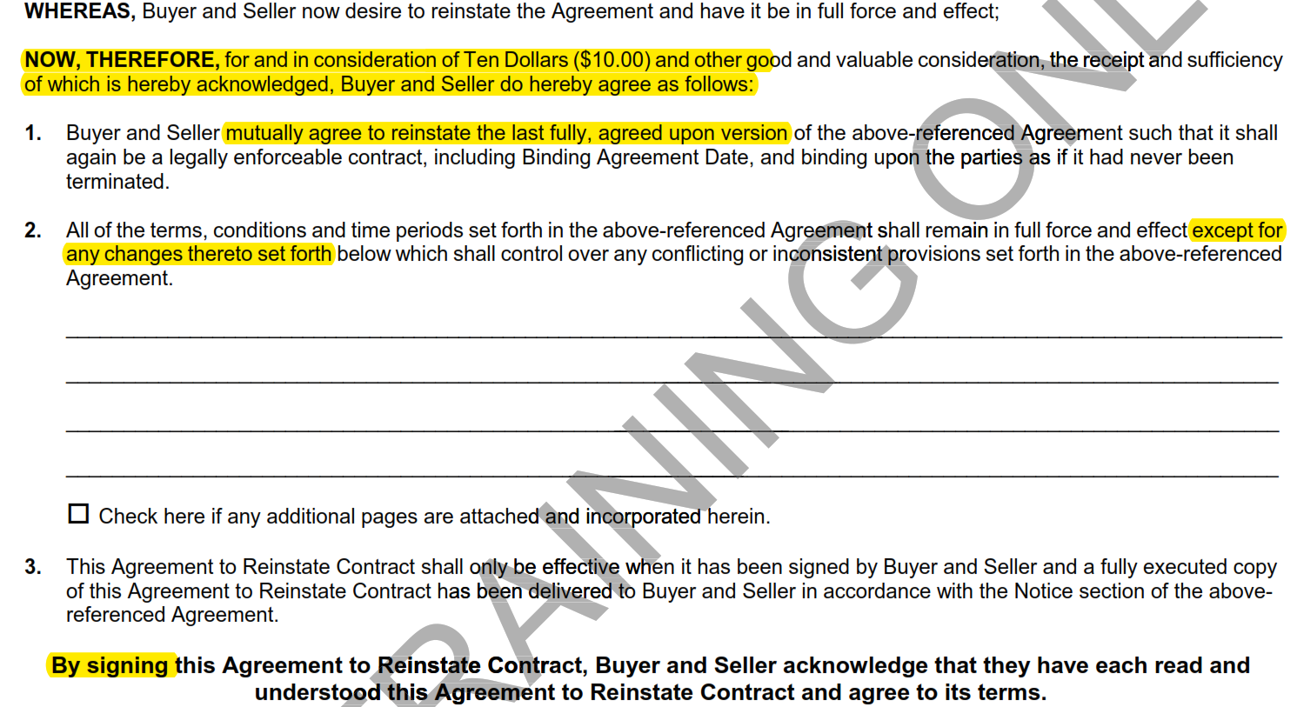
Reinstating Contracts
Be careful when reinstating contracts!
Agreement to Reinstate Contract (F290) properly reinstates a contract and can be used if the parties are able to resolve their previous differences or reasons why the contract failed initially.
Only use this if you recently terminated! Depending on the timing and terms it may be best to do an entirely new contract.

Slide 79
Questions?

