Slide 1
War Stories:
Unrealistic Timelines and Unanticipated Roadblocks
Continuing Education Class
www.campbellandbrannon.com/war-stories

Slide 2
AGENDA
Section 1 – Roadblocks to Closing
Section 2 – The 11th Hour and Closing
Section 3 – Post-closing Claims and Repercussions from
Quick Closings

Slide 3
Road Blocks to Closing

Slide 4
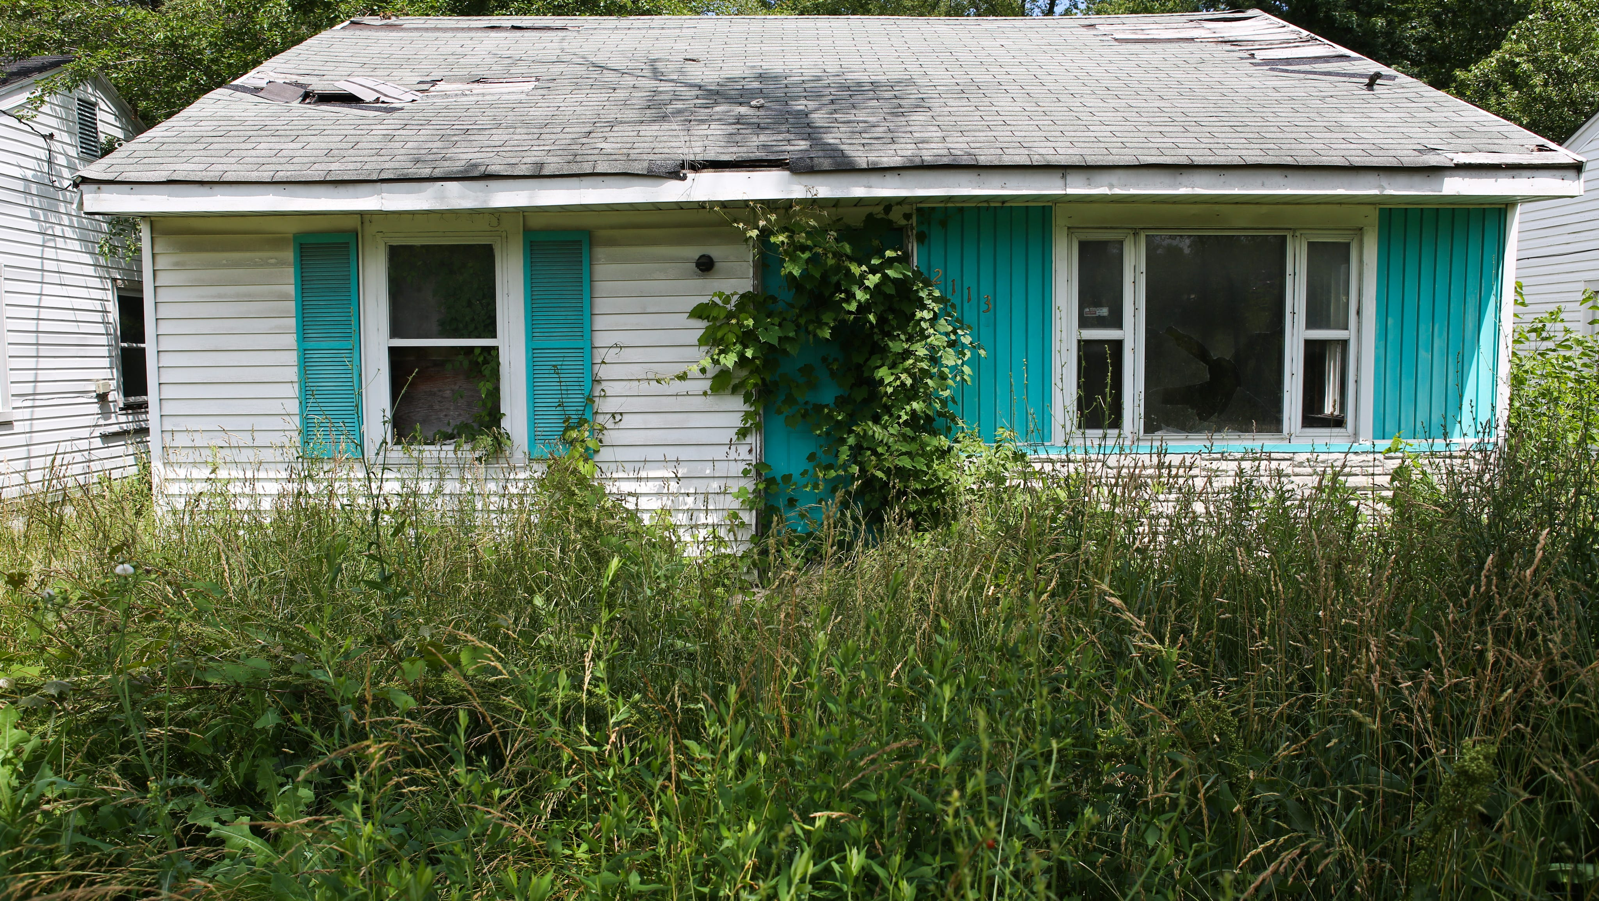
Fraud in the Chain
Text

Slide 5
Fraud in the Chain
Moral of the Story:
A company must be registered with the Secretary of State at the time the company takes title to the property;
Check a company’s status, their date of organization, etc. on the Secretary of State’s website https://ecorp.sos.ga.gov/BusinessSearch ; and
List the state of incorporation in the vesting language on the deed
Abandoned property is owned by an Arkansas LLC but the vesting deed into the LLC did not list the home state
A few years later there is a quitclaim deed from the LLC to a new owner. That new owner then sold the property to the current owner.
During the title exam we noticed that the first LLC was not an active LLC with the GA SOS until years after they purchased the property.
A Georgia LLC was created with the exact same name as the Arkansas LLC. The Georgia LLC then “sold” the property owned by the Arkansas LLC.
The Arkansas LLC still owned the property and current owner did not have title to convey. Owner had to file a title claim.

Slide 6
Estate Heirs
Text

Slide 7
Estate Heirs
Property was unimproved land in City of Atlanta, owned by Dad (he owned a lot of property throughout the city). Dad purchased the property in 1981.
Dad passed away in the early 2000’s. Mom was named executrix of Dad’s estate. Mom passed away around 2008.
In 2018, this property was part of a flip. Mom as executor of Dad’s estate signed a deed selling the property for $15,500 to an individual (this was the forgery – obviously she didn’t sign BECAUSE SHE WAS DEAD!).
Individual then signed a deed transferring title into his LLC.
A few months later, LLC sold property to a builder for $70,000.
Builder constructed a $500,000 home on the property (he had to regrade all the land in addition to building the home itself).
In 2021, Builder contracted with Buyer for sales price of $573,500.
We discovered the forgery in our title exam.
Builder filed claim with title insurance. The administrator of Mom and Dad’s estates claimed that they should be paid the value of the property present day, as is. Title insurance negotiated with administrator and they settled on a $90K payout. Builder’s policy was only $70K and it was standard policy. Builder had to bring an additional $20K to the deal.
Part of settlement was for the estate and heirs to sign quitclaim deeds. Estate signed their deed but the heirs then held out signing. The administrator had told them the settlement amount was only $70k, not $90k. They only agreed to sign deeds if they did not have to make any payments to administrator for his time, so buyer ended up paying administrator’s fees to allow transaction to move forward.
Moral of the Story:
Title Insurance is important!
Without title insurance the builder would have to negotiate with the heirs himself and pay the entire settlement out of pocket.
Because he purchased raw land the title insurance was a standard policy. The GAR contract directs us to issue an enhanced policy, when available. An enhanced policy grows 10% in value every year for the first 5 years so it ends up being worth 150% of its face value!

Slide 8
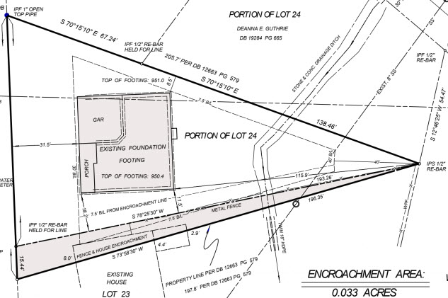
Neighbor’s House on the Property
Text

Slide 9
Neighbor’s House on the Property
Survey showed that the neighbor’s fence was 15 feet over the property AND that the neighbor’s house itself was 8 feet over!
Seller knew about the encroachment and did not disclose it or try to resolve it.
Buyer and Seller were willing to quitclaim the encroachment area to the neighbor but the city wouldn’t approve.
Neighbor wouldn’t sign an encroachment agreement.
Seller and neighbor were negotiating a boundary line agreement but attorneys got involved on both sides and it was going to take months to resolve.
Buyer would not sign any more extensions and terminated because Seller couldn’t provide good and marketable title. Regardless of the timeline Buyer was not obligated to accept a boundary line agreement.
Moral of the Story:
Surveys are vital! A visual inspection of the property alone wouldn’t reveal this encroachment.
A buyer isn’t obligated to accept an encroachment agreement, easement, etc. and has the right to terminate due to a title objection up until closing!
Disclose, disclose, disclose!

Slide 10
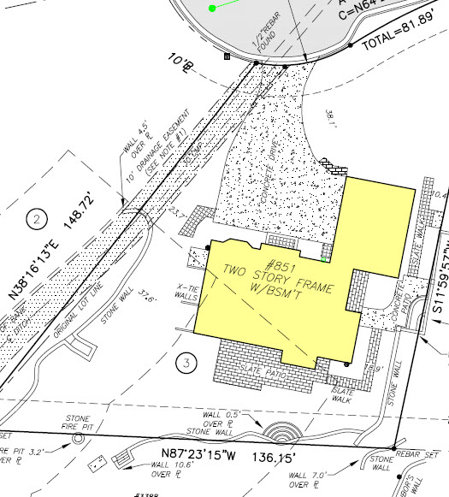
Encroachments on Survey

Slide 11
Encroachments on a Survey
Moral of the Story:
Surveys are vital! A visual inspection of the property alone wouldn’t reveal these encroachment.
A buyer isn’t obligated to accept an encroachment agreement, easement, etc. and has the right to terminate due to a title objection up until closing!
Disclose, disclose, disclose!
The survey showed encroachments on all three sides of the property. Title underwriters required a special exception for these encroachments in the title policy (no longer have good and marketable title as defined in the GAR contract).
The seller could not remove the encroachments in time for closing but was willing to get an encroachment agreement from the neighbors. The buyer would not accept an encroachment agreement.
Additionally seller remembered they had a very old survey that showed these encroachments. They had forgotten about that survey so they failed to disclose the encroachments.
Buyers have a right to terminate for title objections up until closing and are under no obligation to accept an encroachment agreement.

Slide 12
Lien in the Gap

Slide 13
Lien in the Gap
Moral of the Story:
Title insurance is important! Even the most diligent closing attorney wouldn’t have been able to find this FIFA.
Without title insurance the seller would have to go after the prior owner directly to try to recover.
Seller purchased the condo a few months prior.
Our title exam pulled a FIFA against the prior owner that was not paid off at the closing earlier in the year.
The face value of the FIFA was approximately 70% of the current sales price.
FIFA was filed one day before the earlier closing, so it fell in the “gap” of the title exam. There was no way the prior closing attorney could have caught it.
Current owner made a claim on their title insurance policy. Title insurance paid the FIFA almost immediately and we were able to close on time.

Slide 14
Lost Legal Description

Slide 15
Lost Legal Description
The 1997 vesting deed referenced the legal description attached as Exhibit A but there was no Exhibit A attached. The owner lost all original closing documents in a fire.
Title exam also disclosed a Declaratory Judgment action filed by the current lender to reform the legal description so they can foreclose. No service yet obtained on prior owner (the Grantor on the Vesting Deed referenced above). Complaint provided a street address for prior owner – or at least the address of someone with the same name.
We sent QC Deed via FedEx with explanation letter of current status of title, pendency of the DJ action and a request that they please sign the deed before a witness and notary and return to us in FedEx packet provided if they were the prior owner of this property.
Listing Agent did some skip-trace research and found several phone numbers for person(s) with same name as prior owner. Called all of them and on the last try, got the right person. Explained the situation for him again and he signed the deed and returned it to us for recording.
In the meantime, the title underwriter said we could only close this deal based on 2 options – (1) that we were successful in getting the prior owner to sign the deed or (2) that the DJ action went to judgment and the prior deed with missing legal description was reformed. Obviously, option (2) would have delayed closing for several months, possibly with Purchaser terminating the deal.
Fortunately, we were successful with option (1) and got the QC Deed.
If the original deed and title insurance policy hadn’t been lost in a fire, given the age of the deed, the title insurance underwriters may have agreed to insure it without tracking down the prior owner.
Keep an electronic copy of your important documents!

Slide 16
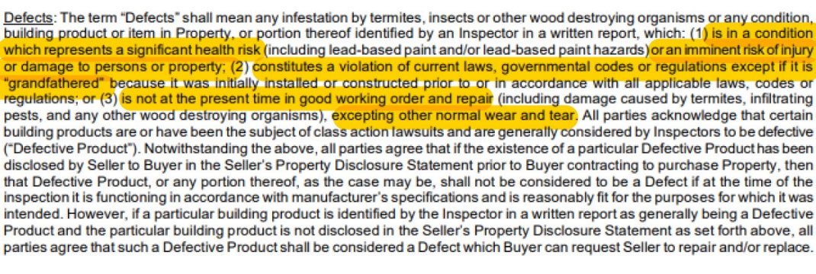
Right to Request Repairs
Can only be used to request repairs for “Defects” as defined in the contract.

Slide 17
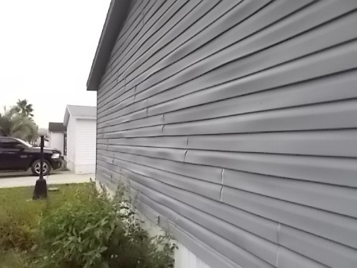
Right to Request Repairs
If the Seller already disclosed the defect the defective product does not give the Buyer the right to request repairs if:
The defective product is disclosed in the Seller’s disclosure;
The Seller’s disclosure is provided to Buyer before the acceptance date of the contract; and
The defective product is functioning according to the manufacturer’s specifications and is reasonably fit for the purpose of which it was intended.

Slide 18
Appraisal Issues
Seller:
Many properties sold off market and were not entered into MLS after closing. Now the appraiser does not have that information from the prior neighborhood sale to inform their opinion.
Buyer:
So many properties closed with the appraisal waived so previous sale prices in the neighborhood may be artificially high.

Slide 19
Financing on Short Timelines
Issues or questions that the lender runs into during underwriting may be items which could be resolved. However, the short timeline limits their ability to resolve those issues even if the buyer unilaterally extends for 8 days.

Slide 20
Rate Locks in the Face of Rising Rates
On all properties but particularly in new construction the rate may have increased significantly since going binding.
The Buyer locks in their rate to keep it from rising further.
The lock is expiring possibly making the house unaffordable for the buyer. They push to close even when they aren’t ready.
If the rates rise too high the buyer may no longer qualify but the financing contingency has passed.

Slide 21
The 11th Hour

Slide 22
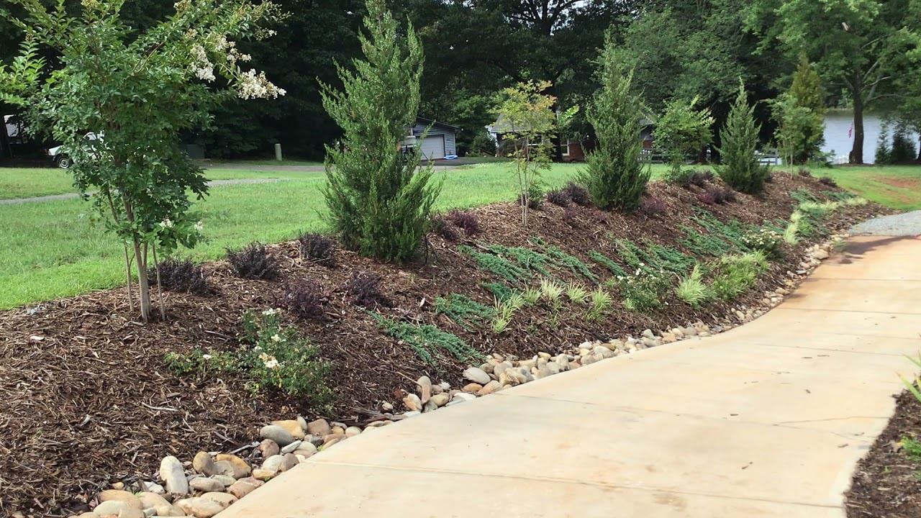
Mulch
Text

Slide 23
Mulch
Four days prior to closing on new construction, buyer has surveyor go stake the lot. The surveyor finds that the neighbor’s chain link fence is encroaching on our property by about 3 feet.
Builder offers to pay for the removal and new construction of a chain link fence on the actual property line and the neighbor agrees.
Buyer then hires an attorney two days prior to closing. Attorney claims that the grading on the side yard is not in conformity with the site plan.
However, the city had issued the CO, which means that the home was built in substantial compliance with the site plan.
Builder gets a quote for $4,000 for a retaining wall to cure the alleged grading issue and offers buyer $5000 in closing costs.
Buyer rejects this and buyer’s attorney claims that the mulch running off the side yard will be a “continual trespass” onto the neighbor’s property (you see where this is going…). The neighbor has no objection.
It is clear buyer just wants out. Earnest money was $25,000. The builder agreed to let the buyer walk for $12,000; he was DONE with these folks.

Slide 24
Association Concerns
Buyer right before closing discovers that the HOA does not permit owners to plant seasonal flowers in their front yard. This is a deal breaker for the Buyer and he wants to terminate but doesn’t have the right.
Ask for all association documents in advance or during due diligence. Make sure that request includes all rules and regulations. The declaration alone won’t have all the rules.
This is especially important if a buyer has a particular concern.

Slide 25
Association Concerns
14 day rush closing with financing. Buyer already has a loan commitment letter.
In the condo questionnaire the association discloses pending litigation between the association and two units.
This is not a title defect, but the lender needs more information from the association to clear up concerns from their underwriters.
Association does not quickly provide lender with requested information so lender does not have clear to close. Contract terminates.
Parties dispute the earnest money. Buyer says Seller is in default because the Seller’s association didn’t quickly provide the requested documents. Seller says financing contingency passed and this was not a title defect so Buyer is in default.
Different lenders will have different concerns and restrictions. We’ve closed numerous loans in this building without issue.
Due to the short timeline the lender did not have time to investigate their concerns and buyer did not have time to find alternative financing.

Slide 26
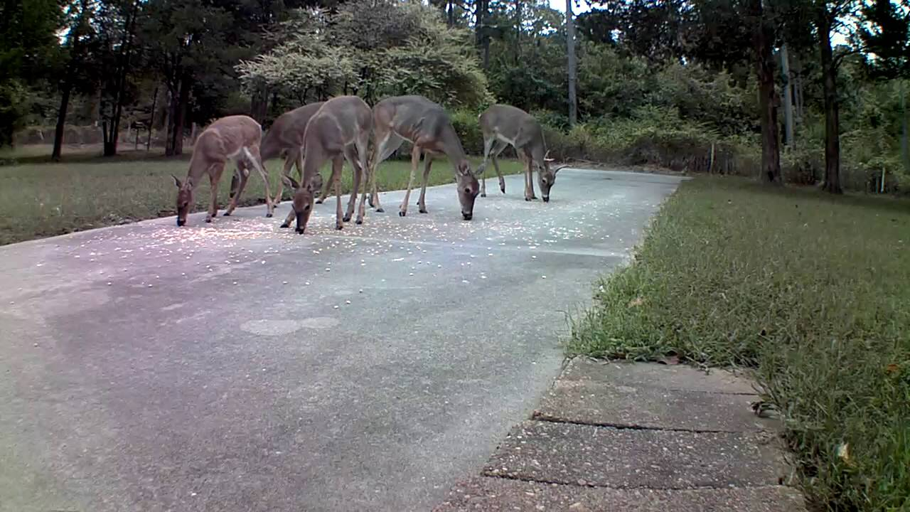
Dead Deer
Text

Slide 27
Dead Deer
On the day of closing a deer died on the driveway.
Buyer claimed that because of the dead deer the property was NOT in substantially the same condition as it was at Binding Agreement Date.
Substantially the same condition in the contract is really in regard to the improvements. However, to avoid fighting it out the Seller scrambled to hire someone to come remove it.

Slide 28
Paternity

Slide 29
Paternity
Seller was the estate of an NFL athlete.
He died young, intestate, with an 8-figure estate.
Two days prior to closing a paternity suit was file against the estate.
After the estate administrator nervously admitted to allow a DNA test the results were NOT a match.
Closing was able to proceed, albeit delayed.

Slide 30
Forbearance & Divorce
Text

Slide 31
Forbearance & Divorce
Divorce Settlement Agreement says Party A shall be responsible for all mortgage payments from xx/xx/xxxx (date) until the house is sold. Net proceeds are to be split at closing.
Loan has been in forbearance so Party A has not made any payments during that time.
Payoff is much higher because of the deferred payments from the forbearance, which reduces the net proceeds to be split between A & B.
Party B says the deferred loan payments should come from Party A’s proceeds
Party A says that since no payments were due during forbearance, they did not violate the Settlement Agreement.
Our hands are tied and we can only follow the terms of the settlement agreement, including how “net proceeds” are defined.
To avoid breaching their contract, Party B agrees to close with the full payoff coming from the “net proceeds” and then sues Party A for reimbursement after closing.

Slide 32
Post-closing Claims and Repercussions from Quick Closings

Slide 33
“Murder” File

Slide 34
“Murder” File
Moral of the Story:
Title insurance is vital! The most diligent title examiner or closing attorney would not be able to discover this title defect. Especially when the husband didn’t randomly confess until over 20 years later. Title insurance paid the estate hundreds of thousands of dollars to release their interest in the property!
The day before closing Seller calls and says, “[w]hen I purchased the property there was a cloud on title. The title insurance people said I should let you know that there was a claim when I sell the property.”
Call the underwriter and as soon as the property address was said her immediate reaction was “oh this is the murder file.”
In the early 90s husband and wife owned the property as JTWROS. They did not have any children together. Wife died and husband sold the property a few years later.
Over 20 years later husband was arrested as a suspect in a murder case. He confessed to the murder he was arrested for and then also confessed to murdering his wife years ago. There was never any suspicion of foul play in her death.
Under Georgia’s “slayer statute” this dissolved the original JTWROS so deceased wife’s estate still held a 50% interest in the property. Seller had to file a title claim to divest deceased wife’s estate’s interest.
Fun fact: there was later an Investigation Discovery episode on his confession.

Slide 35
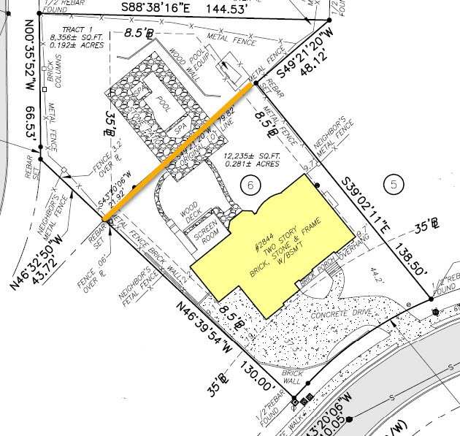
Property Line Crosses the Pool Deck
Property was originally two parcels. The second parcel was purchased later for the purpose of building the pool. The parcels were never combined in the tax record and had separate addresses.
Property closed (not with C&B) and the legal description only included the parcel with the house.
Solution? Track down the prior owners who still technically own the pool to get a quitclaim deed from them.
Prior owners moved to Turkey after closing and are now divorced and live in different cities. They had to make an appointment at the US Embassy to sign the quitclaim deed.
Text

Slide 36
Inspections Concerns
Buyer’s inspection raised concerns but due to either the short closing timeline or lack of a due diligence they didn’t dig any deeper.
Buyer moves in and gets a quote to fix the problems. It is significantly more than Buyer anticipated. Of course, you are their first call.
Protect yourself! If there are issues or concerns on an inspection do NOT offer your opinion as to the seriousness of the problem, the cost to fix the problem, etc. Document in writing that you recommend your Buyer consult with an expert in that field to answer any questions.
If asked for a recommendation for a vendor to address their concerns, provide a list of qualified vendors and let them choose.
Remember! After closing a seller can only be held responsible for hidden, latent, material defects. If it showed up on an inspection report it isn’t hidden!

Slide 37
Unpermitted Work
Either the seller didn’t know about it so they couldn’t disclose the unpermitted work; or
Seller knew about it, didn’t actively conceal it, and the Buyer could have discovered it.
Permits are public record and many jurisdictions provide online access.
The Buyer may be required to tear down the unpermitted work or spend significant sums to bring it up to code. Although unpermitted it may have been to code when built but is now in violation. Because it was unpermitted it is not “grandfathered”. This can be a very expensive undertaking!

Slide 38
Broken Microwave

Slide 39
Broken Microwave
During the temporary occupancy the microwave breaks.
Sellers say this is normal wear and tear.
Buyers say the sellers needs to replace the microwave because they broke it.
Neither party would concede so the agents ended up buying the replacement microwave themselves so they can put it behind them.
Remember! The temporary occupancy states that the buyer is responsible for all repairs during the temporary occupancy. Seller is only responsible for the damage they cause, excluding normal wear and tear. If this is a concern, you can have the seller purchase a home warranty for the buyer or use a special stipulation that at possession the property will be in or substantially in the same condition as of the binding agreement date.

Slide 40
Occupancy “Rules”

Slide 41
Occupancy “Rules”
Seller is elderly and moving to Florida to be closer to family. House is discounted significantly because it indeed needs some TLC . At closing buyers presented laundry list of demands on seller for behavior in property during Temp Occ Period. Including but not limited to:
Entering the house, all shoes off, immediately at the front door (booties not acceptable);
Hand sanitizer upon entry for everyone;
No use of bathrooms allowed by public, estate sale staff or Amvets;
No use of kitchen facilities;
No food or drinks will be permitted inside the house;
If children are present, they must be closely supervised by an adult;
The driveway must be protected from oil stains; and
No vehicles over 7500lb. in driveway.
Since it was cash closing, our office advised to wait to close until seller vacated. Nonetheless, the parties wanted to go ahead and close with escrow agreement for security deposit (buyers originally wanted $25K but settled on $10K).

Slide 42
Occupancy “Rules”
Occupancy ended. Buyers complained of 12 things these were amongst the complaints:
Garage door opener: Only one side of the garage door has an opener, not both. The side that doesn't work is the preferable side for backing out.
The basement exterior door deadlock key is lost, after having been in the house. Seller originally left it in the house.
“Excessive” picture hook holes on every wall and screws/nails.
Damage and cracking to the driveway from vehicles. Tire marks and concrete scrapes indicate oversized vehicles.
Sellers – despite the ridiculousness of the complaints – gave $3000.00 because interpleader action would have cost them at least that.

Slide 43
Buyer’s Remorse
Over the last year buyers turned a blind-eye to many of the things that would normally be a deal breaker for them.
Desperate to find a house that they waived everything and offered huge amounts over asking. Now that they are settling in, they realize this house won’t work for them and isn’t their forever home.
Protect yourself! Document, document, document! If
you documented in writing anytime the buyer waived
contingencies against your advice or offered extreme
terms you are much better protected if they come back to
you later.
If the property was financed as their primary residence,
they must occupy the home as their principal residence
for at least a year before renting it. If they sell in less than
2 years they may be subject to capital gains.

Slide 44
What’s your wildest story?

