Slide 1
2023 GAR Contract Changes
Continuing Education Class
WWW.CAMPBELLANDBRANNON.COM/2023GARCHANGES

Slide 2
AGENDA
Section 1 – Brochures and Brokerage Agreements
Section 2 – Purchase and Sale Agreements
Section 3 – Exhibits and Addendum

Slide 3
Brochures and Brokerage Agreements

Slide 4
CB22 Protect Yourself When Buying a Home to be Constructed
Added a recommendation to also review CB13 “Protect Yourself When Buying Real Property”

Slide 5
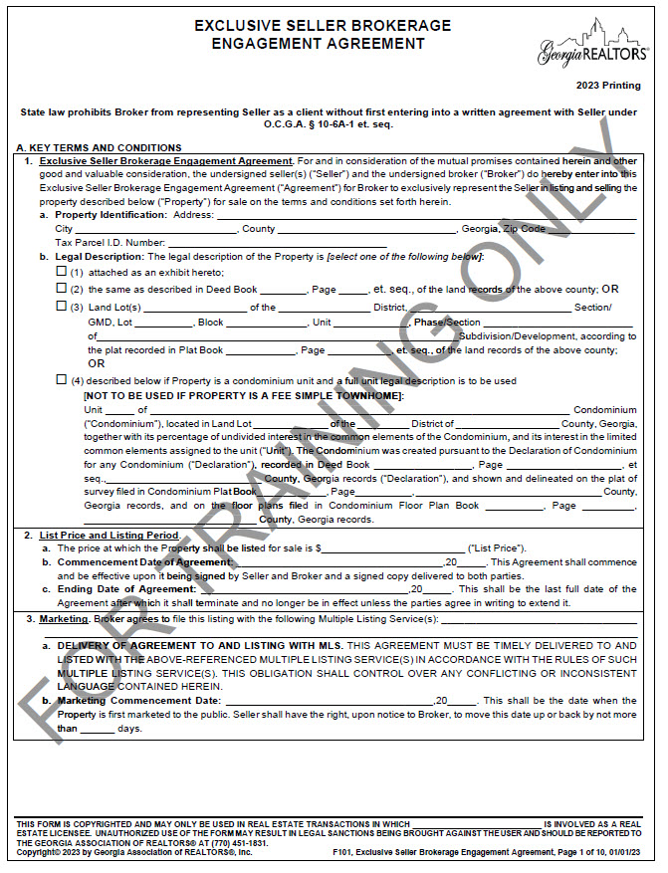
F101 Exclusive Seller Brokerage Engagement Agreement

Slide 6
F101 Exclusive Seller Brokerage Engagement Agreement
New paragraph A7. Lead Paint Disclosure
The hope is this will emphasize to the seller of their obligation to complete the lead paint disclosure AND the importance of it.

Slide 7
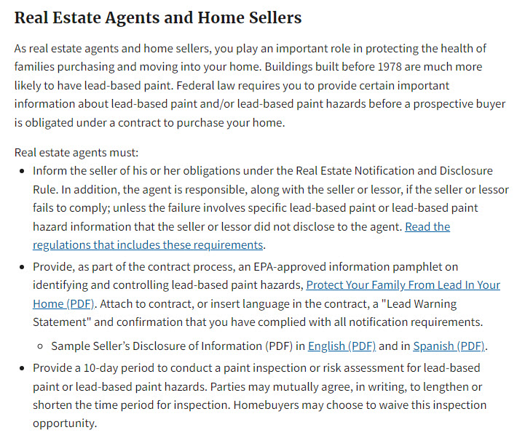
F101 Exclusive Seller Brokerage Engagement Agreement
From the EPA’s website
https://www.epa.gov/lead/real-estate-disclosures-about-potential-lead-hazards#agents
Agents are responsible for notifying Sellers of their obligations regarding lead paint.

Slide 8
F101 Exclusive Seller Brokerage Engagement Agreement
New B3(b) Images previously part of B3(a)
Universal Change: F104, CF24, CF25, CF28
Essentially says: Seller this is the rule about the use of images, but I can’t control what others do when they show the property.

Slide 9
F101 Exclusive Seller Brokerage Engagement Agreement
B4(b) addresses when a buyer’s broker is not a participant of the MLS where the property is listed.
Universal Change: F104
Although MLSs may have a data share agreement that does not create membership in the reciprocal MLS. This also applies to reciprocal key agreements for lockboxes.

Slide 10
F101 Exclusive Seller Brokerage Engagement Agreement
New paragraph B7. Lead Based Paint Disclosure. B7 aligns with the new A7.
Universal Change: F104

Slide 11
F101 Exclusive Seller Brokerage Engagement Agreement
C1 Seller’s Property Disclosure Statement
Universal Change: F104

Slide 12
F101 Exclusive Seller Brokerage Engagement Agreement
Practice Tip! Remember on a counteroffer “N/A” will remove the term from the offer. Instead use “N/C” when you want to indicate there is no change to the term.
New C6(r) Use of Initials “N/A”
Universal Change: F104, F110, F113, F122, F125, F128, F201, F210, F213, F228, CF04, CF24, CF25, CF28

Slide 13
Purchase and Sale Agreements

Slide 14
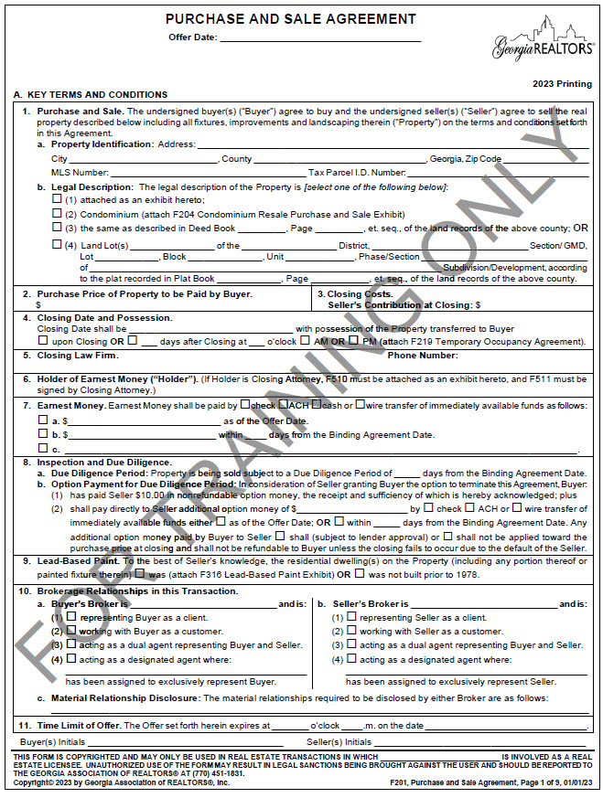
F201 Purchase and Sale Agreement

Slide 15
F201 Purchase and Sale Agreement
A4. Closing Date and Possession changed “at closing” to “upon closing”
Universal Change: F210, F213

Slide 16
F201 Purchase and Sale Agreement
B3(a) Seller’s Contribution at Closing new item added
B3(b) Items Paid by Buyer additional item added
Universal Change: F210, F213, F228, F243

Slide 17
F201 Purchase and Sale Agreement
How we handle tax prorations is based on the closing date!
Jan – May:
Estimate based on previous year
May – August:
Estimate based on Tax Assessment
August – December:
Prorate actual bill
This can be modified based on learning new information!
Seller moved prior to January 1 (i.e. Homestead)
New Construction
Significant remodel in prior year

Slide 18
F201 Purchase and Sale Agreement
B4(a). Right to Extend the Closing Date added language to clarify the right to extend applies even after the financing contingency is expires.

Slide 19
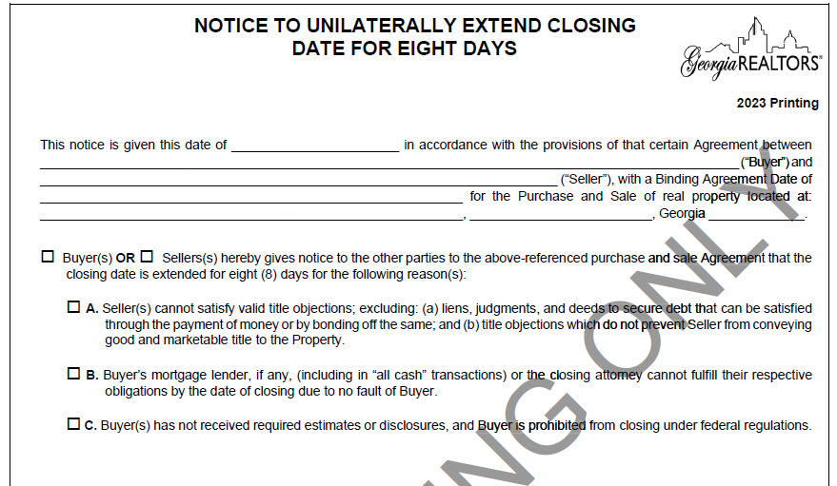
Review: Notice to Unilaterally Extend (F270)
Unilaterally Extending for 8 days (F270): can only be used ONCE and must be for one of three reasons:
Seller cannot satisfy title objections
Lender or closing attorney cannot close due to no fault of the buyer
Lender did not disclose on time
If the reason for extension does not fall under one of these three categories use the Mutual Extension (F716) or an amendment.

Slide 20
Review: Notice to Unilaterally Extend (F270)
Pop Quiz!
Contract has a fifteen day temporary occupancy.
Lender isn’t ready to close so the buyer provides the seller with the notice to unilaterally extend.
What is the date of possession?

Slide 21
Review: Notice to Unilaterally Extend (F270)
When exercising the unilateral extension, you need an additional amendment to change the possession date!

Slide 22
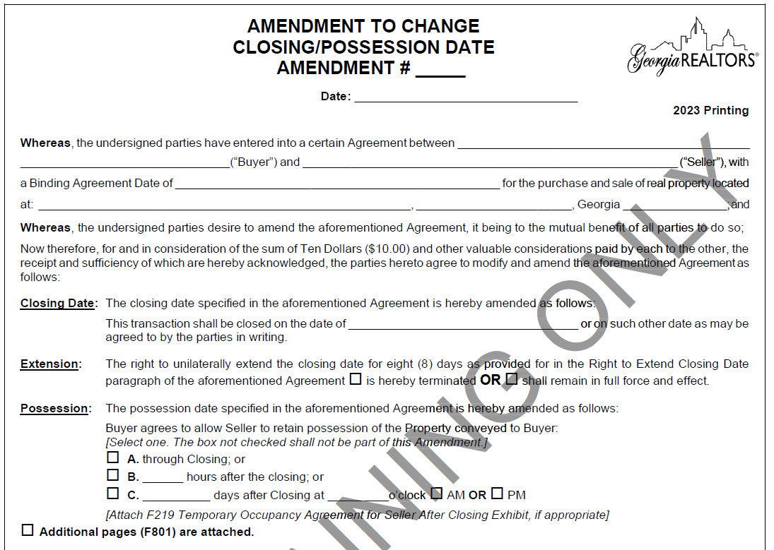
Review: Amendment to Change Closing/Possession Date (F716)
When closing is extended, the date of possession also extends.
The mutual extension allows you to amend the closing and possession date at the same time.
Practice Tip! When using the mutual extension you can also terminate the parties’ right to future unilateral extensions.

Slide 23
F716 Amendment to Change Closing/Possession Date
Updated language

Slide 24
F201 Purchase and Sale Agreement
B5. Closing Law Firm added language outlining the scope of the closing attorney’s representation in a cash transaction.
Universal Change: F210, F213, F228, F243, CF04
This is similar to our cash engagement letter.

Slide 25
F201 Purchase and Sale Agreement
One of the closing attorney’s tasks is to run a title exam to insure “good and marketable title”. What is good and marketable title? It is the same thing as a “clear title”?
Another role of the closing attorney is to issue the title policies. The contract directs us to issue an enhanced owner’s policy. What is the difference between a standard and enhanced policy?

Slide 26
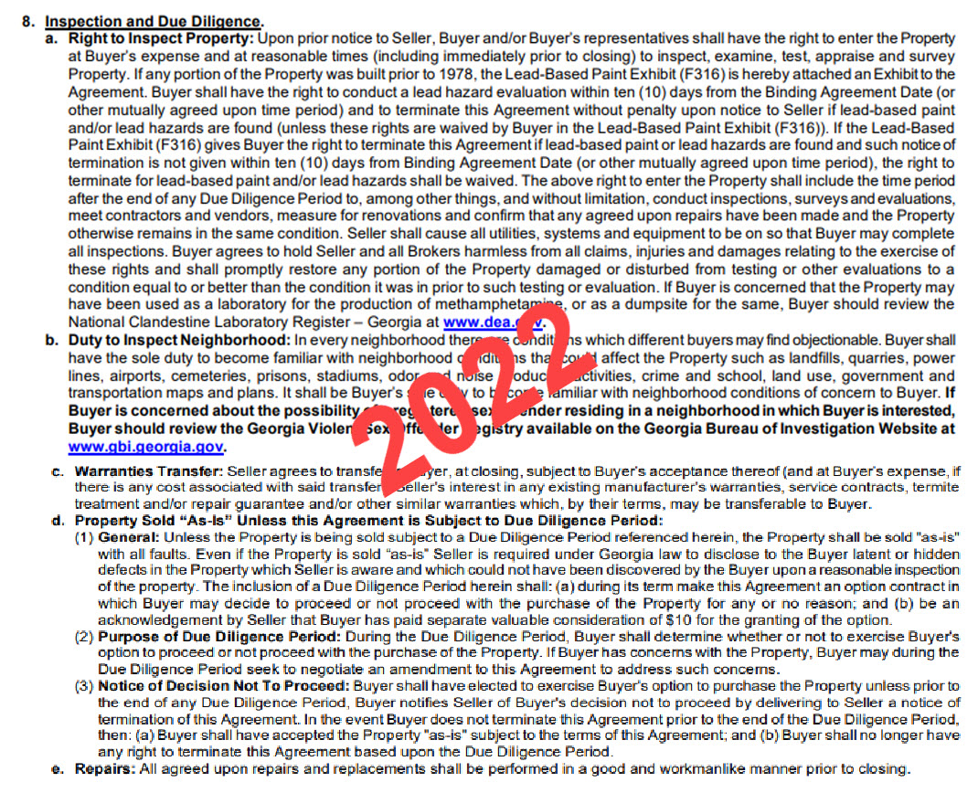
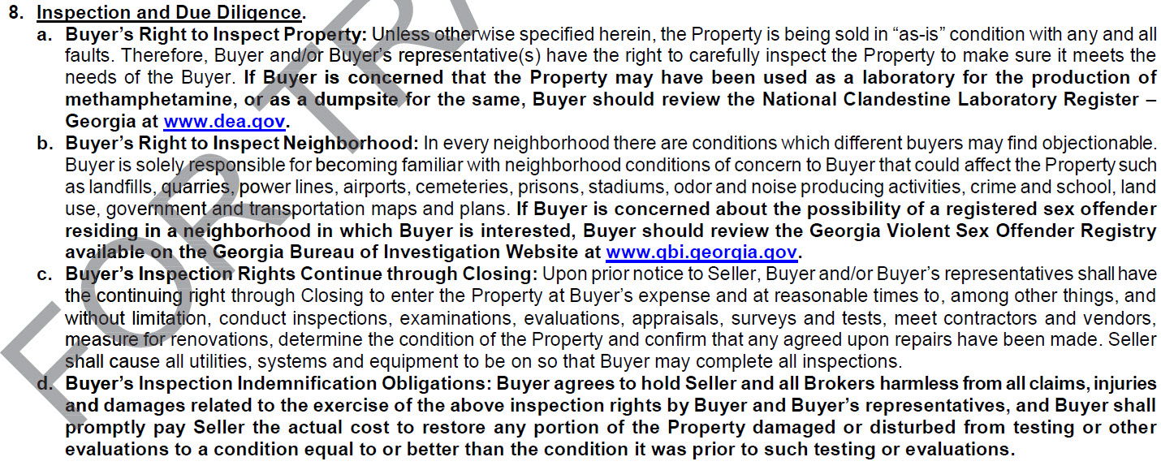
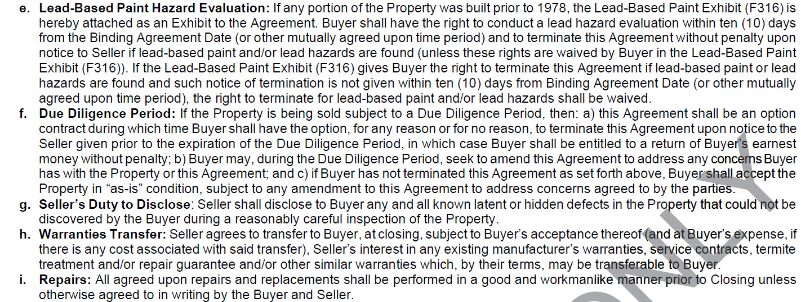
F201 Purchase and Sale Agreement

Slide 27
F201 Purchase and Sale Agreement
B8(a) Buyer’s Right to Inspect Property (previously titled Right to Inspect Property) bolded language regarding methamphetamine production; moved language from the old B8(d)(1) regarding the property being sold “as-is” to this paragraph; and broke the paragraph down.
Universal Change: F210, F213

Slide 28
F201 Purchase and Sale Agreement
B8(b) Duty to Inspect Neighborhood is now titled Buyer’s Right to Inspect Neighborhood. Goal is to emphasize that while this is the Buyer’s responsibility it is their right to inspect but they are not obligated to inspect.
Universal Change: F210, F213, F228

Slide 29
F201 Purchase and Sale Agreement
Even with due diligence or an “as-is” contract, the seller must disclose any latent or hidden defects of which they are aware that could not be discovered by the Buyer
New B8(c)Buyer’s Inspection Rights Continue through Closing includes language previously found in B8(a).
Moved to its own paragraph to make it clear this right applies after due diligence ends or even if there is no due diligence.
B8(d) Property Sold “As-Is” Unless this Agreement is Subject to Due Diligence Period deleted and moved to other sections
Universal Change: F210, F213

Slide 30
F201 Purchase and Sale Agreement
New B8(d) Buyer’s Inspection Indemnification Obligations language from the old B8(a) moved here and modified.
Previously stated the Buyer would restore damage. Now it states the Buyer will pay to restore the damage.
Universal Change: F210, F213

Slide 31
F201 Purchase and Sale Agreement
New B8(e) Lead-Based Paint Hazard Evaluation incorporates some of the language from the old B8(a) and clarifies that the right to inspect for lead paint survives past due diligence
Automatically incorporates the Lead-Based Paint Exhibit (F316) to the Agreement.

Slide 32
F201 Purchase and Sale Agreement
New B8(f) Due Diligence Period incorporates some of the language from the
old B8(d)
New B8(g) Seller’s Duty to Disclose previously part of B8(d)(1)
Goal is to make it clear this duty to disclose only applies to known latent or
hidden defects.
Universal Changes: F210, F213

Slide 33
F201 Purchase and Sale Agreement
Repairs is now B8(i) and the language was modified slightly
This has always been true but is now
included in the boilerplate language.
Universal Change F210, F213

Slide 34
Review: Repairs
Don’t obligate yourself to perform repairs you can’t realistically complete.
What are our options if the agreed upon repairs are not completed?
Delay closing until fixed;
Escrow money from Seller funds (not a great option with a lender);
Pay vendor to fix repairs from Seller proceeds at closing;
Increase Seller Paid Closing Costs; or
Prepare an amendment that Seller’s obligation survives closing.

Slide 35
F201 Purchase and Sale Agreement
B10(a)(1) No Agency Relationship added new language
This isn’t new but is clarifying what was already true
Universal Change: F210, F213, F228, F243
C4(e) Entire Agreement , Modification and Assignment added special stipulation reference number
Universal Change: F210, F213, F228, F243, CF04

Slide 36
F201 Purchase and Sale Agreement
New C4(g) FIRPTA Affidavit
Universal Change: F210, F213, F228, F243
Practice Tip! This is a discussion you should have with your Seller BEFORE listing the property
FIRPTA Solutions can help your client navigate the FIRPTA minefield
Sales Price $300,000 or less and buyer acquires as principal residence | No Withholding
Sales Price between $300,001-$1,000,000 and buyer acquires as principal residence | 10% Withholding
All transactions—Any Sales Price and buyer NOT acquiring as principal residence | 15% Withholding

Slide 37
F201 Purchase and Sale Agreement
Pop Quiz!
Property was listed for $299,900.
Seller received multiple offers
and accepted an offer for
$305,000.
If the Buyer is purchasing as their primary residence how much is withheld?
($30,500)
If the Buyer is not purchasing as their primary residence how much is withheld?
($45,750)
What if the seller accepted an offer at list price?
($0 or $44,985)
Sales Price $300,000 or less and buyer acquires as principal residence | No Withholding
Sales Price between $300,001-$1,000,000 and buyer acquires as principal residence | 10% Withholding
All transactions—Any Sales Price and buyer NOT acquiring as principal residence | 15% Withholding

Slide 38
F201 Purchase and Sale Agreement
C4(o) Survival of Agreement (previously C4(n)) added additional item that survives closing
Universal Change: F210, F213, F243, CF04

Slide 39
F240 Option Agreement
Changed “among” to “between”

Slide 40
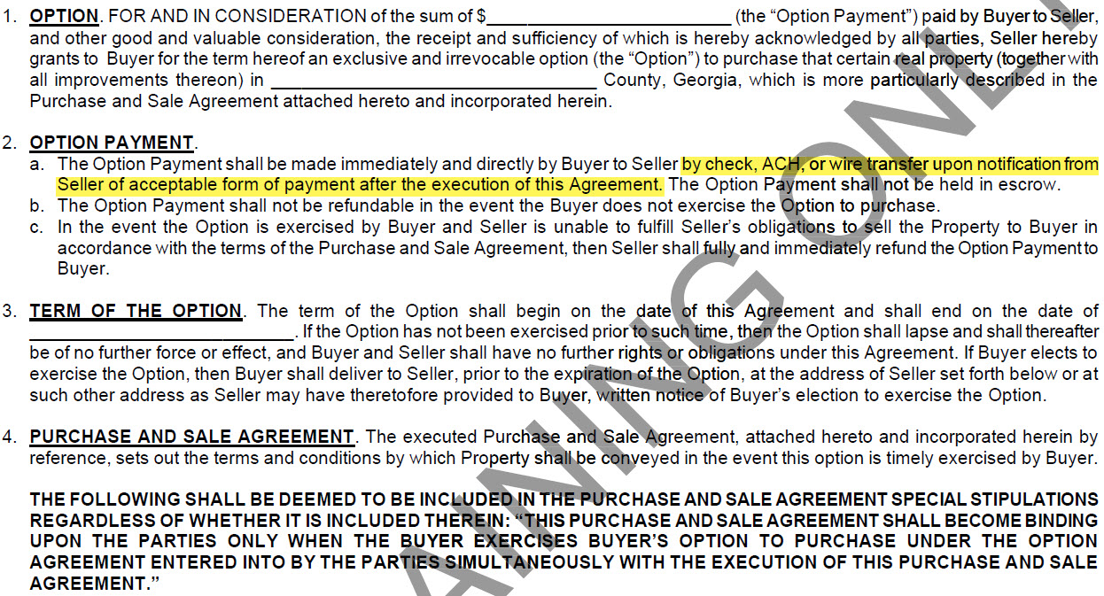
F240 Option Agreement

Slide 41
F240 Option Agreement
Paragraph 5 now called Exercise of Option
Paragraph 6 Option Commission removed language to write out dollar amount and changed “contemporaneously with” to “immediately upon”

Slide 42
F240 Option Agreement
Paragraph #4 now labeled and becomes paragraphs 7-11
Paragraph 11 added additional language

Slide 43
F210 and F213 Lot and Land Purchase and Sale
Same changes as F201, so what’s different about these sales?
Things we think about:
Houses:
Termites / Warranties / Encroachments
Improvements
Building or zoning violations
Keys and openers (i.e. possession)
Land & Lots:
Zoning / utilities / sewer & water access
Permitting
Environmental studies
Surveys

Slide 44
Review: F519 Mutual Termination
Used when BOTH parties want to terminate
Addresses disbursement of earnest money
Must be signed by both parties

Slide 45
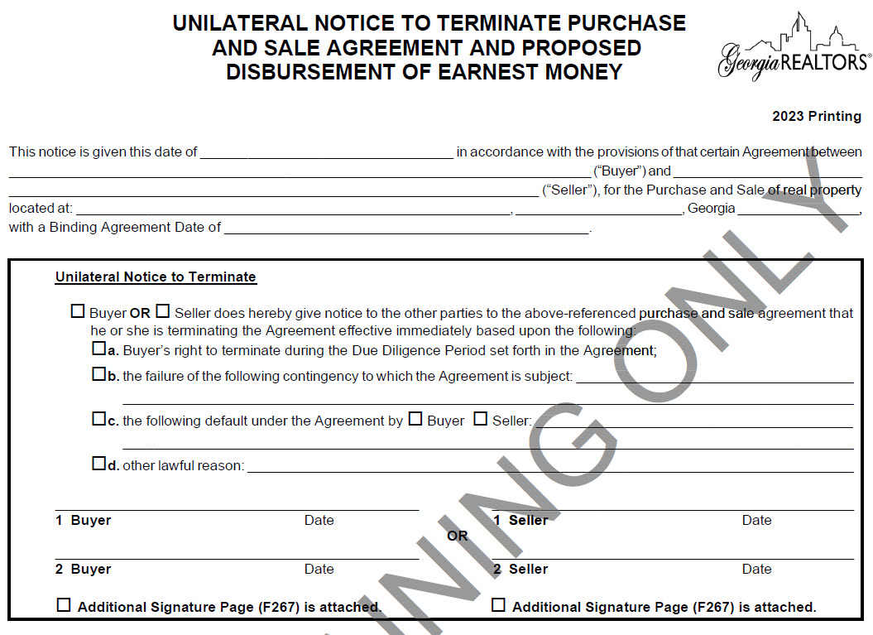
Review: F522 Unilateral Termination
Two Sections:
First section terminates the contract and is only signed by one party.
This is the section that terminates the contract.
The termination is effective even if the parties are disputing the earnest money disbursement.

Slide 46
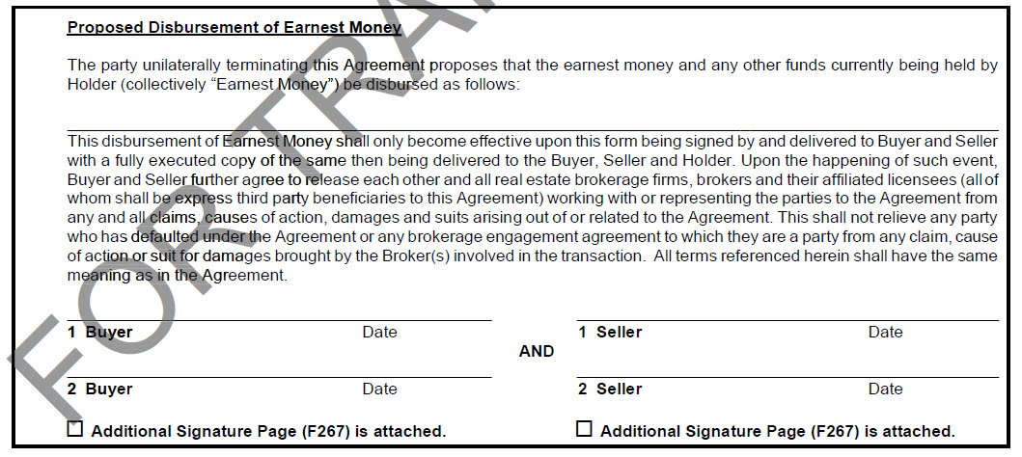
Review: F522 Unilateral Termination
Two Sections:
Second section proposes the disbursement of earnest money and must be signed by both parties.

Slide 47
Exhibits and Addendum

Slide 48
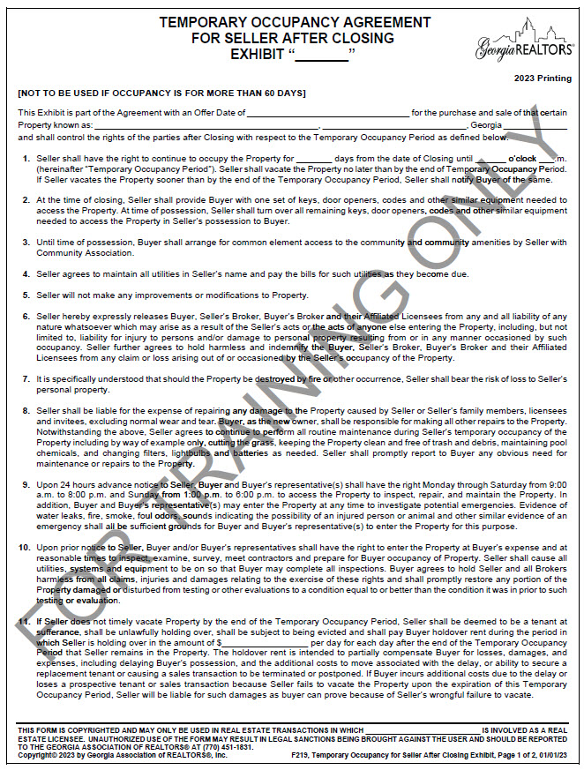
F219 Temporary Occupancy Agreement Exhibit

Slide 49
F219 Temporary Occupancy Agreement Exhibit
Updated language in paragraphs 2 and 8

Slide 50
F219 Temporary Occupancy Agreement Exhibit
You may still want to enumerate any specific maintenance items that aren’t listed in paragraph 8 (mosquito treatments, pest control, gutter cleaning, etc.).
Buyer is still responsible for all repairs (including appliances) during the Seller’s occupancy. Most Buyers expect the property to be in substantially the same condition as the Binding Agreement Date at possession.
Special Stipulation for Property Condition at Possession
“Seller warrants that at the time of transfer of possession as stated in the Temporary Occupancy Agreement all items remaining with the Property will be in substantially the same condition (including conditions disclosed in the Seller’s Disclosure Statement) as the Offer Date. This stipulation shall control over the normal wear and tear language included in the Temporary Occupancy Agreement Exhibit (F219).”
Another option is for the Seller to purchase a home warranty for the Buyer. A home warranty could help cover some of those repair expenses without putting the full burden on the Seller.

Slide 51
F219 Temporary Occupancy Agreement Exhibit
Practice Tip!
Holdover rent is meant to encourage seller to move out. Make this a painful number – if the holdover rent is less than the cost of a hotel room there isn’t much motivation to get out.
New paragraph 9
Paragraph 10 is now paragraph 11 and language was added about the holdover rent

Slide 52
F219 Temporary Occupancy Agreement Exhibit
New paragraph 15

Slide 53
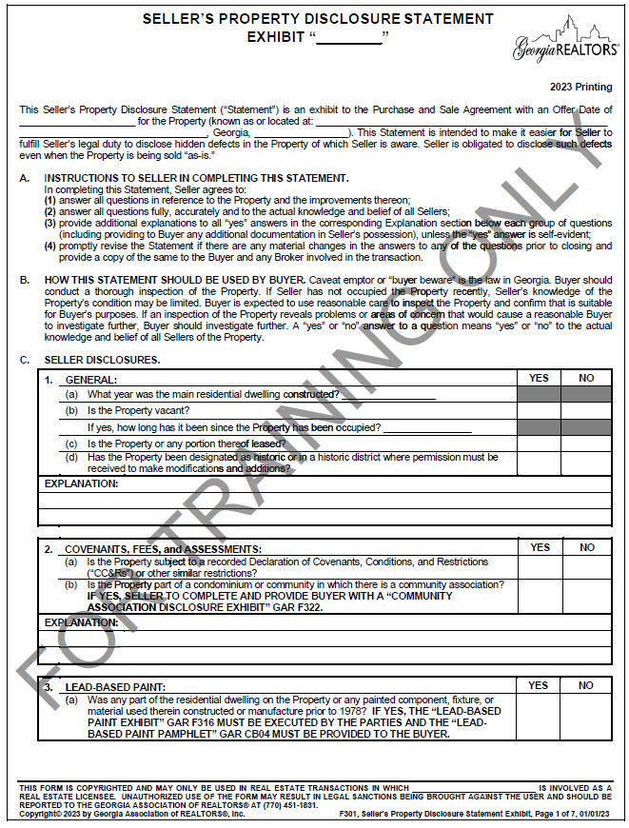
F301 Seller’s Property Disclosure Exhibit

Slide 54
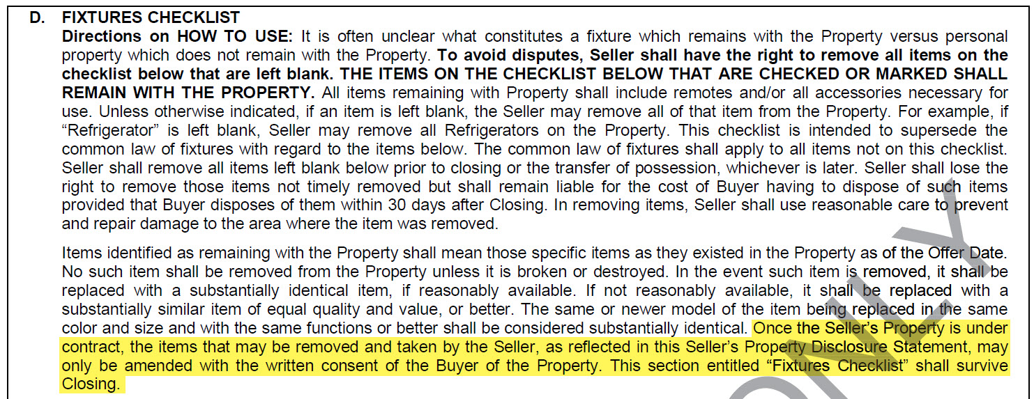
F301 Seller’s Property Disclosure Exhibit
D. Fixtures Checklist added that items on the fixture checklist can be removed after binding with written consent of the buyer.
Universal Change: F302, F304

Slide 55
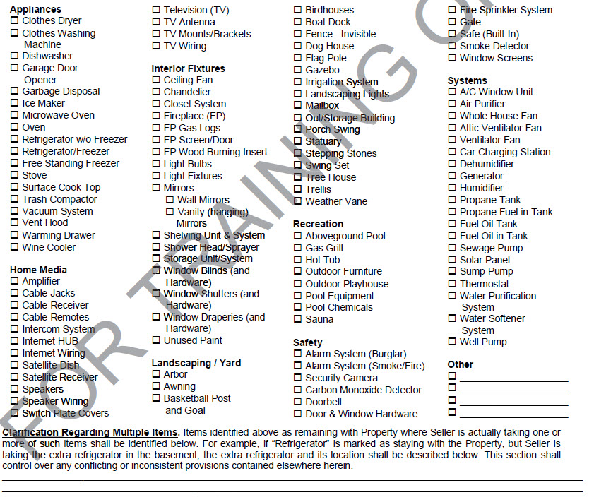
F301 Seller’s Property Disclosure Exhibit
Practice Tip!
The checklist doesn’t encompass the components of a “smart home” system. If any of those items are remaining enumerate the components that will remain.
No new items added to the checklist.

Slide 56
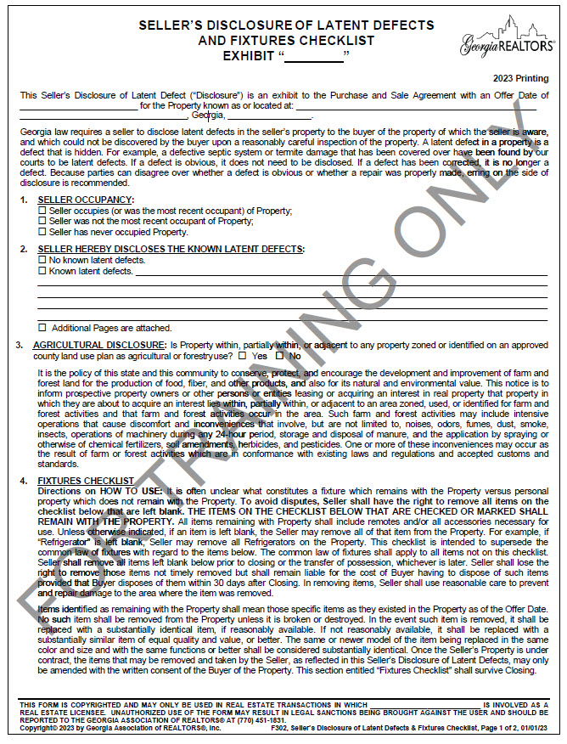
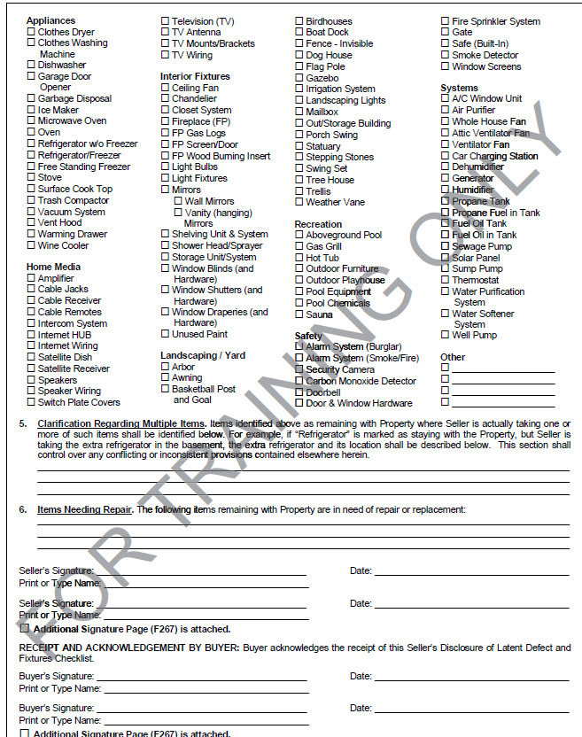
F302 Seller’s Disclosure of Latent Defects and Fixtures Checklist
Practice Tip!
If your seller isn’t willing to sign the F301 or doesn’t have the knowledge necessary to complete it use F302 instead. F302 provides a place to disclose latent defects and provides a fixtures checklist.

Slide 57
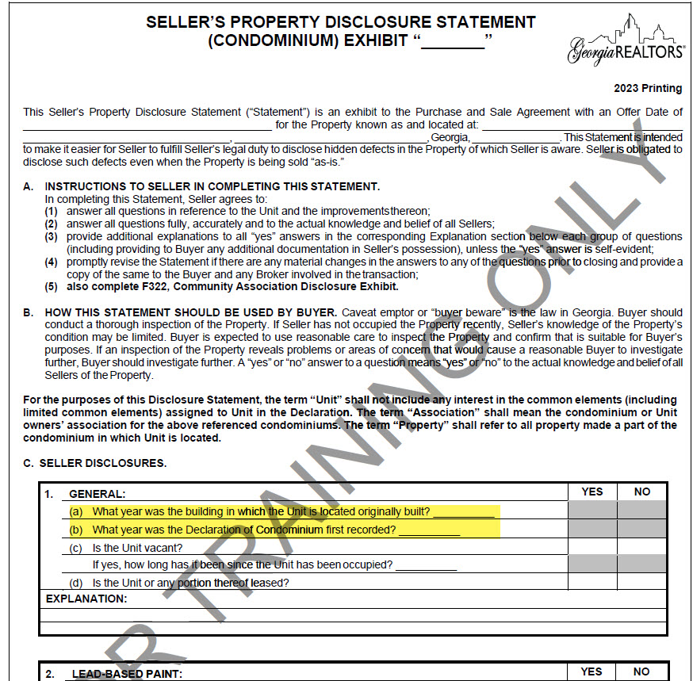
F304 Seller’s Property Disclosure (Condo) Exhibit
New C1(a) and (b)
Notes:
This is particularly relevant for condo conversions

Slide 58
F304 Seller’s Property Disclosure (Condo) Exhibit
Pop Quiz!
Can a condo be “fee simple”?
Yes! Although “fee simple” is often used colloquially to refer to townhouses or homes the term is not mutually exclusive.
Fee Simple is a legal term used when you have total ownership of the property. In a condo you have total ownership of your unit, the neighbors don’t have a right to it.
Notes:
This is particularly relevant for condo conversions

Slide 59
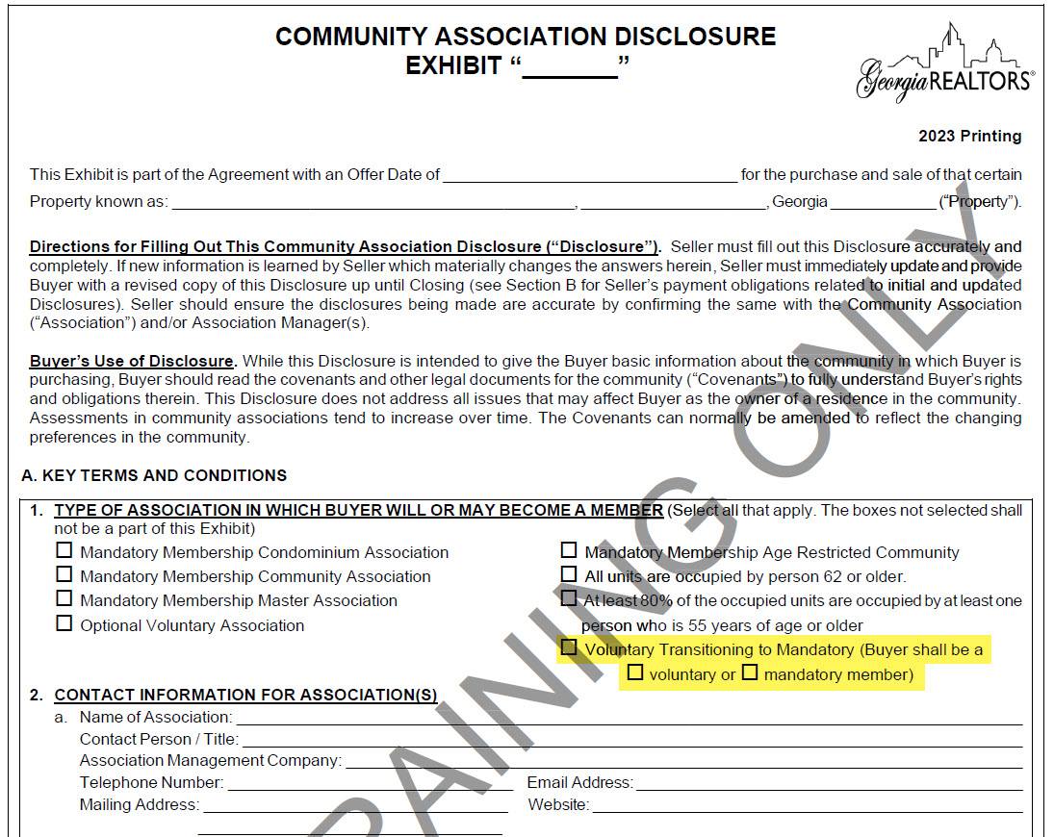
F322 Community Association Disclosure Exhibit
A1. Type of Association in Which Buyer Will or May Become a Member new option added

Slide 60
F322 Community Association Disclosure Exhibit
CCI fees
What are they?
A Covenant Compliance Inspection
Why do we order them?
The association is outlining any outstanding violations
on the property so there are no hidden costs or surprises
to the Buyer after closing.
Why is this the seller’s responsibility to pay?
They aren’t available for all properties but when available it is required by our title underwriters in order to convey good and marketable title - if there are outstanding violations an unpaid fine could become a lien on the property.

Slide 61
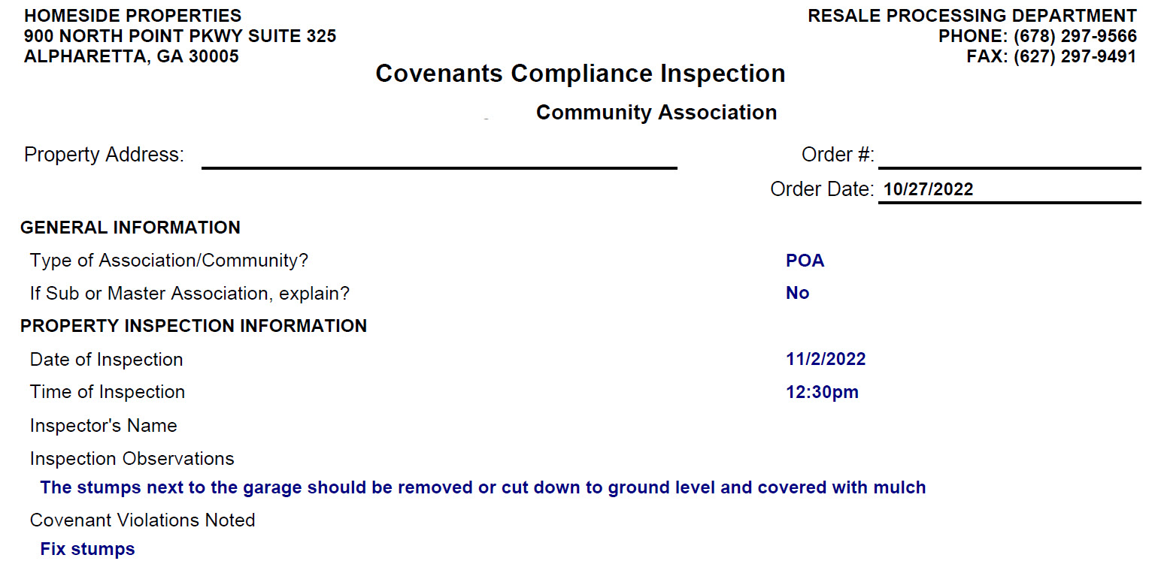
F322 Community Association Disclosure Exhibit
CCI fees
What is the cost?
CCI fees vary but average around $100.
What about timeline?
Since someone must physically go out to the property, it takes longer to receive than a standard closing letter.

Slide 62
F322 Community Association Disclosure Exhibit
Tips when completing the CAD:
Have your sellers call their management company before listing to get a copy of ALL fees paid at closing – if they don’t ask for all fees management companies will often quote them the cost of only the letter.
NEVER leave the Transfer, Initiation, and Administrative Fees section blank.
It is never a bad idea to pad the amount disclosed
If you ever had any violations on the property, even if they have been fixed, make sure it was actually closed out with the management company!

Slide 63
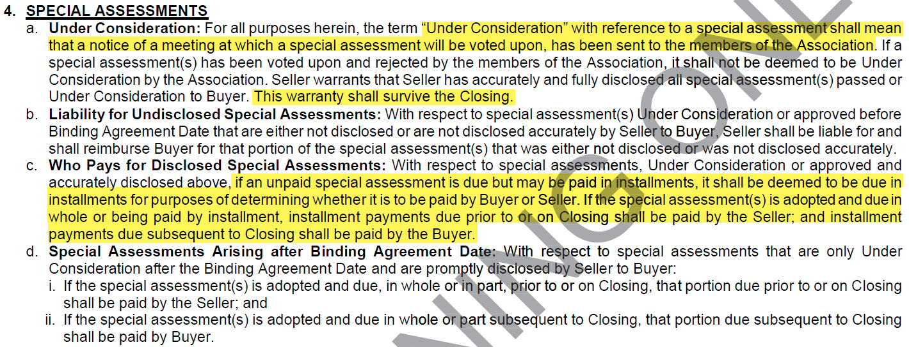
F322 Community Association Disclosure Exhibit
Special Assessments
Don’t forget to disclose pending special assessments!
What about rumored special assessments that don’t yet meet the definition of “under consideration”?
Even if the special assessment is due in installments and it is properly disclosed, an HOA may accelerate the payments when the property is sold. In that case the total balance of the special assessment is the responsibility of the Seller.

Slide 64
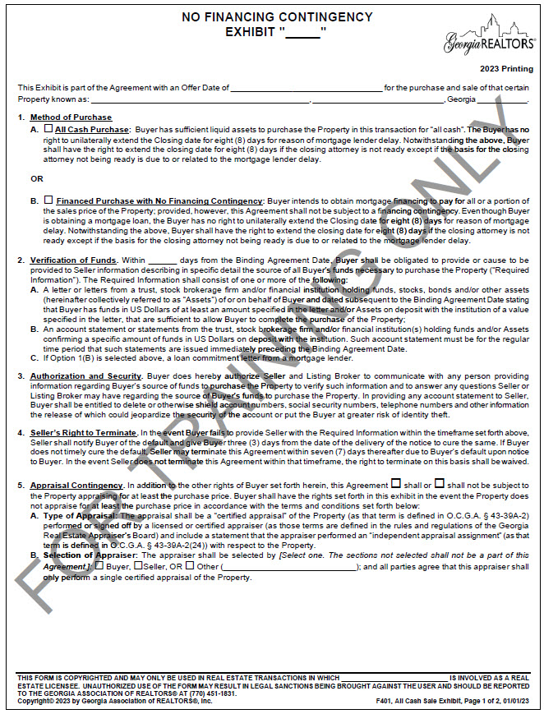
F401 No Financing Exhibit
Exhibit overhaled and renamed

Slide 65
F401 No Financing Exhibit
1. All Cash Sale is now Method of Purchase
The hope is that this prevents a bait-and-switch situation and allows the parties to more accurately reflect their intentions.

Slide 66
F401 No Financing Exhibit
Practice Tip!
Previously if there was no financing contingency the seller could request proof of funds immediately. If the buyer is obtaining a loan with no financing contingency, make sure the date for the verification of funds provides sufficient time for the lender to provide a loan commitment letter.

Slide 67
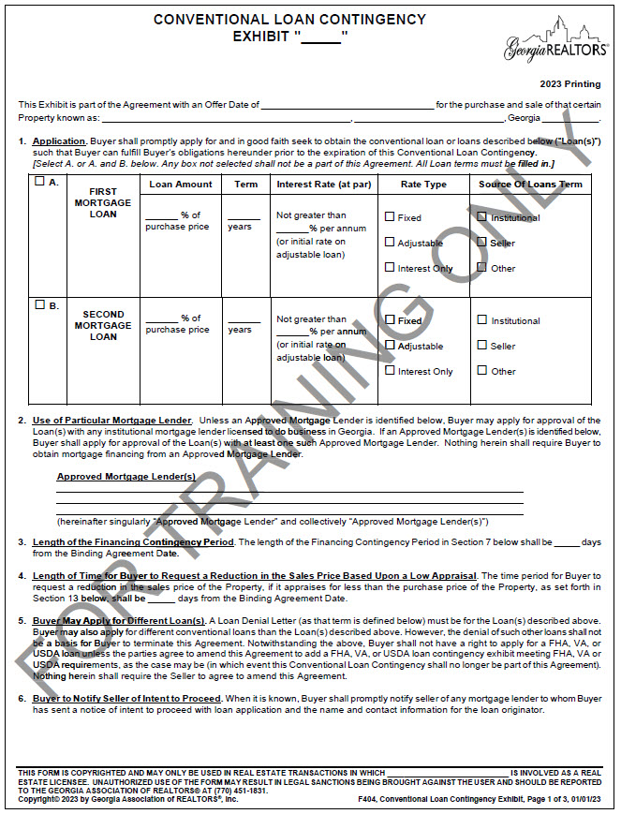
F404 Conventional Loan Contingency Exhibit

Slide 68
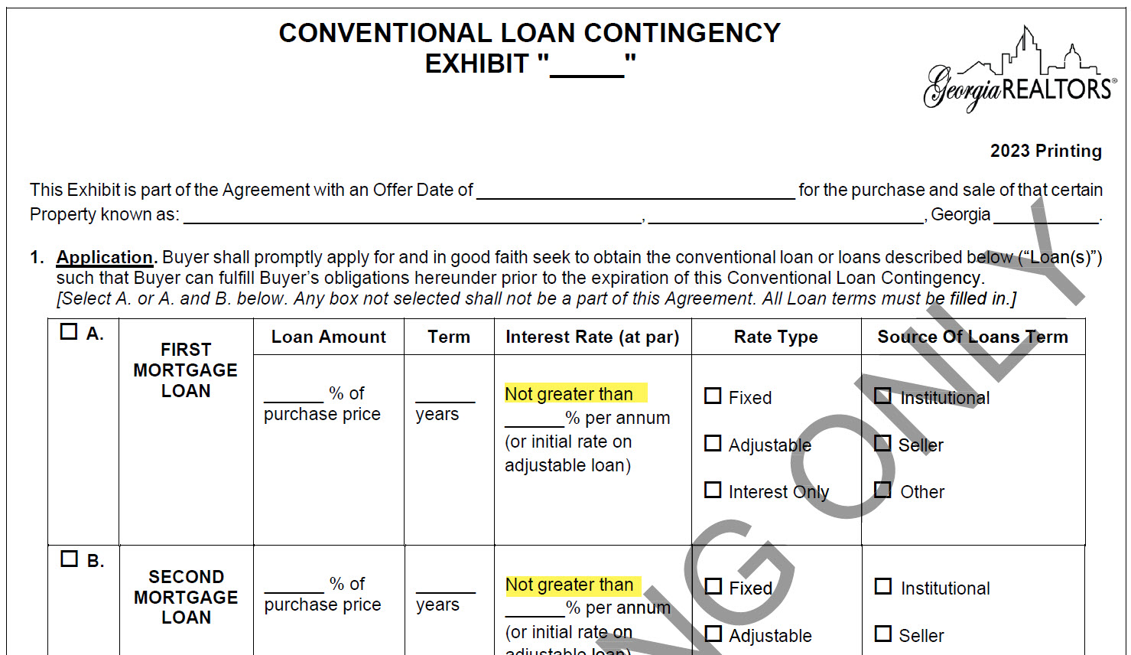
F404 Conventional Loan Contingency Exhibit
Added “not greater than” to the loan terms “Interest Rate (at par)”.
Universal Change: F407, F410, F413
Reminders!
The buyer must apply with one of the lenders listed BUT they don’t have to use that lender.
The loan denial letter must be from the lender listed.
This is a great place for the seller to gain a little bit more control over the direction of the closing.

Slide 69
F404 Conventional Loan Contingency Exhibit
New paragraph 3. Length of Financing Contingency Period
Trying to pull all the key terms to the first page.
Universal Change: F407, F410, F413

Slide 70
F404 Conventional Loan Contingency Exhibit
New paragraph 4. Length of Time for Buyer to Request a Reduction in Sales Price Based Upon a Low Appraisal
Note that this date is calculated from the binding agreement date.

Slide 71
F404 Conventional Loan Contingency Exhibit
7. Financing Contingency (previously paragraph 5) reworded and added language clarifying the relationship between the financing and appraisal contingency.
Universal Change F413 (see paragraph 6)

Slide 72
F404 Conventional Loan Contingency Exhibit
13. Appraisal Contingency reworded to incorporate the new section 4

Slide 73
F407 FHA Loan Contingency Exhibit
6. Financing Contingency same changes as the conventional financing contingency (F404) but references the Amendatory Clause rather than the appraisal contingency.
Universal Change: F410

Slide 74
F407 FHA Loan Contingency Exhibit
12. Amendatory Clause added language clarifying that if the property doesn’t appraise the Seller may agree to the lower price via an amendment.
Remember the reduction in sales price doesn’t happen automatically - Seller isn’t required to accept the lower price! However, if the Seller agrees to the lower price the Buyer does not have the right to terminate.
Universal Change: F410

Slide 75
Practice Tip!
Amendatory Clause
Amendments
Boilerplate Language
Special Stipulations
Handwritten and Initialed Changes
Exhibits and Addenda

Slide 76
F407 FHA Loan Contingency Exhibit
16. Repairs Required in FHA Commitment clarification that there is no penalty to Buyer.

Slide 77
F410 VA Loan Contingency Exhibit
15. VA Rules and Regulations; Termite Letter
Either party can pay for the initial termite letter but if a reinspection is required, the reinspection fee is the Seller’s responsibility.

Slide 78
F601 Sale of Lease of Buyer’s Property Contingency Exhibit
3A. Buyer closing on the sale of Other Property

Slide 79
F604 Back-up Agreement Exhibit
Paragraph 1 clarifies situations with multiple back-up offers and updated the language throughout

Slide 80
F604 Back-up Agreement Exhibit
Paragraph 2
Paragraph 3

Slide 81
F604 Back-up Agreement Exhibit
Paragraph 4
Paragraph 5

Slide 82
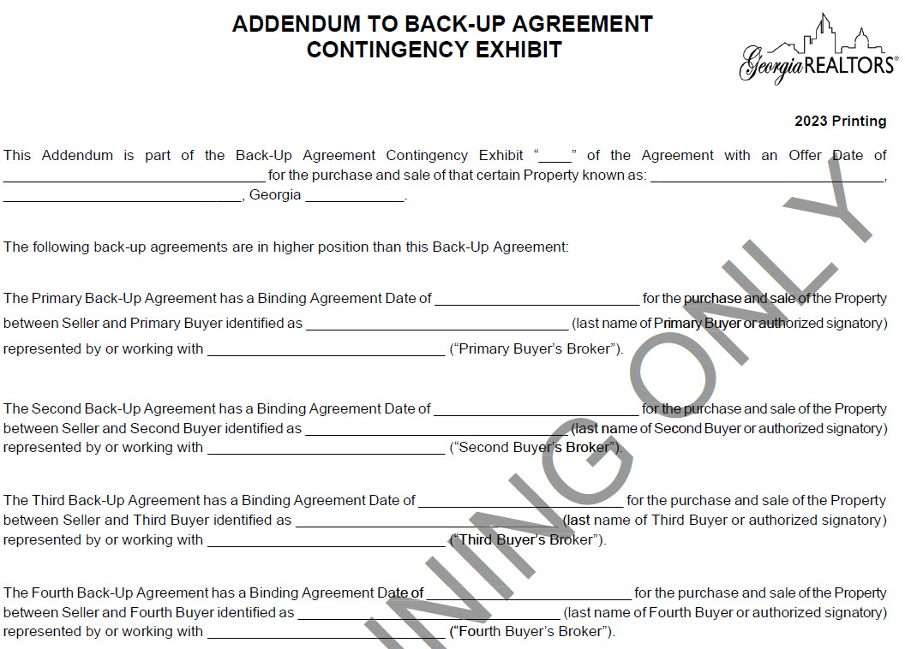
F605 Addendum to Back-Up Agreement
New Form!

Slide 83
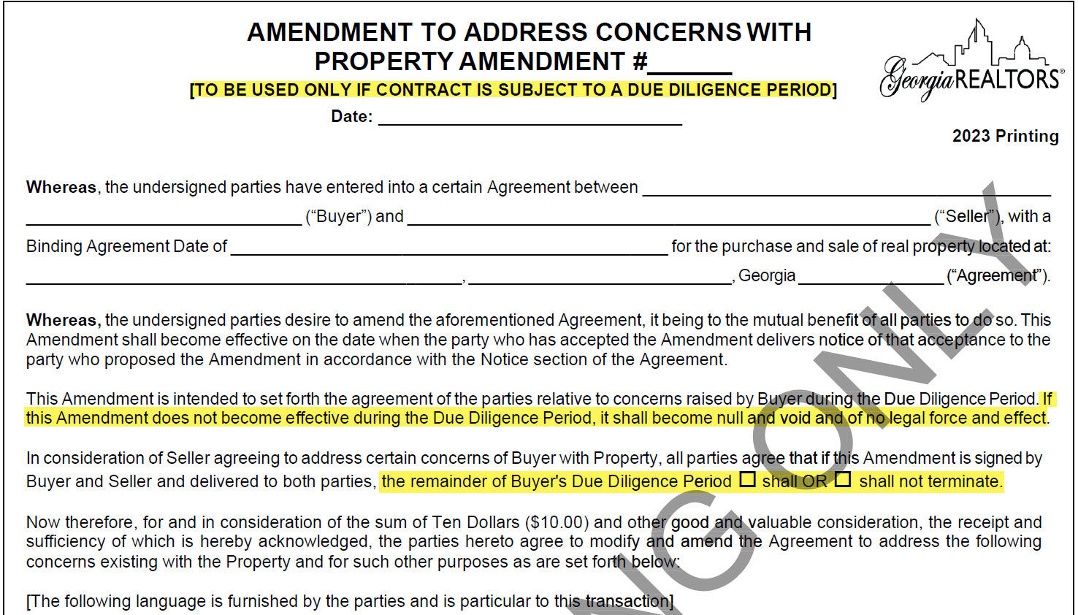
Review: F704 Amendment To Address
Concerns with Property (“ATAC”)
ATAC may only be used during due diligence.
If due diligence lapses before ATAC becomes effective, ATAC automatically becomes null and void → at this point you would need a regular amendment.
Remember to state whether ATAC does or does not terminate the remainder of due diligence.

Slide 84
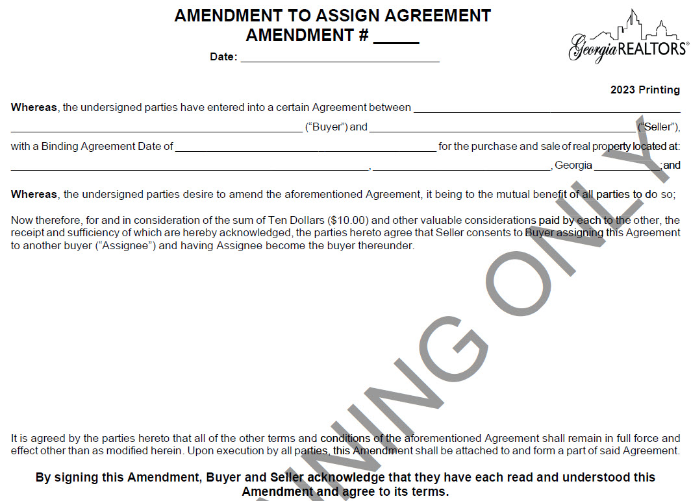
F735 Amendment to Assign Agreement
New Form!

Slide 85
F735 Amendment to Assign Agreement
Previously only has the option to use a special stipulation. F735 allows it to be added after binding.
If the Agreement is later assigned, Assignor and Assignee should execute F279 “Assignment of Purchase and Sale Agreement Rights”

Slide 86
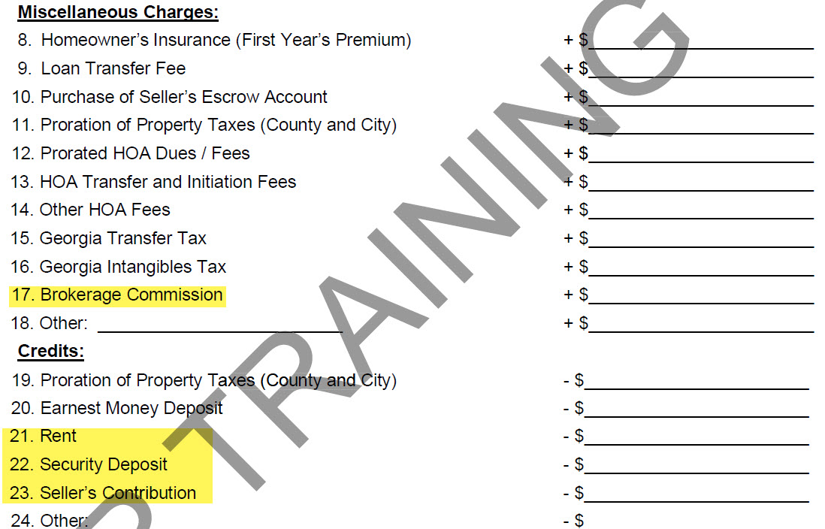
F840 Estimate of Cost to Buyer
Updated language to comply with DOJ – showing that the Buyer could be on the hook for commission

Slide 87
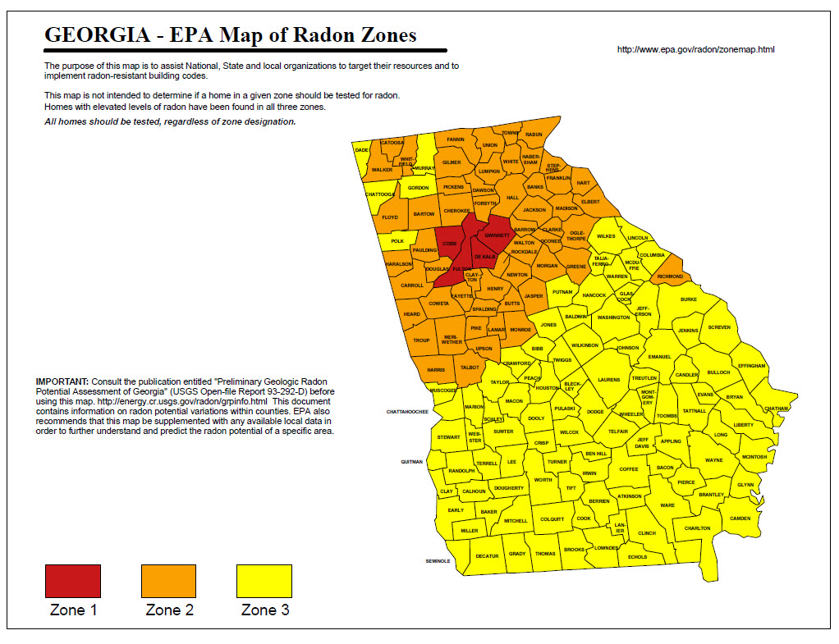
F913 Lease for Residential Property
New C5(d) Radon Disclaimer
New C6(o) Georgia Landlord Tenant Handbook

Slide 88
Questions?
Attorneys@cb.law

