Slide 1
Condos 101
Continuing Education Class
www.campbellandbrannon.com/condos101

Slide 2
AGENDA
Section 1 – Intro
Section 2 – Under Contract
Section 3 – Mortgage Considerations
Section 4 – Condo Living

Slide 3
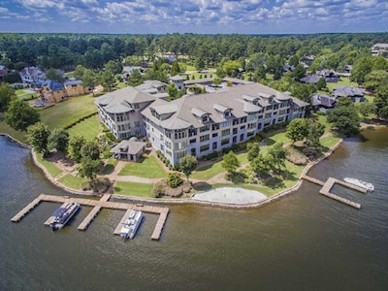
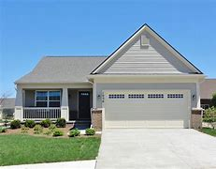
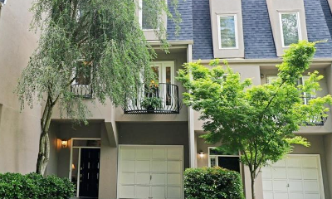
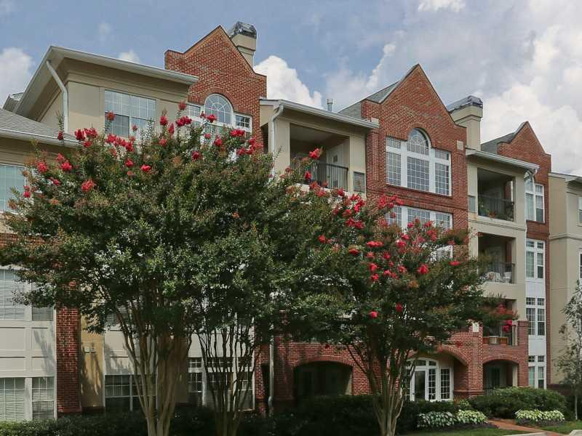
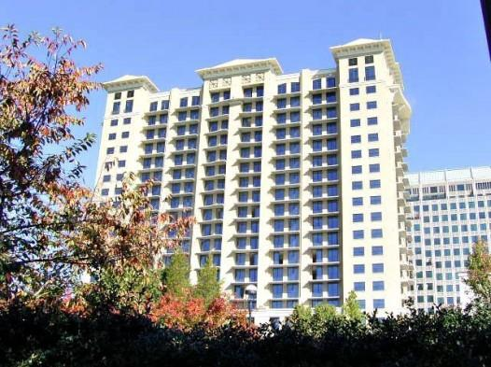
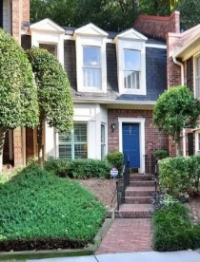
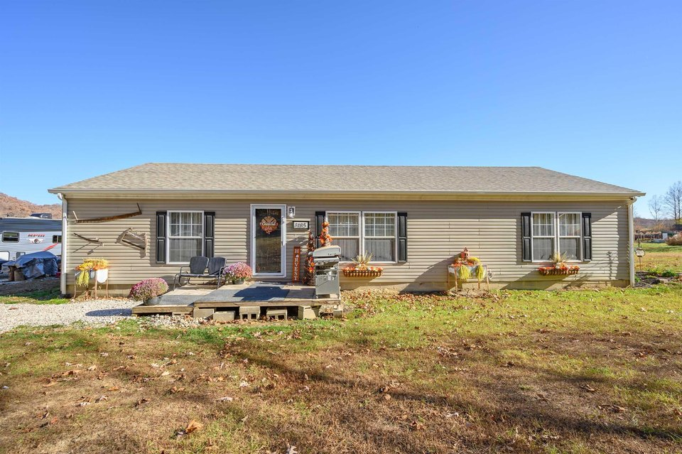
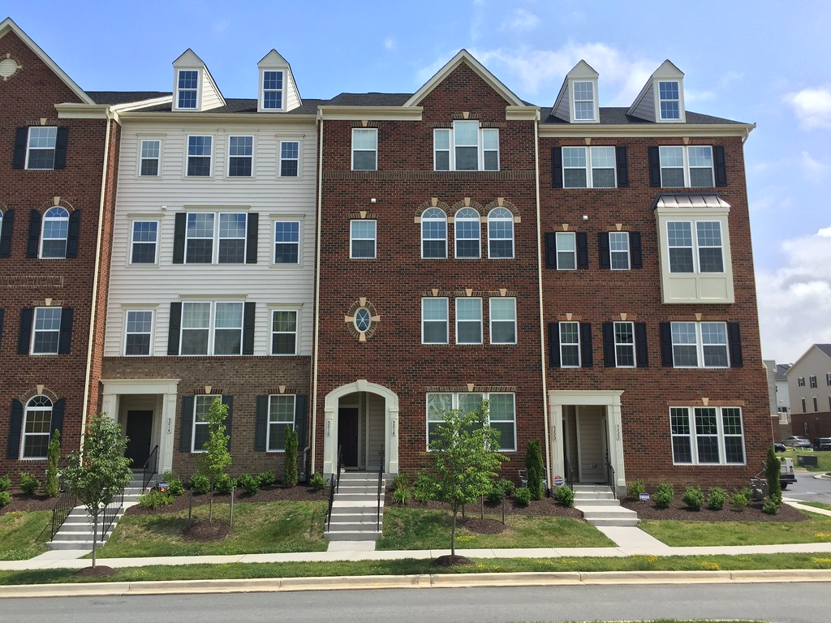
Which of these is a Condo?

Slide 4
Which of these is a Condo?
A condo is not a style of property but a style of ownership.
In a condo you have exclusive ownership of your unit and an undivided percentage of the condo’s common elements.
The common elements are further divided into common elements and limited common elements.
Even if a property is called a townhouse, it still may be a condo. The legal description is your key to find out!
The legal description for a property will always reference a Declaration of Condominium.
If in doubt, ask a CB attorney!

Slide 5
What’s the difference?
Single Family
A form of ownership where the owner owns not only the structure but also the land underneath. If the property is part of an HOA and depending on the covenants the owner may or may not be responsible for the roof, deck, patio, landscaping, etc.
Condominium
A form of ownership where the owner owns only their unit and a shared interest in common areas. Typically, the walls, ceiling and floor are the boundaries to each unit and the owner does not own the land beneath their unit.

Slide 6
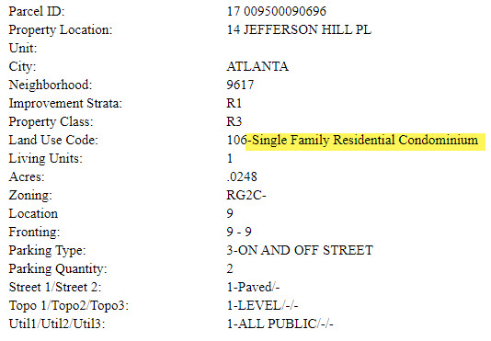
How do I know what I have?
Legal Description
The legal description references a declaration of condominium.
Tax Assessor
Tax assessor’s records will show the property type.

Slide 7
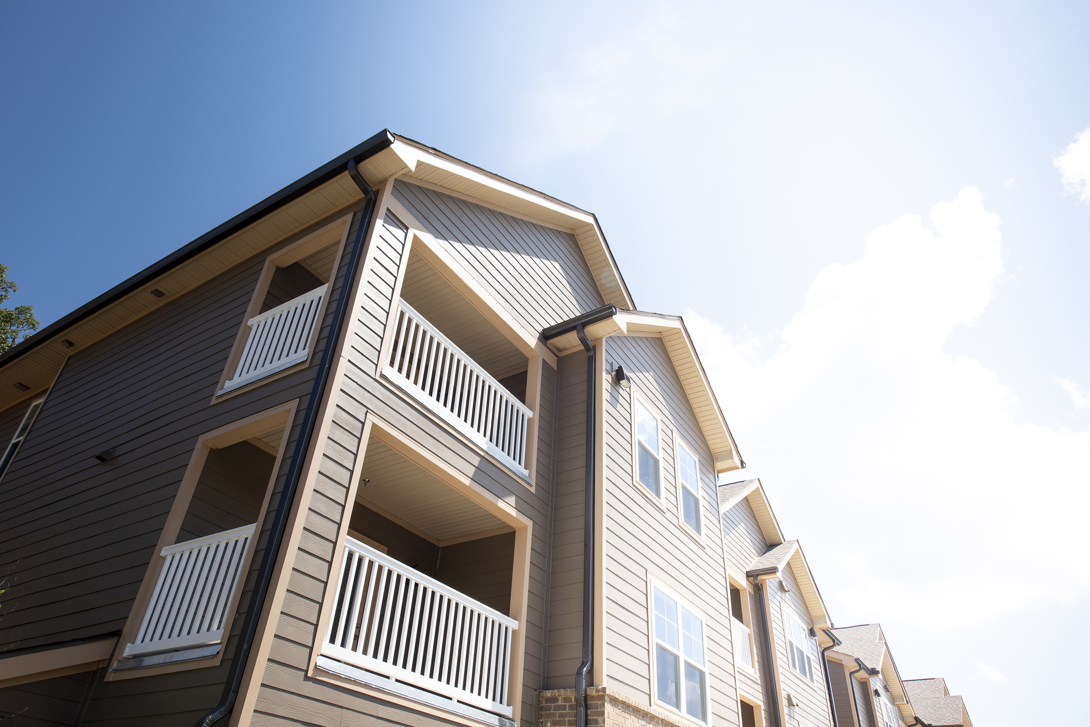
Title
Common Elements: “all portions of the condominium other than the units.”* Common elements are owned by all unit owners as tenants in common.
i.e. building exteriors, roads, general parking facilities, pool, gym, etc.
Limited Common Elements: “a portion of the common elements reserved for the exclusive use of those entitle to use one or more, but less than all, of the units.”* Limited common elements are assigned to unit owners through the Declaration of Condominium
i.e. balconies, patios, entrance stoops, etc.
Unit: “a portion of the condominium intended for any type of independent ownership and use.”* Units are defined by horizontal and vertical boundaries.
*O.C.G.A. § 44-3-70

Slide 8
An undivided interest in what now?
What does it actually mean to have undivided ownership in the common elements?
All unit owners own the common elements as tenants in common. The percentage of their share of ownership is set out in the declaration. This is typically determined by the square footage of the units.
Unit owners typically share association expenses at a rate proportionate to the ownership percentage. i.e. two bedroom and three bedroom units have different monthly assessments.
Undivided means that although you have a percentage of ownership in the common elements, your percentage of ownership cannot be subdivided. For example, you can’t say this corner of the pool is my 1% of ownership in the common elements so no one else can swim in this corner – everyone has equal access.

Slide 9
What about parking spaces and storage units?
They are limited common elements assigned through the declaration or an amendment to the declaration.
Upon sale the limited common elements automatically transfer to the new unit owner.
Limited common elements are most often NOT included in the legal description but incorporated by reference through the declaration.
Example: All that tract or parcel of land lying and being in Land Lot 99 of the 17th District of Fulton County, Georgia, and being more particularly described as follows: Condominium Unit No. 1805 of Ovation, a Condominium, as more particularly described and delineated in the Declaration of Condominium for Ovation, a Condominium, recorded in Deed Book 41978, Page 476, et seq., Fulton County, Georgia records, as the same may be amended. This conveyance is made subject to the Declaration and all matters referenced therein, and all matters shown on the plat recorded in Condominium Plat Book 17, Pages 13-16, Fulton County, Georgia records, as the same may be amended, and the floor plans recorded in Condominium Floor Plans Book 32, Pages 497-528, aforesaid records, as the same may be amended.
If unit owners want to “sell” their limited common elements to a neighbor they must go through the association. The association will draft an amendment to the declaration to make the change official. The unit owners are responsible for the fees associated with drafting and recording the amendment.

Slide 10
Under Contract

Slide 11
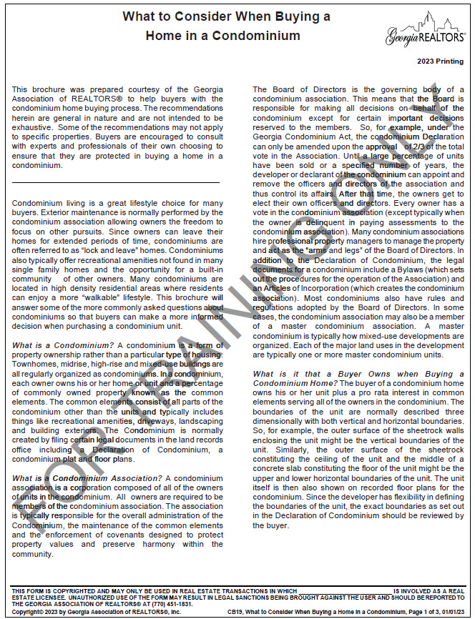
Under Contract - Brochures
GAR provides a consumer brochure (CB19) – “What to Consider When Buying a Home in a Condominium.”
Explains condo ownership, assessments, initiation fees, the role of the association, etc.

Slide 12
Under Contract
A condo can be a resale, converted property, or new construction!
Sometimes the contract rights of the parties will vary depending on the sale type.
New Construction: buyers have some statutory protections. The earlier you go under contract the more you can customize your unit – but beware this will often increase your earnest money or construction deposit!
Conversion: an existing building that was previously used for another purpose is converted to condo units. This is most common in older historic apartment buildings or warehouse space converted to condos. The developer provides the purchaser with a report on the condition of the existing systems in the building.
Resale: The sale of an existing condo unit. There are no additional protections – remember Georgia is a Buyer beware state!

Slide 13
Under Contract – New Condos
The first purchaser of a condo unit has 7 days to rescind the contract without penalty.
The 7 days begin to run from the time the buyer receives the condo disclosure package.
A new condo may go under contract before the developer breaks ground and/or be contingent upon a certain amount of pre-sales.
This right does not apply to a resale or purchasing a new condo for investment purposes.
Initial monthly assessments may be low in new construction – until the condo is in full operation it is hard to ascertain the true running cost.

Slide 14
Under Contract – Conversion
A condo created from an existing building.
Most common conversions are historic apartment buildings, schools, warehouses, or factories.
Existing tenants must be given 120 day notice of the conversion and be offered the opportunity to purchase their unit at a set price and term – during this time they have a right of first refusal to match any offer presented by any other buyer.
Buyers must be given the condo disclosure package, but the disclosure must also contain information about the condition and life expectancy of existing systems in the building.

Slide 15
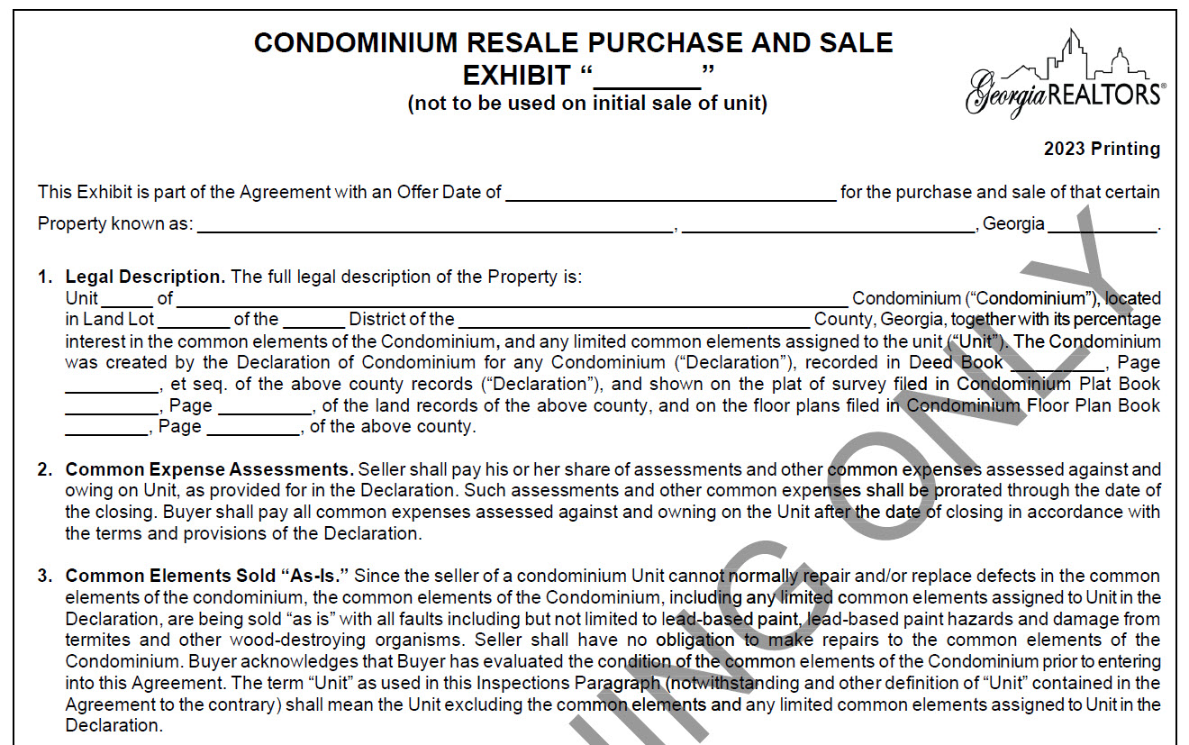
Under Contract – Resale Exhibit (F204)
Resale exhibit covers info specific to condos that isn’t included in F201 including:
Fill in the blank legal description that includes a reference to the Declaration of Condominium;
Responsibility for assessments; and
That because the seller cannot repair defects in the common elements the condo’s common elements are sold “as-is”.
This also protects sellers if the association makes a change to the common elements after going binding – the buyer does not have an out just because the common elements are not the same as of the binding agreement date.
If the unit is being sold with the right to request repairs the common elements are not subject to that right.

Slide 16
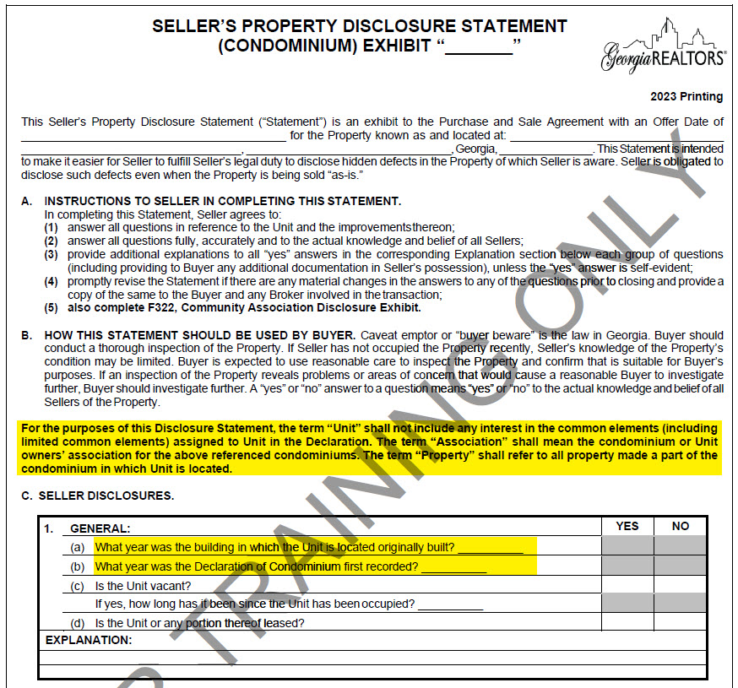
Under Contract – Condo Disclosure Exhibit (F304)
Only covers the unit and not the common elements – but if you have info about the common elements it is always better to disclose!
Questions differ from the other disclosures to include concerns specific to a condo (parking, storage, etc.). For example, the building may significantly predate the condo itself.

Slide 17
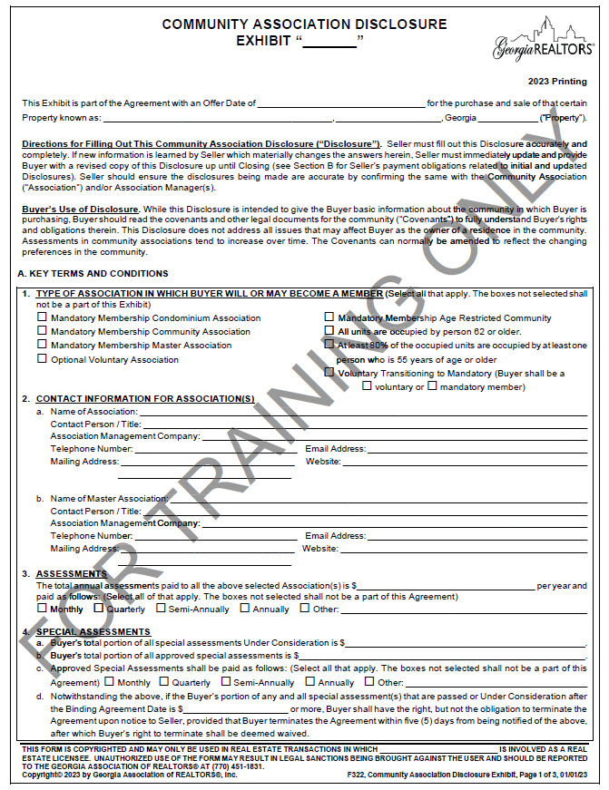
Under Contract – Community Association Disclosure (F322)

Slide 18
Under Contract – Community Association Disclosure (F322)
Even if assessments are paid monthly the CAD asks you to disclose the total annual cost and how that payment is split.
Be aware, dues change over time!
The seller isn’t responsible for higher assessments. However, if you know they’ve increased, update your CAD. This is especially relevant at the beginning of the year.

Slide 19
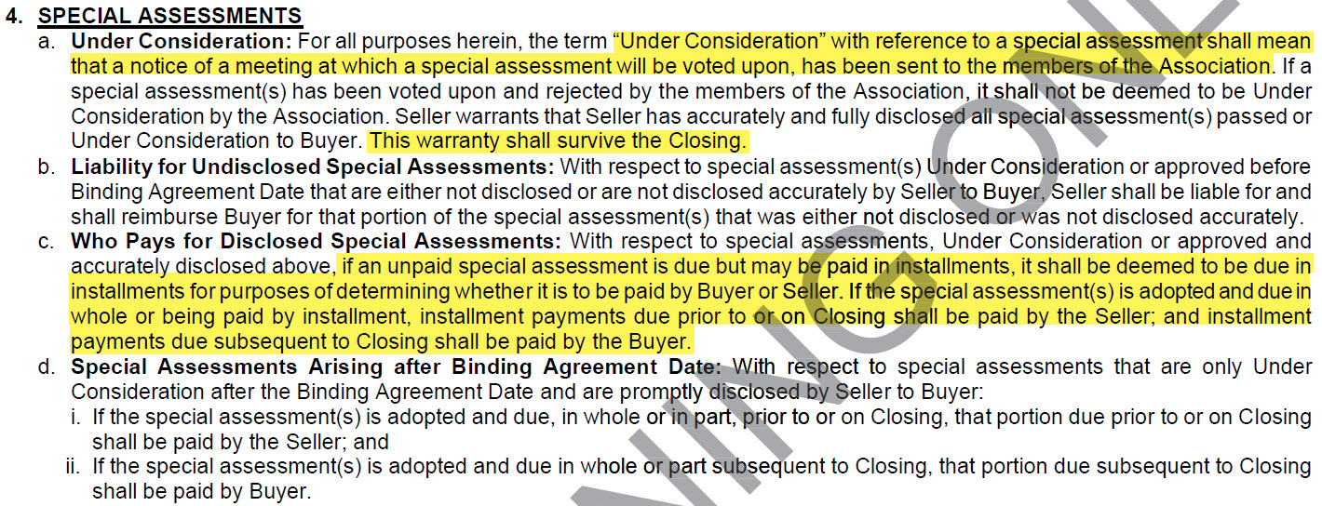
Under Contract – Community Association Disclosure (F322)
Special Assessments
Don’t forget to disclose pending special assessments!
Even if the special assessment is due in installments and it is properly disclosed, an HOA may accelerate the payments when the property is sold. In that case the total balance of the special assessment is the responsibility of the Seller.
What about rumored special assessments that don’t yet meet the definition of “under consideration”?

Slide 20
Under Contract – Community Association Disclosure (F322)
"Under Consideration" is defined as notice of a meeting at which a special assessment will be voted on has been sent to the members. Assessment could be discussed in meetings but not yet "under consideration."
This is why it is so important to ask for copies of meeting minutes – they will reveal important community information and possible special assessments which are not yet “under consideration.”
Before listing, seller should ask the association if they will allow the buyer to assume future special assessment installments or if seller will be required to pay them in full at closing.

Slide 21
Under Contract – Community Association Disclosure (F322)
Closing Letter: Seller must pay all fees required to obtain the letter in advance of closing.
Transfer and Initiation Fees

Slide 22
Under Contract – Community Association Disclosure (F322)
Tips when completing the CAD:
Have your sellers call their management company before listing to get a copy of ALL fees paid at closing – if they don’t ask for all fees management companies will often quote them the cost of only the letter.
Do NOT complete the CAD for your seller!
NEVER leave the Transfer, Initiation, and Administrative Fees section blank. It must be filled in with a number – it can’t say “all” or “100%”. It is never a bad idea to pad the amount disclosed
If you ever had any violations on the property, even if they have been fixed, make sure they were closed out with the management company!

Slide 23
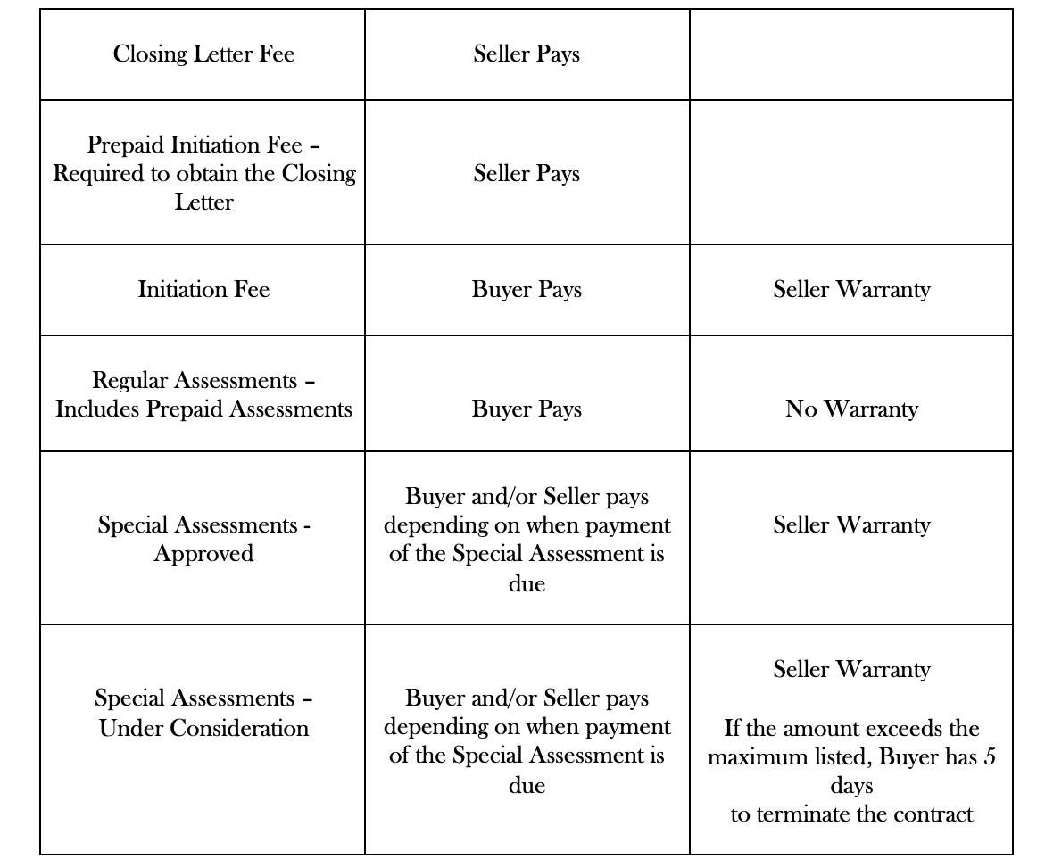
Under Contract – Community Association Disclosure (F322)

Slide 24
Questions to Consider in Due Diligence
What services and amenities are provided through the association?
Are high assessments an indication of poor money management or the high level of service and amenities provided?
Does an inspector need special instructions or permission to access any systems during the inspection?
Although a common element may need repair and not be in the seller’s power to repair, will the association confirm in writing their responsibility for maintaining that common element?
Ask for copies of all rule and regulations – not just the covenants!
Review the master insurance policy.

Slide 25
Questions to Consider in Due Diligence
The association is not a party to the contract so any stipulations requesting documents should put the obligation on the seller.
Consider requesting:
Declaration
By-laws
Rules & Regulations
Article of Incorporation
You can also look this up with the
Georgia Secretary of State
Operating budget
Reserve study
Board meeting and annual meeting minutes

Slide 26
Reading Board Meeting Minutes and Financials
Ask for copies of meeting minutes – this will give you a behind the scenes look of the concerns and thoughts of other unit owners.
i.e. there might be talk of a possible future assessment which hasn’t yet reached the level of “under consideration” or maybe a committee was recently created to develop new parking rules

Slide 27
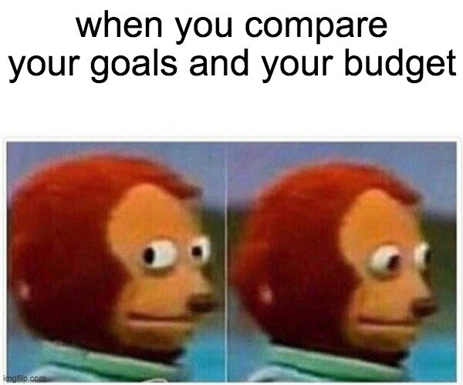
Reading Board Meeting Minutes and Financials
Review the last few annual budgets. Did any line items significantly increase or decrease? If so, why? How stable has the budget been over the last few years?
What are the reserves? What anticipated expenditures are covered by the reserves? Think of the reserves as the community’s safety net- is the net big enough for the community?
When was the last capital reserve study?

Slide 28
Mortgage Considerations

Slide 29
Mortgage Considerations
With condos there is typically extra scrutiny from lenders because decisions of the association can impact your property value. You are buying part of the community!
Future association decisions can also impact your ability to afford the property.
Rates on condos will almost always be higher than on a single-family residence.
The down payment will impact the rate and the level of scrutiny by underwriters – Talk to your lender!

Slide 30
Mortgage Considerations
Condos must be warrantable to qualify for a conventional loan. Underwriters evaluate matters such as:
The rate of delinquency;
Percentage of investor owners;
In a non-established condo they will often review governing docs;
Budget;
Reserves;
Pending lawsuits; and
The master insurance policy.
FHA and VA loans also require condo approval but may consider additional factors.

Slide 31
Mortgage Considerations
Reasons why a condo might not be FHA or VA approved:
Inadequate reserves;
Insurance;
Rates of delinquency;
Litigation; or
Too much commercial space

Slide 32
Mortgage Considerations
Conventional – higher interest rate may be reduced with a down payment of at least 25%
FHA – Check for FHA condo approval at https://entp.hud.gov/idapp/html/condlook.cfm
If the condo isn’t FHA approved, spot approval may be available for individual units but check with your loan officer to see if that is something they offer.
Spot approval can take up to 6 weeks or more and requires a significant amount of documentation.
VA – Check for VA condo approval at https://vip.vba.va.gov/portal/VBAH/VBAHome/condopudsearch
VA loans do not allow spot approval for individual units.

Slide 33
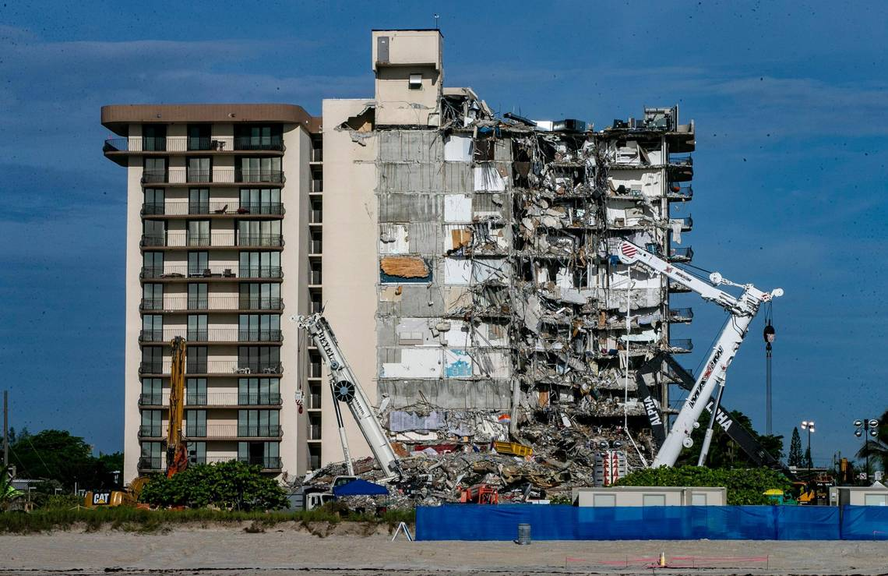
Mortgage Considerations
Condo Questionnaire
In the wake of the condo collapse in Florida, Fannie and Freddie added questions to the condo questionnaire about condo reserves and deferred maintenance.
Although it is natural that all buildings have some level of deferred maintenance, underwriters are scrutinizing condo records in much greater detail to try to identify at-risk buildings.

Slide 34
Mortgage Considerations
Condo Questionnaire
Lenders may not review the condo questionnaire until after the financing contingency expires. It could cause significant delays in closing or prevent closing altogether.
What can parties do?
Sellers: Sellers and listing agents should request condo bylaws, covenants, financial statements, and recent board meeting minutes prior to listing.
Buyers:
Buyers in the market for condos can ask their loan officer in advance whether their underwriter(s) have standard language or documentation they request from condo associations.
Buyers should also request copies of the condo association by-laws, covenants, financial statements, notices of special assessments, and most recent meeting minutes.
Even in a cash transaction, buyers should request this information as part of their due diligence.
Have other units closed recently? Who was their lender? Did they have any problems with the condo questionnaire?

Slide 35
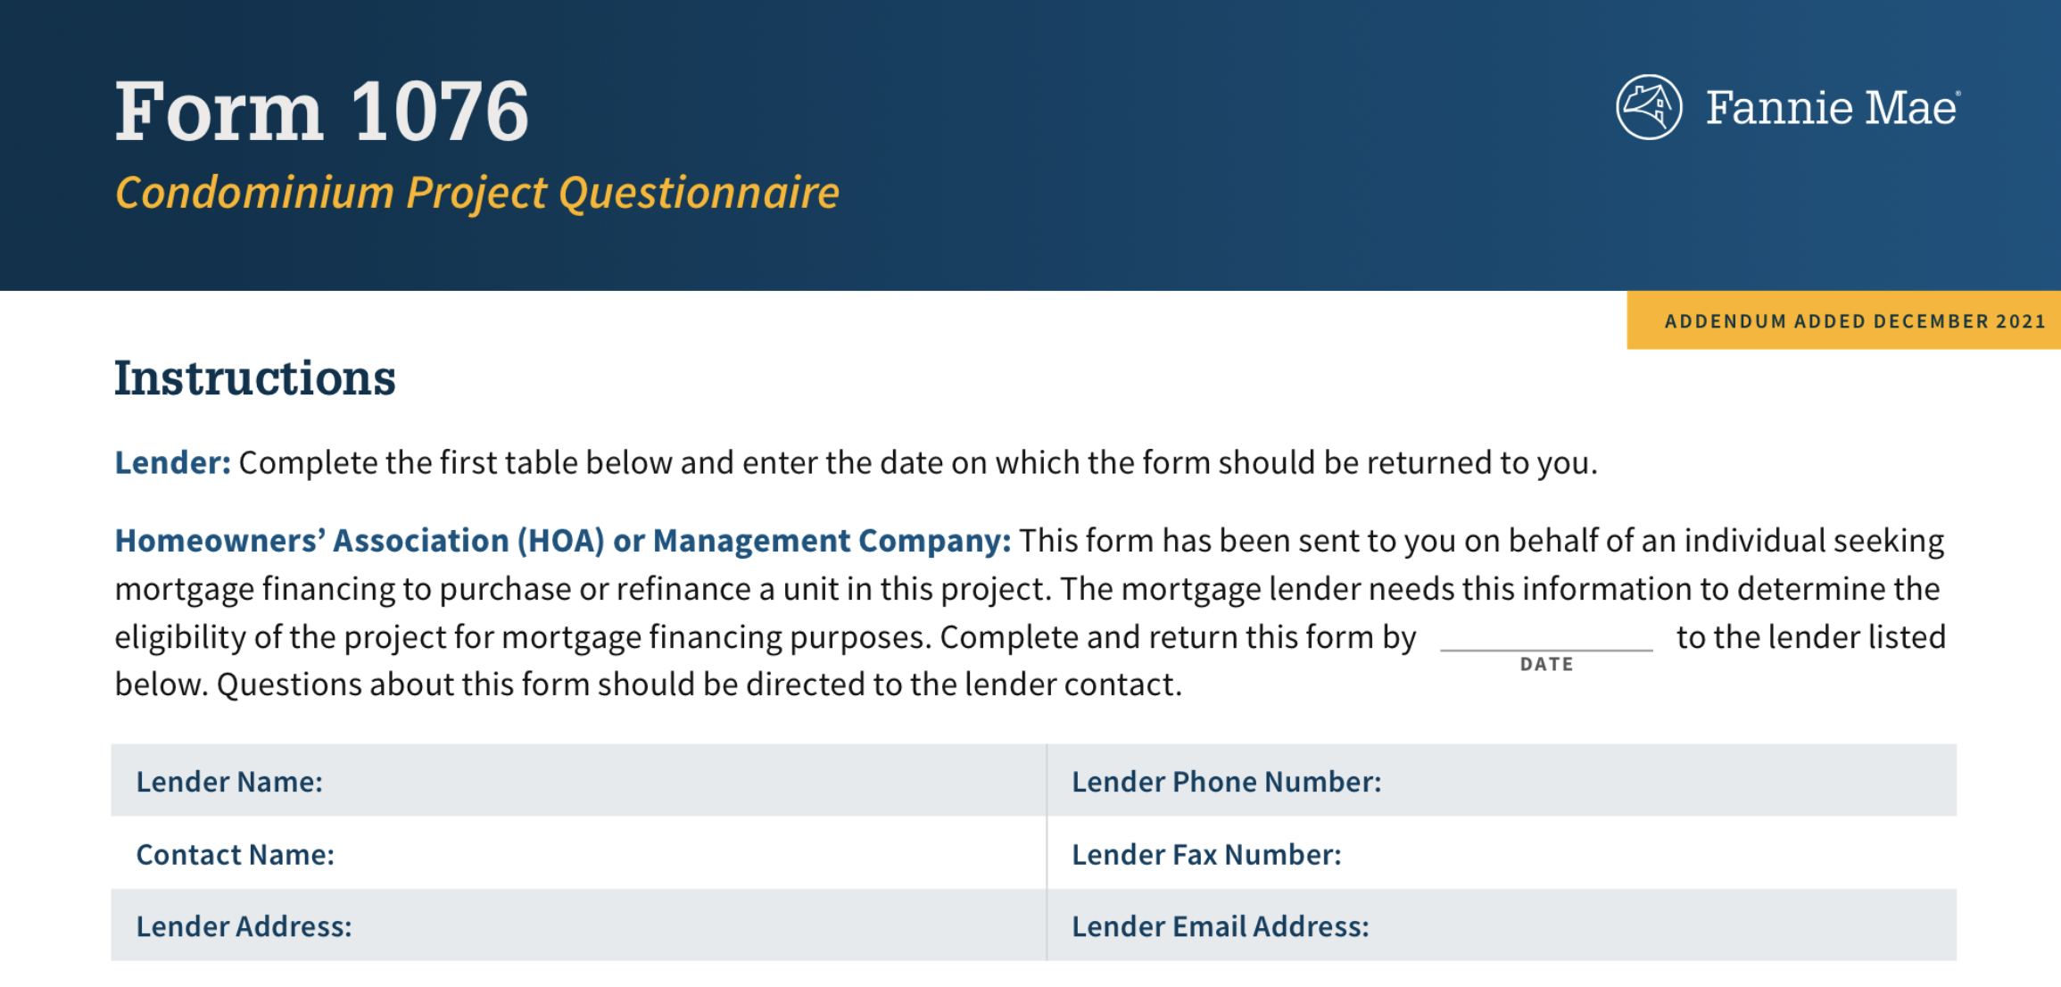
Mortgage Considerations
Condo Questionnaire
The condo questionnaire may trigger follow up questions or requests from the lender.
If the association does not provide the requested information, it can create a delay.
As the buyer, use a stipulation to protect yourself in case the lender can’t approve the condo.

Slide 36
Mortgage Considerations
Condo Questionnaire Special Stipulations
“All parties acknowledge that lender, as part of the condominium approval, requires appropriate documentation including but not limited to the condo association bylaws and covenants and any amendments thereto, notices of special assessments, financial statements including the most recent budget, and meeting minutes from the most recent [insert number] board meetings. As time is of the essence, Seller shall provide Buyer with any and all such aforementioned documentation and information within ___ days of binding agreement date. Should Seller fail to provide ALL of the above referenced documentation within ___ days of binding agreement date, Buyer shall have the right to terminate this Agreement with no penalty and a refund of all Earnest Money.”
“All parties agree that should the lender not obtain lending approval of condominium (as to the condominium project as a whole and unrelated to Buyer’s loan qualification) by [INSERT CONTINGENCY DATE], Buyer may terminate with no penalty and Buyer shall be entitled to earnest money.”
“This Agreement shall be contingent upon the condominium in which the unit is located being eligible for financing and approved by Buyer’s lender. If Buyer obtains written notice from Buyer’s lender indicating that (1) it is declining Buyer’s loan application because the condominium in which the unit is located is ineligible for financing or (2) Buyer’s lender is unable to determine whether the condominium in which the unit is located is eligible for financing because the association or management company for the condominium has not provided sufficient information (documents) for the lender to make such a determination, then Buyer may terminate this Agreement by providing written notice to Seller, along with the notice from Buyer’s lender, within ____ days from receipt of documents. If Buyer timely provides such notice, then the Earnest Money shall be returned to Buyer. If Buyer does not timely provide such notice, then the contingency contained in this paragraph shall be waived and of no further force or effect. This contingency is applicable irrespective of whether there is any loan, financing, or all cash, contingency exhibit attached hereto and shall survive the expiration, wavier, or satisfaction of the same.”

Slide 37
Mortgage Considerations
Before listing or showing a property, review the condo’s status!
Seller – what is the FHA and VA approval status of your condo?
Buyer- are you set on a particular loan product? If you are set on an FHA or VA loan, check the properties status before viewing or making an offer.

Slide 38
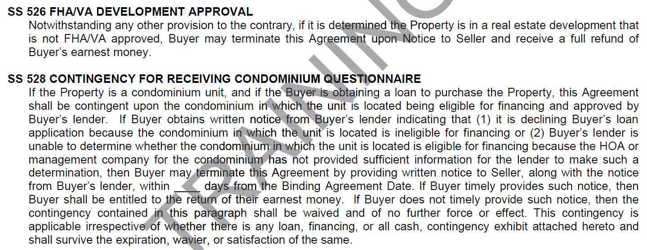
Mortgage Considerations
GAR provides two mortgage stipulations specific to condos

Slide 39
Litigation
Consider the fact pattern and how results could impact each unit owner.
Does this only impact a few units?
Does it involve health, safety, structural integrity, or ability to use your unit?
Known damages? Has the insurance carrier agreed to cover?
Is the association the plaintiff or defendant?
Is the association seeking to recover for a defect? Was the defect remedied and they are seeking reimbursement or is still defective?
Is this a dispute between unit owners?
Is the litigation to enforce past due assessments?

Slide 40
Condo Living

Slide 41
Fee Simple Ownership
Pop Quiz!
Can a condo title be “fee simple”?
Yes! Although “fee simple” is often used colloquially to refer to townhouses or homes the term is not mutually exclusive.
A fee simple title is a legal term used when you have total ownership of the property. In a condo you have fee simple ownership of your unit, the neighbors don’t have a right to it.

Slide 42
Insurance
Unit owners still need their own policy! Most will get an HO-6 policy.
An HO-6 policy includes coverage for personal property, unit improvements, and personal injury claims.
Your insurance needs should be evaluated on a case-by-case basis with your insurance agent.
Often cheaper than single family homes because the association policy protects the common elements.
Georgia law requires that the condo have insurance for specific risks. Lenders are likely to ask for a copy of the condo’s policy.

Slide 43
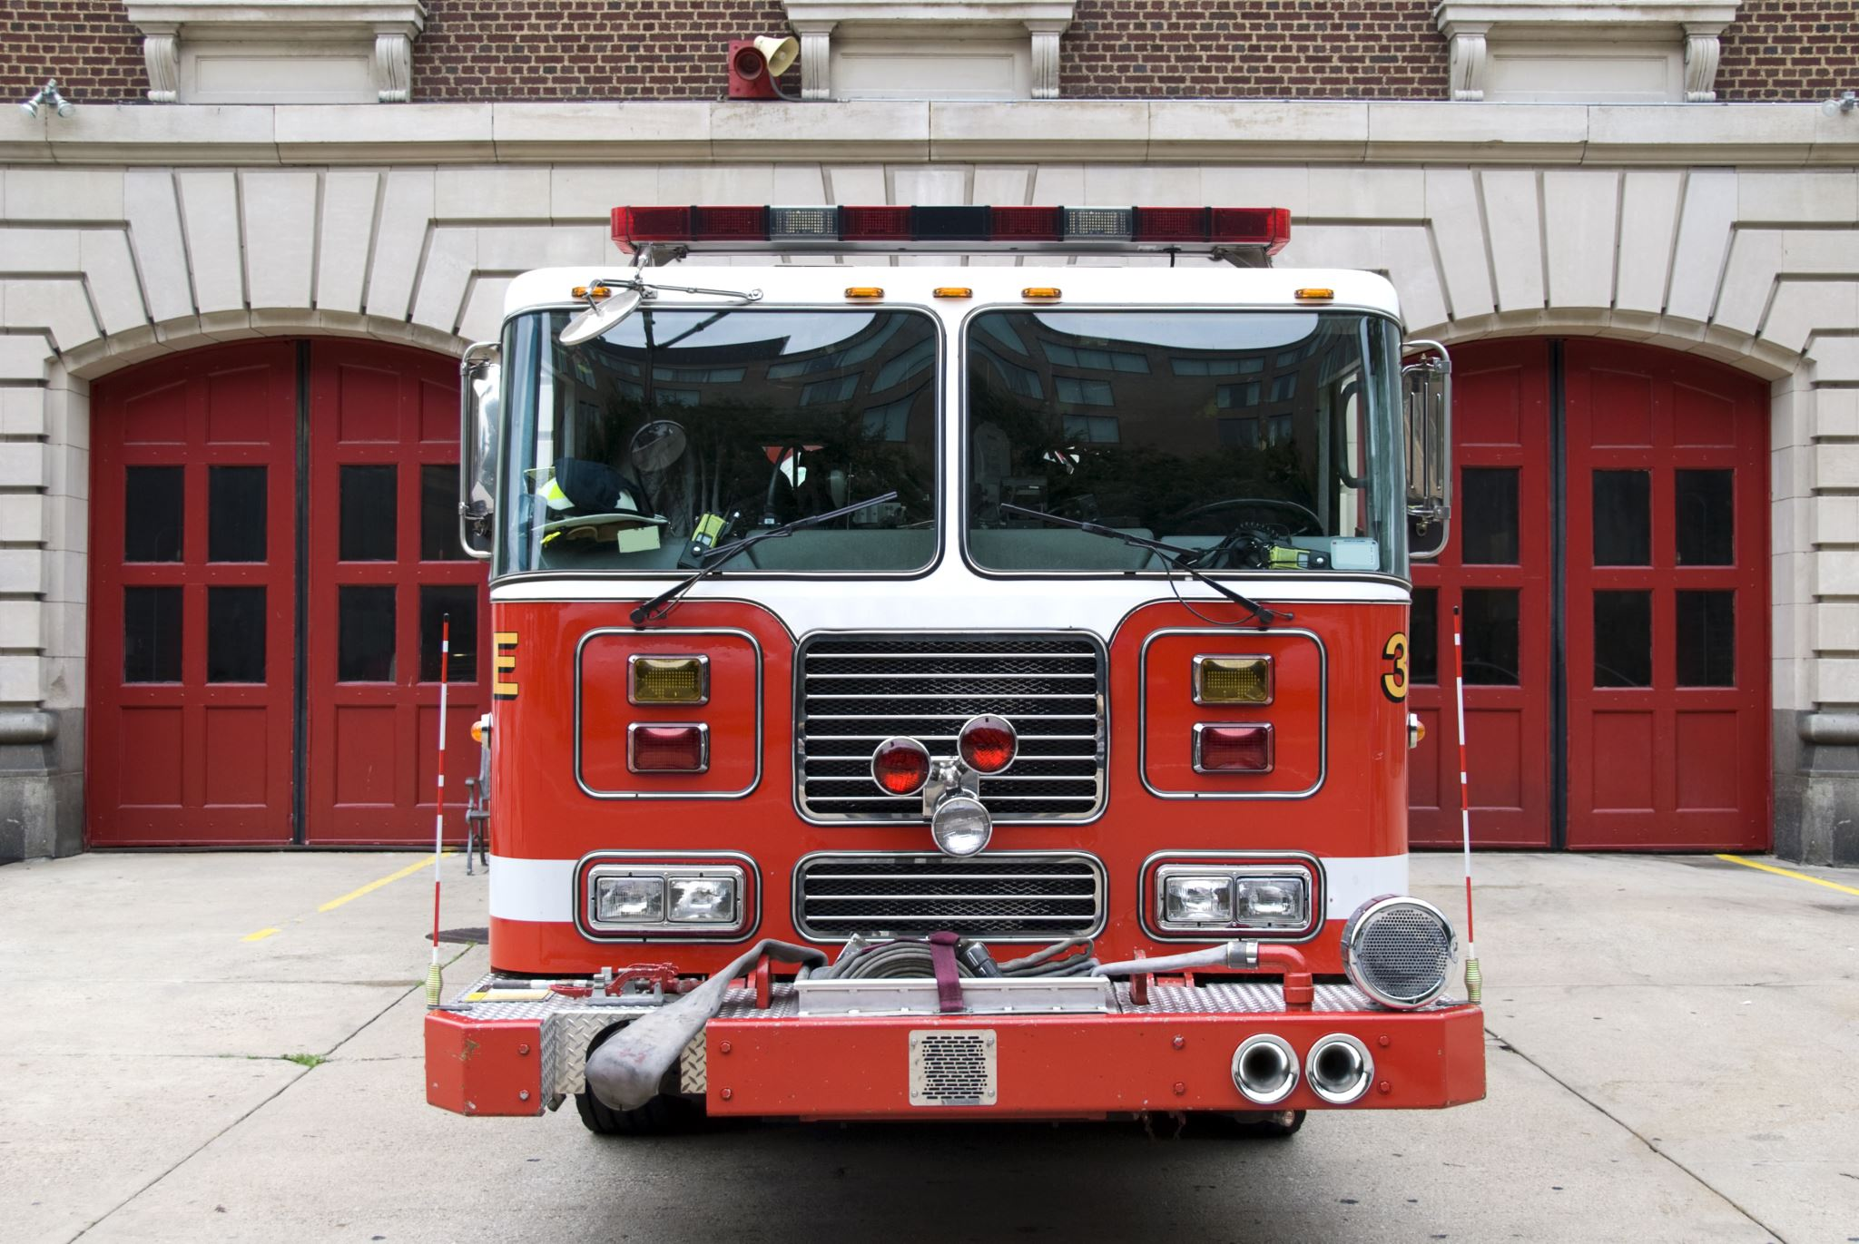
Insurance
Georgia law requires that the master policy cover:
Fire and extended coverage for the full insurable replacement cost;
All common elements, limited common elements, foundation, roofs, and exterior walls; but
Does NOT have to cover water damage or water perils.

Slide 44
Insurance
Condo insurance can be complicated!
Have your buyer speak with their insurance agent.
Never give insurance advice – advise them to speak with the experts!

Slide 45
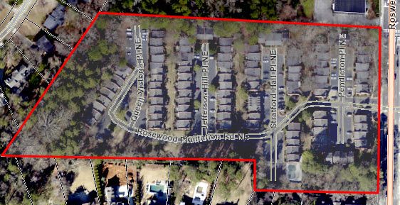
Property Taxes
The condo association itself does not hold title to any real property so there is no property tax bill for the association.
Since each unit owner has an interest in the common elements, taxes for the common elements are assessed to the unit owners.
Tax map for one unit shows the entire condo because the unit owner owns the common elements with the neighbors as tenants in common.

Slide 46
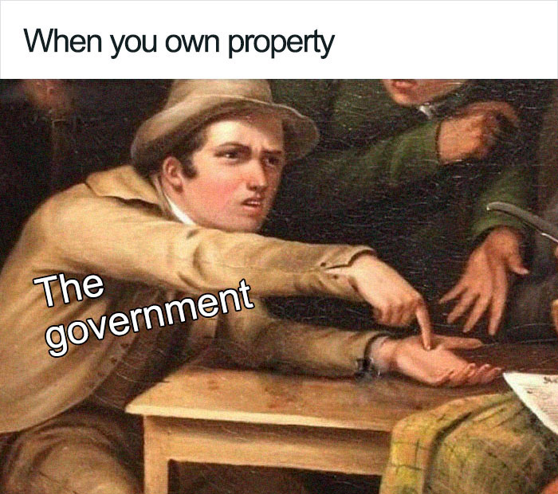
Property Taxes
Your property taxes include your unit and a pro rata share of the common elements.
Taxes for your unit and your share of the common elements are not separated but billed together as they both contribute to the fair market value of your property.

Slide 47
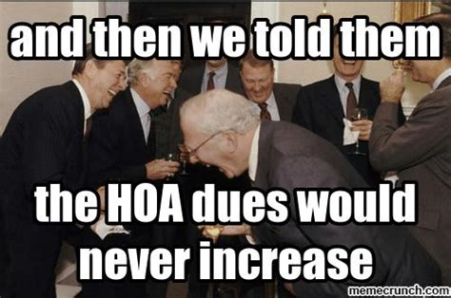
Assessments
Remember that assessments will go up over time.
There may be additional fees paid to the association besides the assessment. Additional fees may include monthly utilities, gate remotes, pool access keys, etc.
Evaluate assessments in light of what they provide: water, sewer, trash, pest control, termite protection, landscaping, concierge.
Know that special assessments are always a future possibility.
What can you do? Join the board!

Slide 48
Best Practices
Ask if open houses or caravans are allowed. Some associations may have restrictions on hours you can show the property or the type of signage you can use –just ask!
Listing agent, include private remarks with information on how to access the unit. Selling agent, review the information before showing – scope it out ahead of your client’s arrival so you can help direct them.
Make sure you know how to view all the amenities so your client can see all the benefits that come with the condo.
Are there any deal breakers for your client? Assigned parking? Pet restrictions? Leasing restrictions? Grills? Decorations? Unit must have a southern exposure?

Slide 49
Questions?
attorneys@cb.law

