Slide 1
Demystifying
The Permitting Process
Continuing Education Class
www.campbellandbrannon.com/permitting

Slide 2
Introduction to our Instructors
C. Justice Choate, Jr.
Real Estate Attorney
Campbell & Brannon
Licensed in 2008
John Moores, AIA
Architect, REALTOR
Licensed in 2005

Slide 3
Agenda
Section 1 – When is a permit needed
Section 2 – Researching properties and basic information
Section 3 – How to protect your clients.

Slide 4
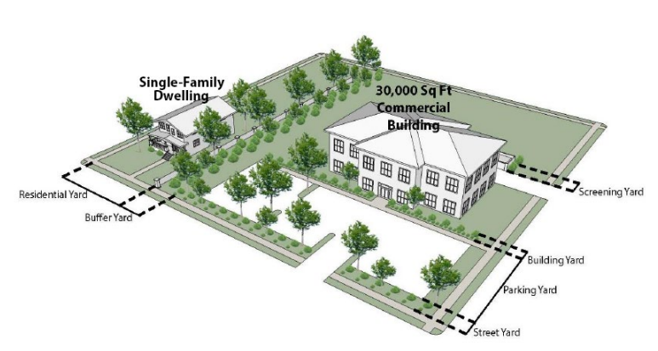
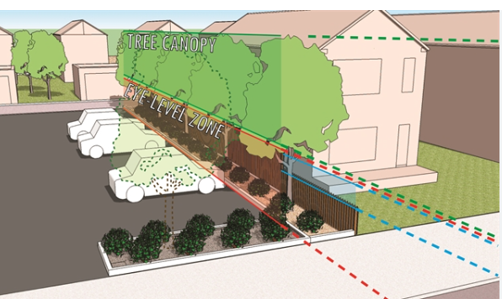
Heard this before?
“This seems newly renovated. Do you know if it was permitted”
“Oh, this attic is high enough to build out”
“This backyard is perfect for an ADU”
“I wanna build a workout shed beside our home”
“Can I add the ADU onto my existing garage?”
“You should consult a land-use attorney or architect - let me give you a couple of names.”

Slide 5
Demystifying the Permit Process
What we are covering today:
Part 1: Build ‘By-Right’ | Renovations, New Attics and ADUs
What will be offered in the future:
Part 2: SAP vs Variance
Part 3: Subdivisions

Slide 6
Learning Objectives for this CE
To understand when a permit is needed and basic zoning guidelines
Researching properties and online resources
You will better understand how to Protect your Clients

Slide 7
The Permitting Process (Part 1)
Section A: When do I need a permit
Section B: History of Zoning / Atlanta
Section C: Zoning & Buildable area
Section D: Researching a Property
Section E: Applying for a permit & Resources

Slide 8
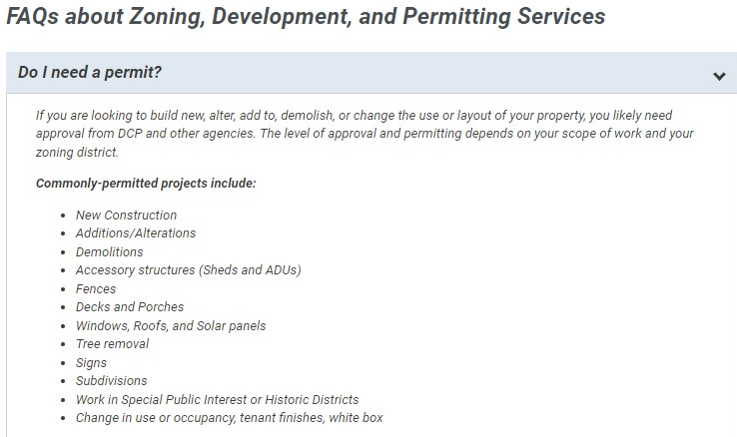
Section A: When do I need a permit?

Slide 9
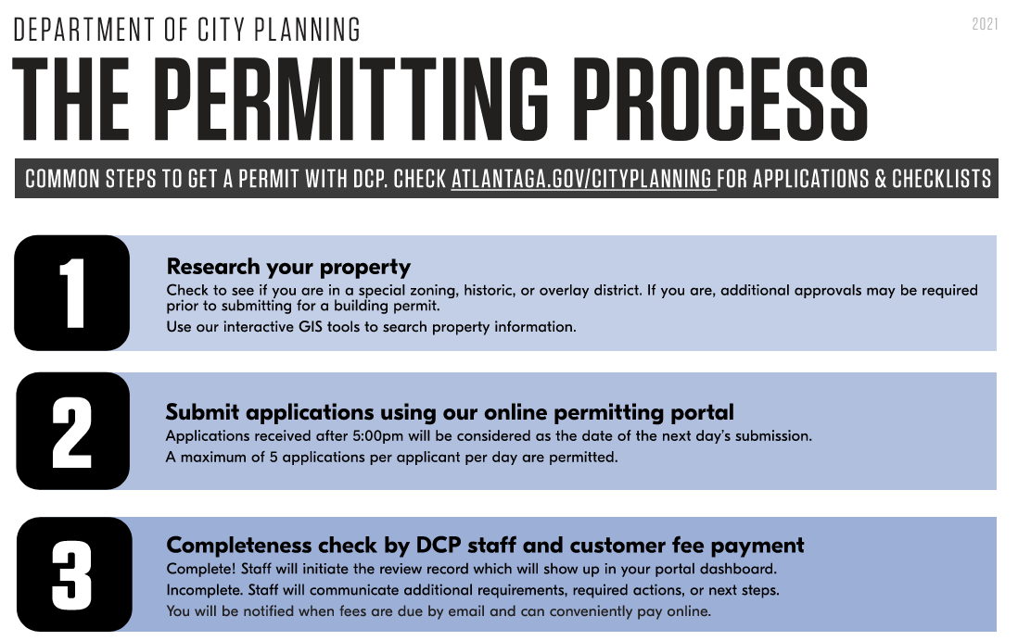
Section A: When do I need a permit?

Slide 10
Section A: When do I need a permit?
When is a building permit necessary?
Remember to consider your client’s intentions for the property. If the tasks are minor—floor refinishing, repainting the dining room walls, or replacing the carpet, the need to discuss permitting is not top of mind.
When you know your client wants a 5 bedroom and the house only has 4, consider the need for a permit. If the home is in a historic district (e.g.: Inman Park, Druid Hills, etc..) there are limitations as to what can be done to the structure. Is a pool non-negotiable, even if it has to be built? These are all signs that a permit would be needed. Before a client makes an offer on a property discuss the potential need for the permit and connecting the buyer with a professional who can review the property to determine the feasibility and necessary steps to see the project to fruition.
Practice Point: Arming yourself with a strong arsenal of contractors, architects, and design professionals is essential to connecting clients with the appropriate people to determine if a permit is needed.

Slide 11
Section A: When do I need a permit?
When does a renovation require a new CO?
Danger in re-buying unpermitted work:
Open permits are a potential for review if the buyers either seek a new permit that brings review of the property back into or if a complaint is made against the property for a building or zoning violation.
If an open permit reveals a non-conforming violation, the buyer is responsible for bringing the property up to code. The work could include expense and time. A buyer should always review the county website and or make a direct inquiry of the owners as to their knowledge of open permits on the property.
If a property has an open permit, the buyers should determine the risk of additional work to bring the property into compliance.
Proper Due Diligence items for renovations/ new builds as it pertains to permits.
If a buyer determines that the property needs work which will require permitting or if the property has open permits that the buyer needs additional information to make an informed decision, ensure that the contract includes terms and timelines for the buyer to conduct their due diligence.

Slide 12
Section A: When do I need a permit?
Disclosures, language and / or exhibits to add to the contract
The following stipulations can be included in contracts when representing Buyers which provide for the Buyer’s right to terminate for issues that must be addressed during due diligence.
Example: Buyer’s ability to construct a pool means that the buyer must have a permit which includes surface ratios and topography. These surveys almost always need more time than is typically agreed to in a typical due diligence period. You can write a special stipulation that provides for additional period of due diligence as it pertains to specific items.
If acceptable to the Seller, it is the best practice to use the broad stipulation which allows a Buyer to terminate.
If this is unacceptable to the Seller, the second narrow options still covers the great majority of issues which would potentially concern the Buyer.
Practice point: As with most advice to Buyers, we would recommend including a disclaimer that any list will not catch every items which might be objectionable. However, given that the Seller will not accept the broad stipulation, it will hopefully capture most items of concern.
If you know a property contains an item upon initial offer (for example you know the property has a stream which will limit the ability to build on the property you will need to edit accordingly.

Slide 13
Section A: When do I need a permit?
Broad Stipulations to Include in Initial Offers
Buyer shall have the right to terminate the Purchase and Sale Agreement without penalty and with full refund of all Earnest Money if in Buyer’s sole discretion any matters revealed by said survey are objectionable to Buyer.
Buyer shall notify Seller of such termination for matters revealed by said survey no later than ___ days from Binding Agreement Date.
Narrow Survey Stipulation if above is unacceptable to Seller
To the best of Seller’s knowledge, there are no encroachments, easements, sewer lines, storm drainage lines, other utility lines not serving only the subject property, water buffers, flood zones, setback issues which would prevent the Buyer from constructing a NEW POOL / DOUBLE GARAGE / ADU on the Property.
Should the Buyer obtain a recent survey of the Property which reveals any such item, Buyer shall have the right to terminate the Purchase and Sale Agreement without penalty.
Buyer shall notify Seller of such termination no later than ___ days from Binding Agreement Date.

Slide 14
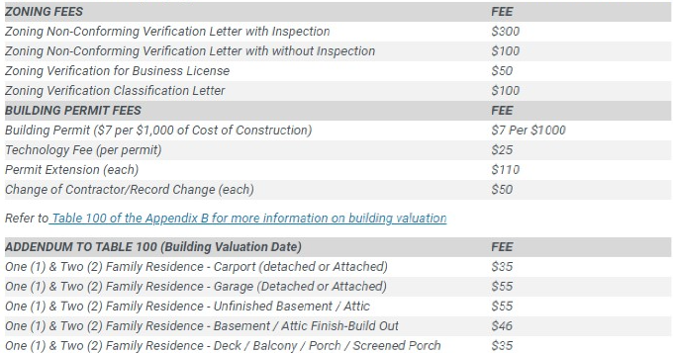
Section A: When do I need a permit?

Slide 15
Section B: History of Zoning

Slide 16
Section B: History of Zoning

Slide 17
Section B: History of Zoning
atlcitystudio.org

Slide 18
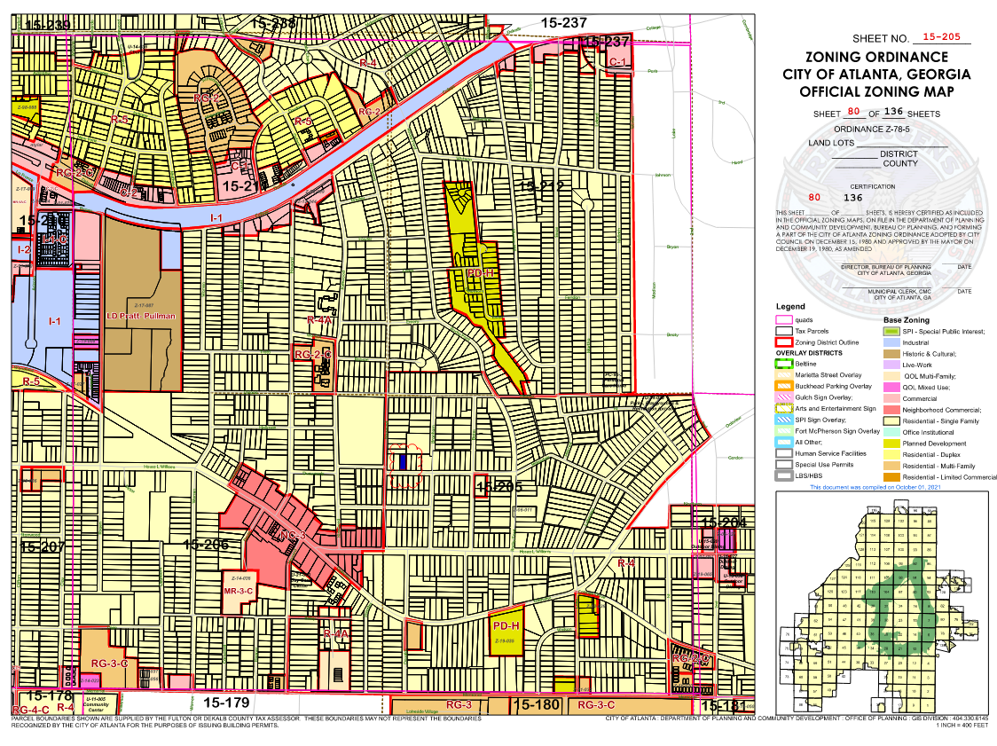
Section C: Zoning & Buildable Area

Slide 19
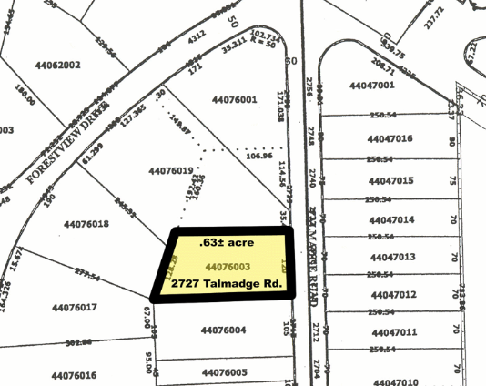
Section C: Zoning & Buildable Area
Plat Map

Slide 20
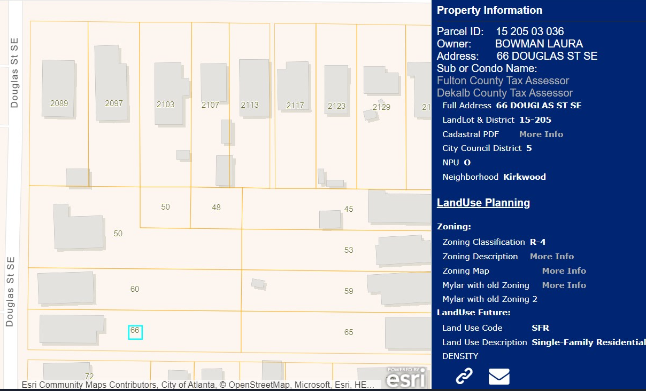
Section C: Zoning & Buildable Area

Slide 21
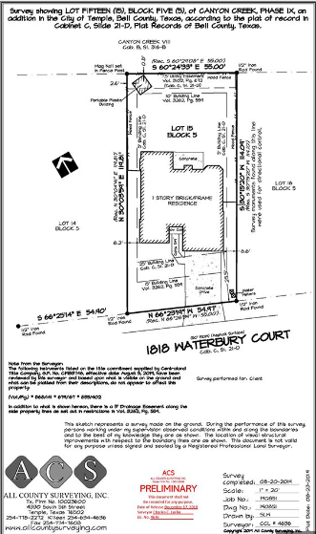
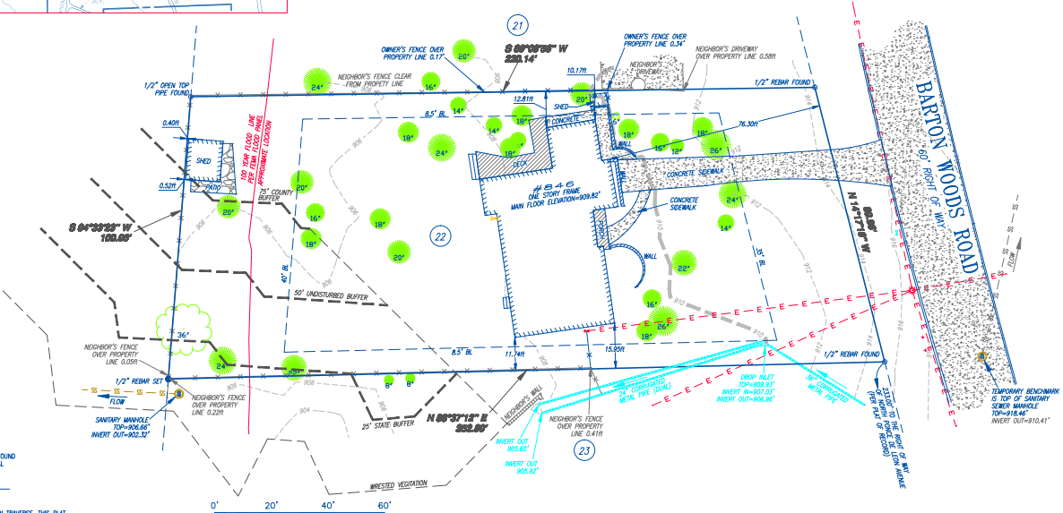
Section C: Zoning & Buildable Area
Trees, Topography & Utilities
Metes and Bounds Survey

Slide 22
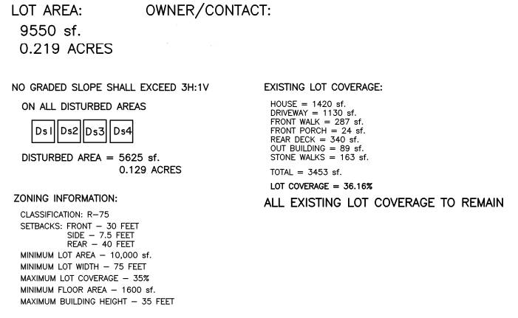
Section C: Zoning & Buildable Area

Slide 23
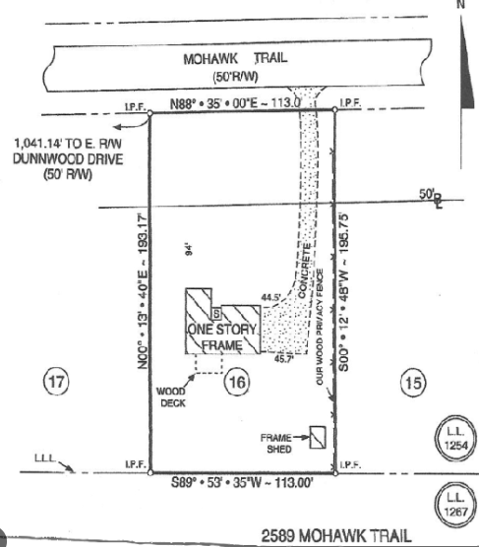
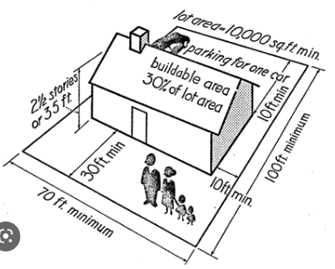
Section C: Zoning & Buildable Area
Metes and Bounds Survey

Slide 24
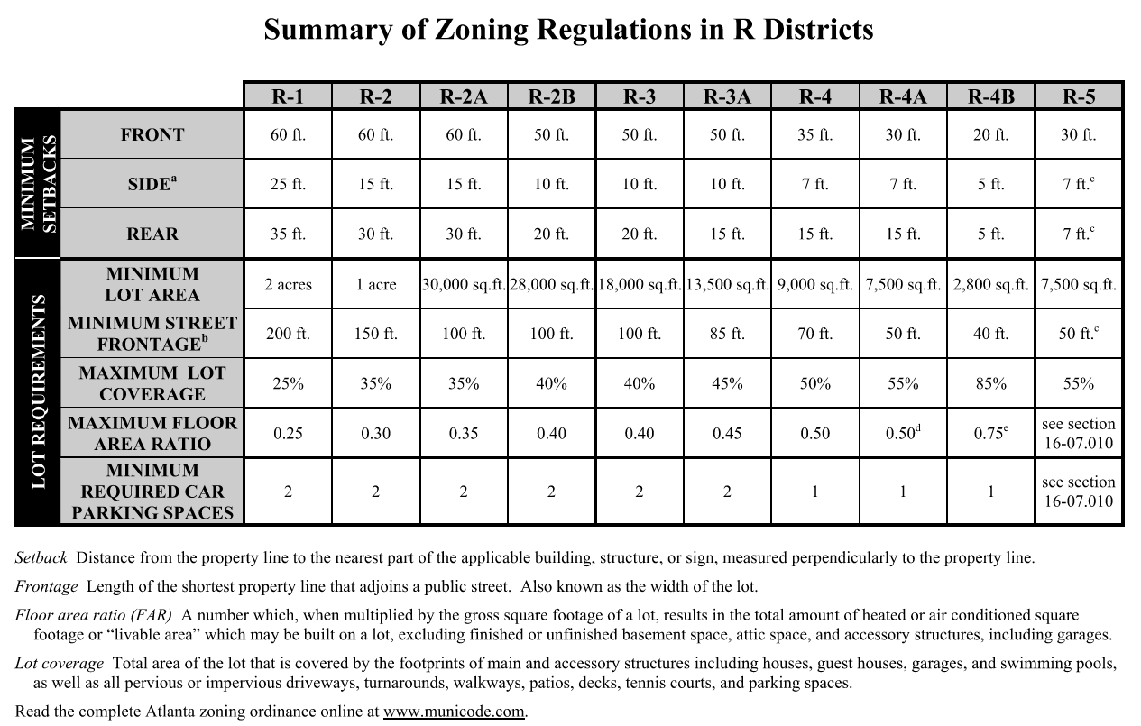
Section C: Zoning & Buildable Area

Slide 25
Section C: Zoning & Buildable Area
PRACTICE POINT: If a survey indicates that the property is over the current building setback lines, the property might be grandfathered. This means that the violation does not need to be corrected, but it does not your ability to replace the non-conforming structure in the same location.
Often, older structures that are outside of the building setback lines (example: garages that abut the property line) can only be maintained. Renovation or addition to the structure that is built outside of the building setback line could require a variance.
As the building setback violation relates to title insurance, your title insurance does not provide coverage for setback violations that made known to you through the purchase of a new survey.

Slide 26
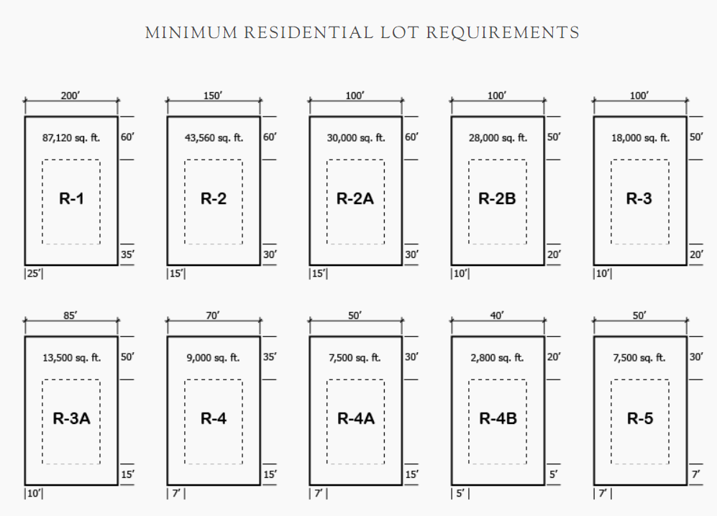
Section C: Zoning & Buildable Area

Slide 27
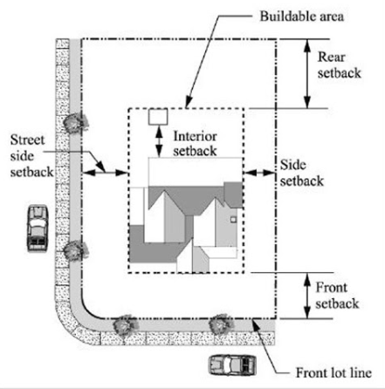
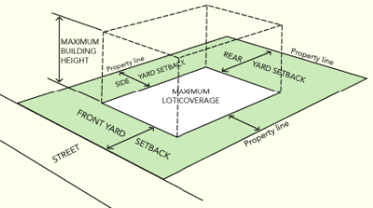
Section C: Zoning & Buildable Area

Slide 28
Section C: Zoning & Buildable Area

Slide 29
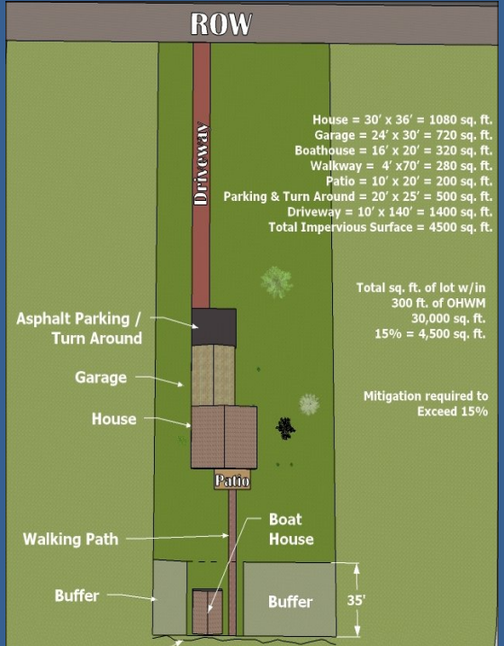
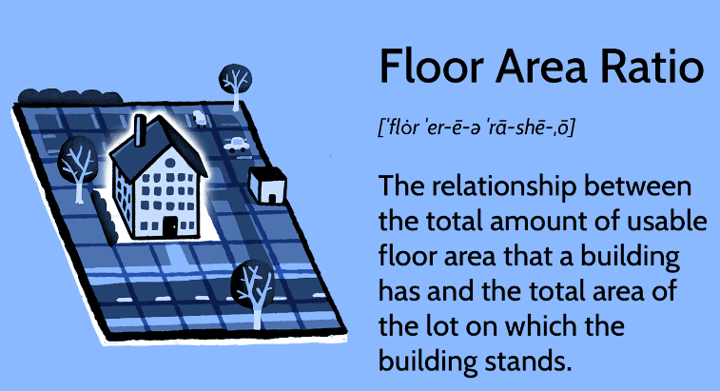
Section C: Zoning & Buildable Area

Slide 30
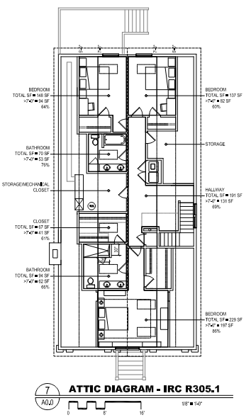
Section C: Zoning & Buildable Area
Attic / New Square Footage

Slide 31
Section C: Zoning & Buildable Area
An accessory structure (without a kitchen) is subject to the following regulations: shall not exceed 20 feet in height, shall not cover more than 25 percent of the area of the rear yard, and shall not contain a total floor area greater than 30 percent of the main structure.
The size of the accessory structure may be increased through BZA action. However it must NOT have a kitchen.
An Accessory Dwelling Unit (with a kitchen) is subject to the following regulations: shall not exceed 20 feet in height and having a floor area of 750 square feet.
The size of an accessory dwelling unity may not be varied by the BZA.
Again, you may apply to the BZA to increase the size of an accessory structure (without a kitchen) if you so choose. However, the size of an accessory dwelling unit cannot be varied.
Feel free to reach out if you have any clarifying questions/concerns.
Regards,
Tamaria Letang, AICP
Project Manager|Development Services Division
City of Atlanta | Office of Zoning and Development
55 Trinity Avenue SW, 3rd FL, Suite 3350 | Atlanta, GA 30303
p: 470.755.1245| e-fax: 404.589.5533 |e: TLetang@atlantaga.gov

Slide 32
Section D: Researching a Property

Slide 33
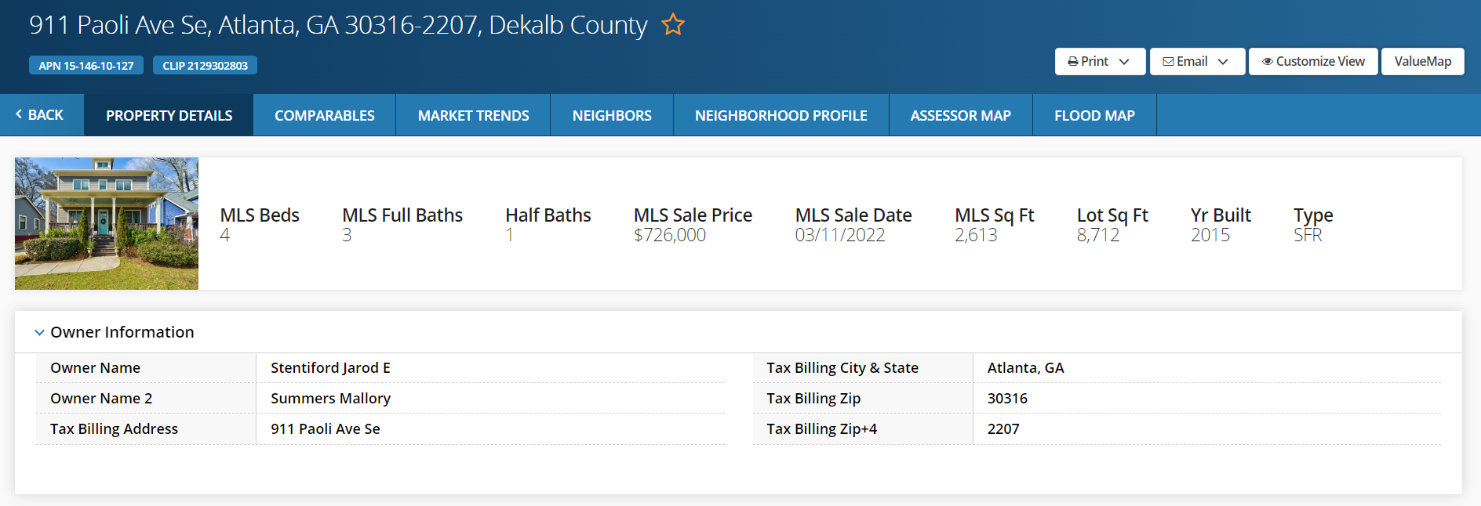
Section D: Researching a Property
Step One | MLS / Realist
Establish address
Jurisdiction, City & County

Slide 34
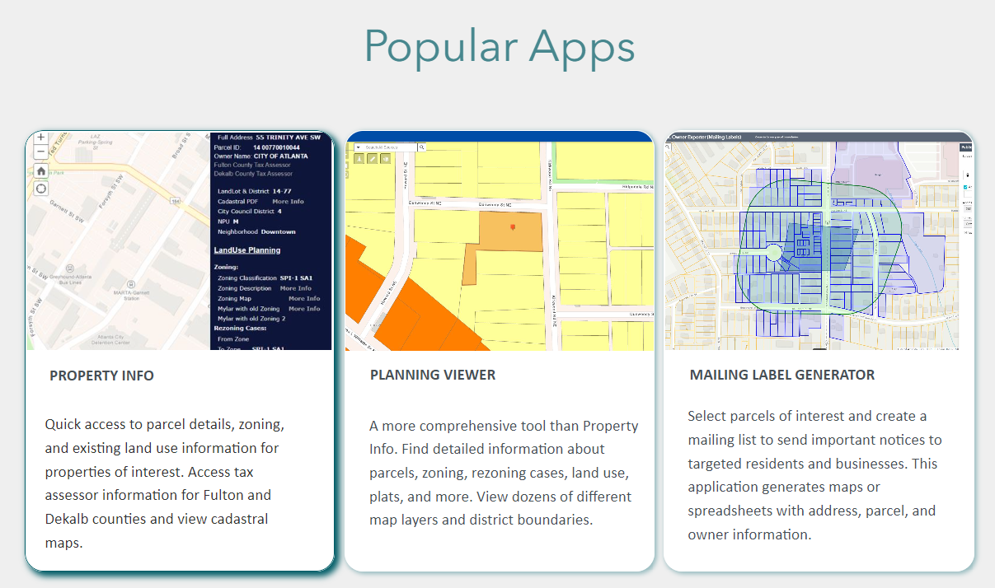
Section D: Researching a Property
gis.atlantaga.gov

Slide 35
Section D: Researching a Property
gis.atlantaga.gov | Establish Zoning

Slide 36
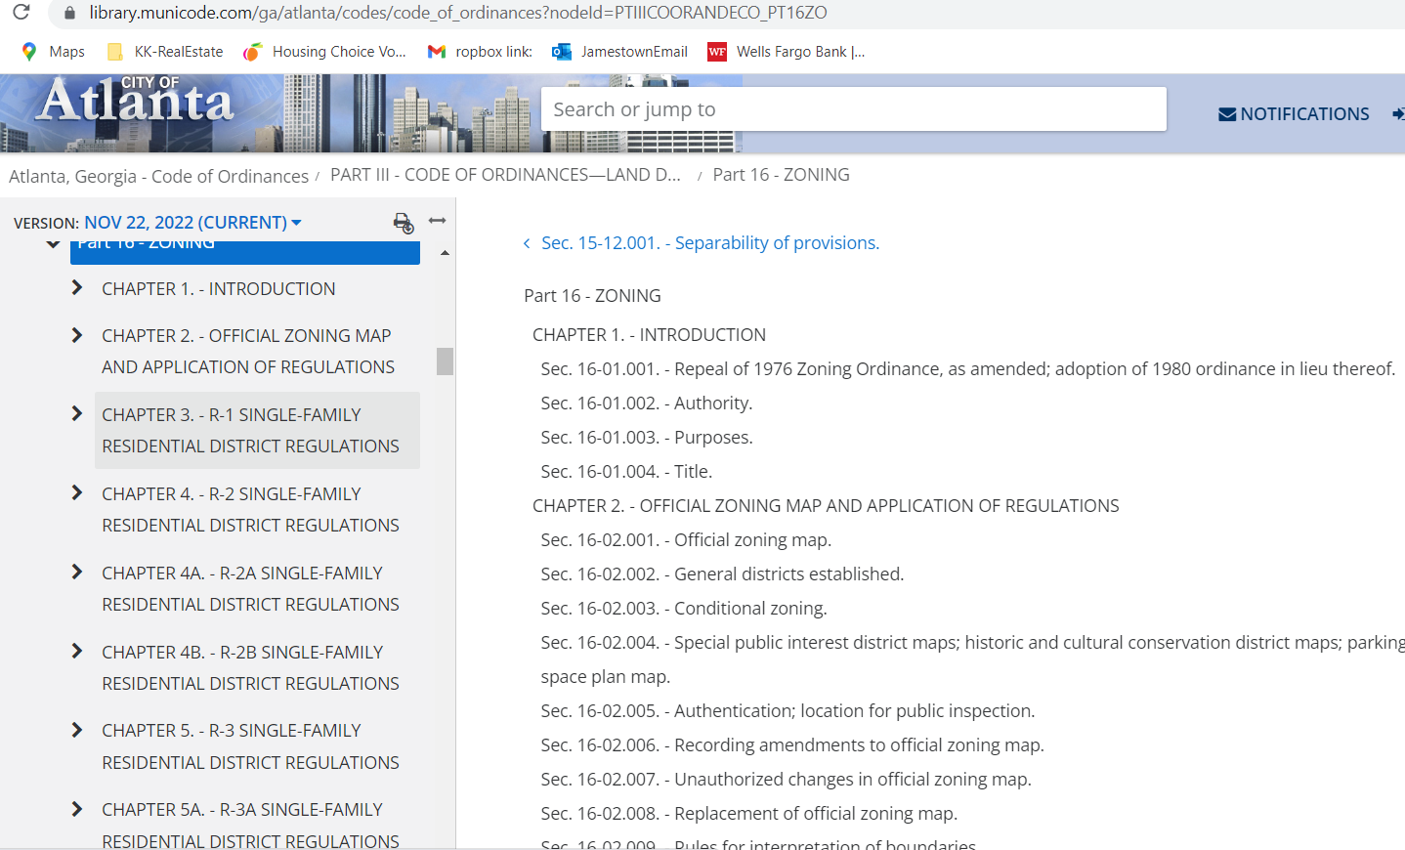
Section D: Researching a Property
Municode.com

Slide 37
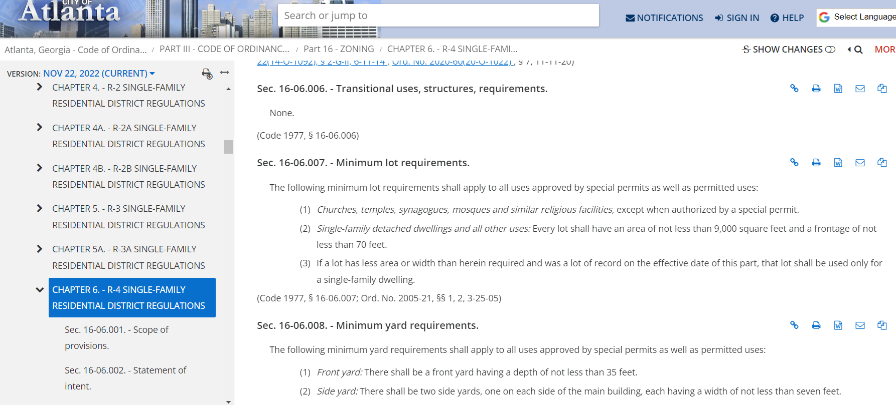
Section D: Researching a Property
Municode.com

Slide 38
Section D: Researching a Property
Atlantaga.gov

Slide 39
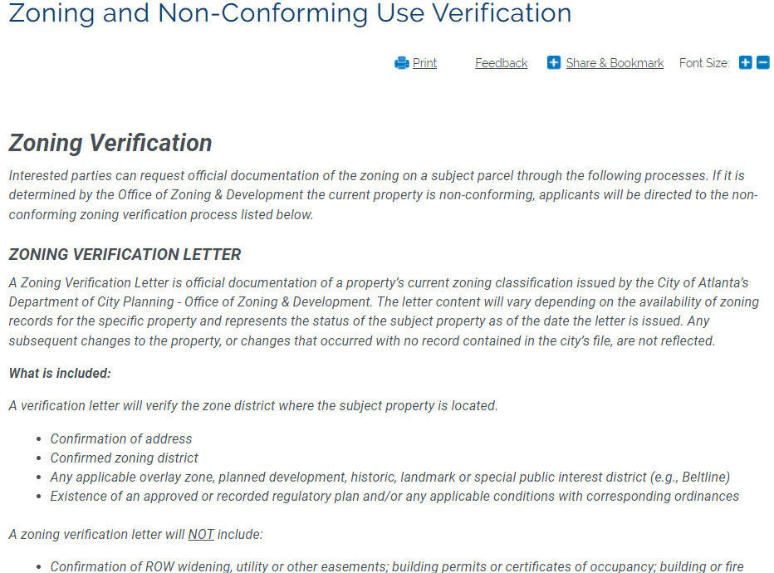
Section D: Researching a Property
Atlantaga.gov

Slide 40
Section D: Researching a Property
PRACTICE POINT: Knowing the zoning classification can be of great importance to your buyer client and even your listings.
If your seller has a property with three units, confirm that the tax card reflects three separate units on the property before listing it as a tri-plex. **Older multi-family properties might have more units than the tax card reflects and than the current zoning allows. If the zoning does not allow the number of units in the property this could affect a buyer’s ability to obtain financing on the property.

Slide 41
Section D: Researching a Property
PRACTICE POINT: Knowing the zoning classification can be of great importance to your buyer client when purchasing raw land to develop .
Confirming your buyer can construct a structure allowed by current zoning ordinances will affect a buyer’s decisions and use of your time! Some lots and neighborhoods have recently been affected by changes to the zoning ordinances. It is possible that the tax card does not reflect the current zoning ordinance. If there is any confusion, you must request confirmation of the zoning
If the zoning is in question, you must provide additional time for clarification. If the seller objects, the buyer can offer up additional earnest money to conduct further investigation.

Slide 42
Section D: Researching a Property
Summary:
At this point you have:
Verified the agency having jurisdiction (city and county)
Confirmed zoning designation
Understand the site limitations
Determine the buildable area

Slide 43
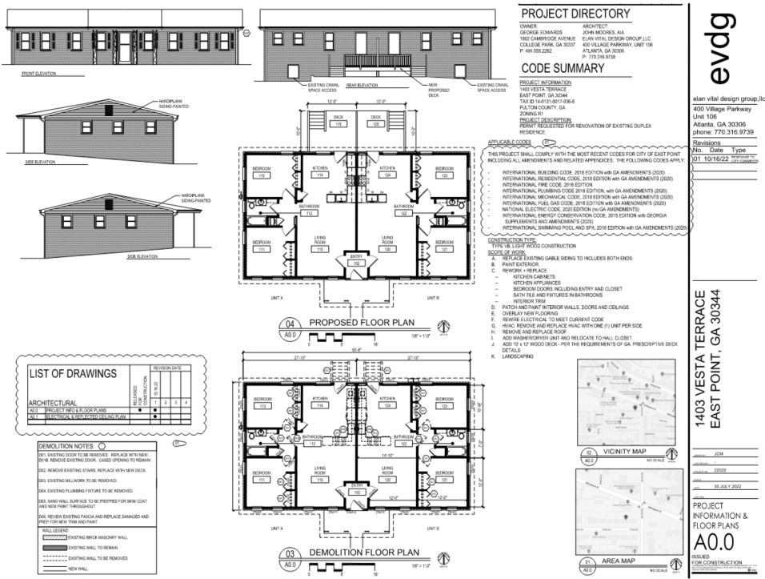
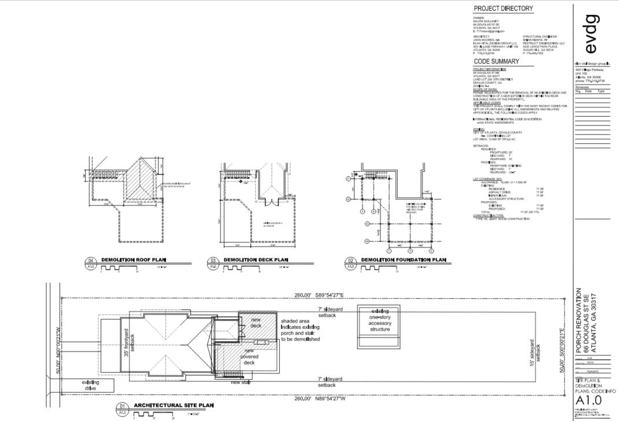
Section E: Applying for a Permit & Resources

Slide 44
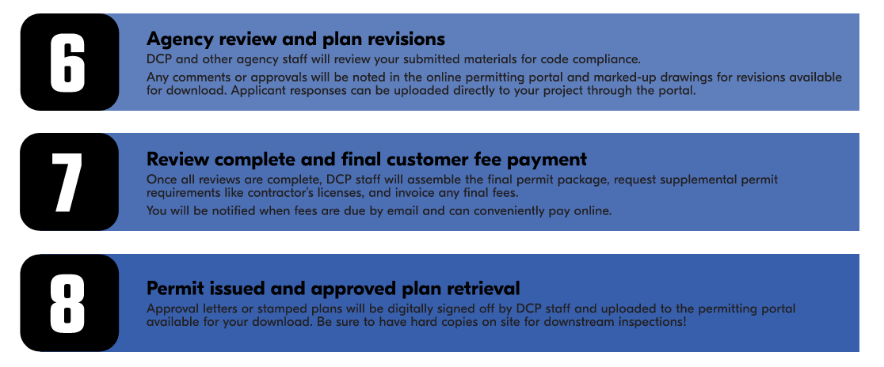
Section E: Applying for a Permit & Resources

Slide 45
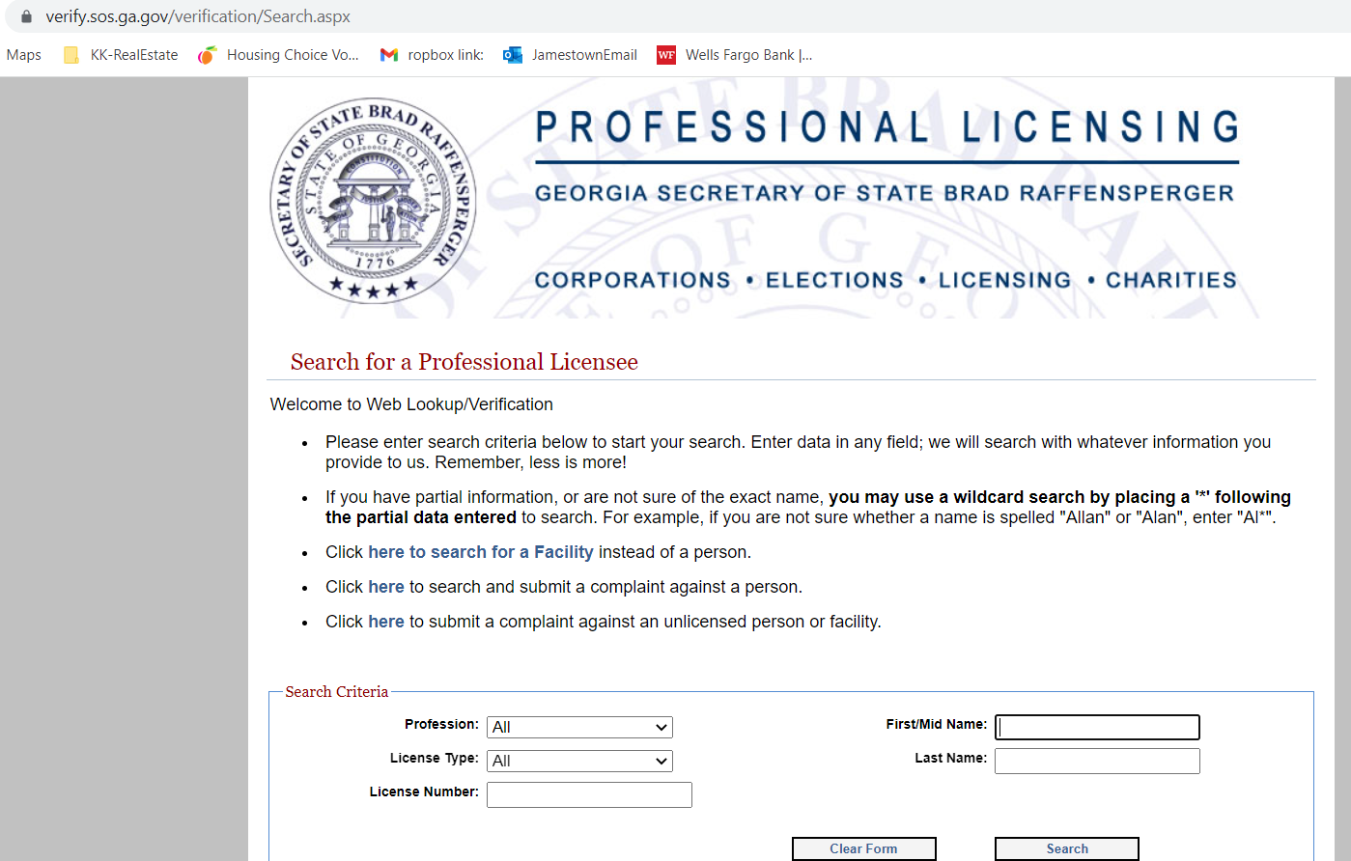
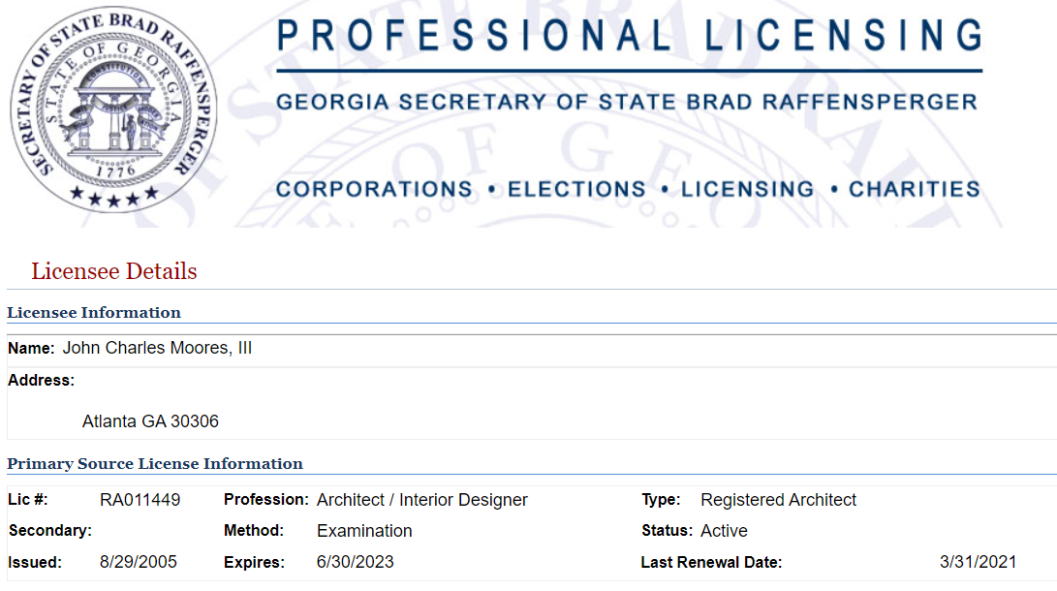
Section E: Applying for a Permit & Resources

Slide 46
Section E: Applying for a Permit & Resources

Slide 47
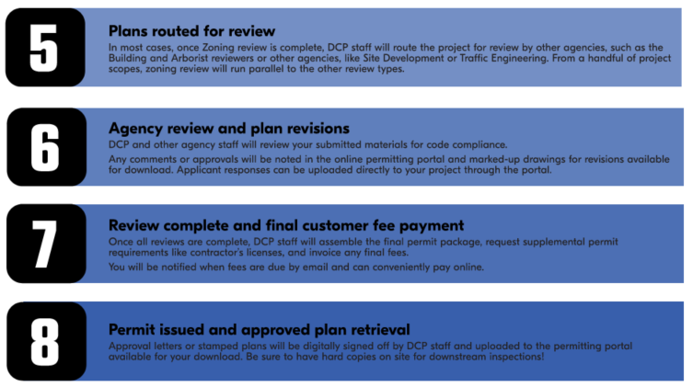
Section E: Applying for a Permit & Resources

Slide 48
Section E: Applying for a Permit & Resources

Slide 49
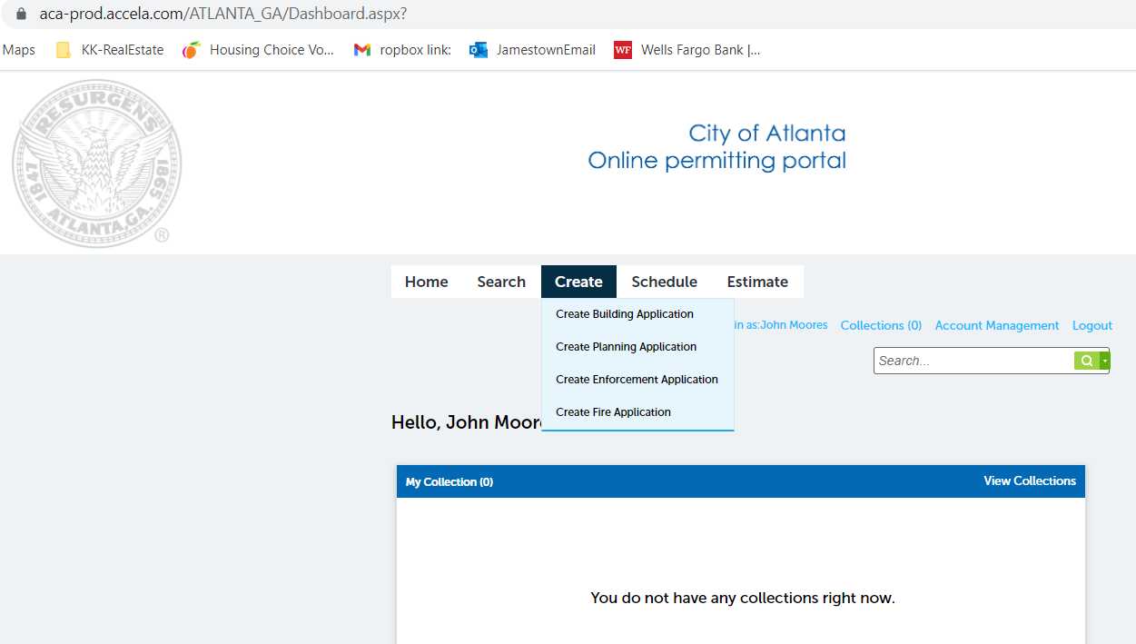
Section E: Applying for a Permit & Resources

Slide 50
Thank you
Questions? attorneys@cb.law
www.campbellandbrannon.com/permitting

