Slide 1
Contracts & Conversations: 2024 GAR Contract Changes and Navigating Difficult Conversations About Commission, Estates, Seller Divorces, and Other Uncomfortable Topics
2024GARCHANGES

Slide 2
Agenda
From the Home tab, click the drop-down next to Layout for various design options
Section 1 – Brochures and Brokerage Agreements
Section 2 – Purchase and Sale Agreements
Section 3 – Exhibits, Addendum, and Stipulations
Section 4 – Navigating Difficult Conversations

Slide 3
Brochures and Brokerage Agreements

Slide 4
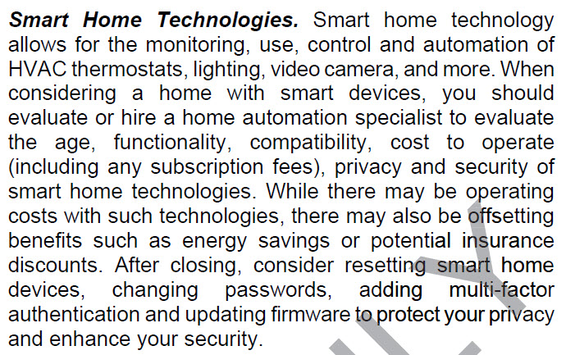
CB13 Protect Yourself When Buying Real Property
New! Added a section on Smart Home Technologies

Slide 5
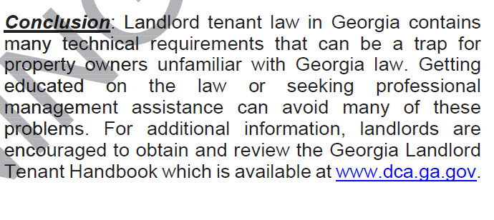
CB31 What New Landlords Need to Know About Leasing Property
New! Added a reference to the Georgia Landlord Tenant Handbook

Slide 6
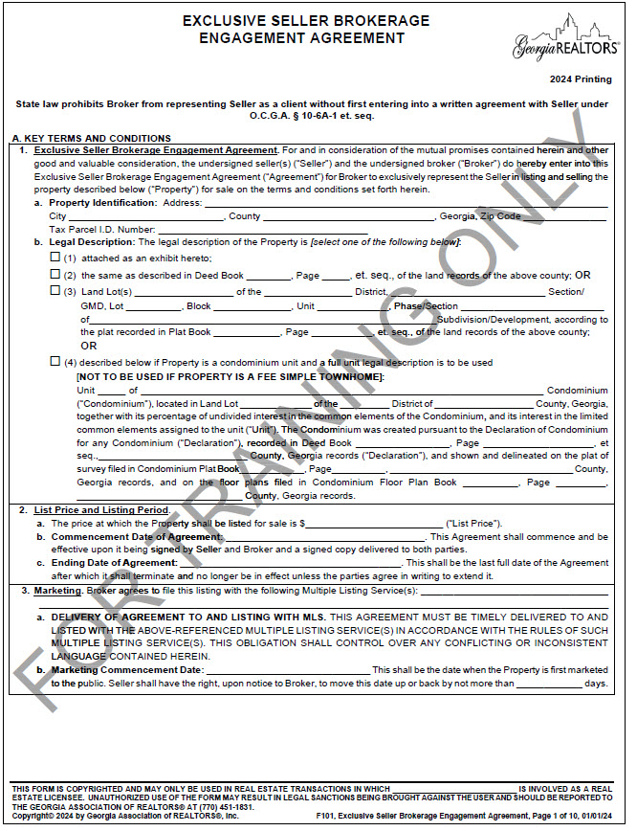
F101 Exclusive Seller Brokerage Engagement Agreement

Slide 7
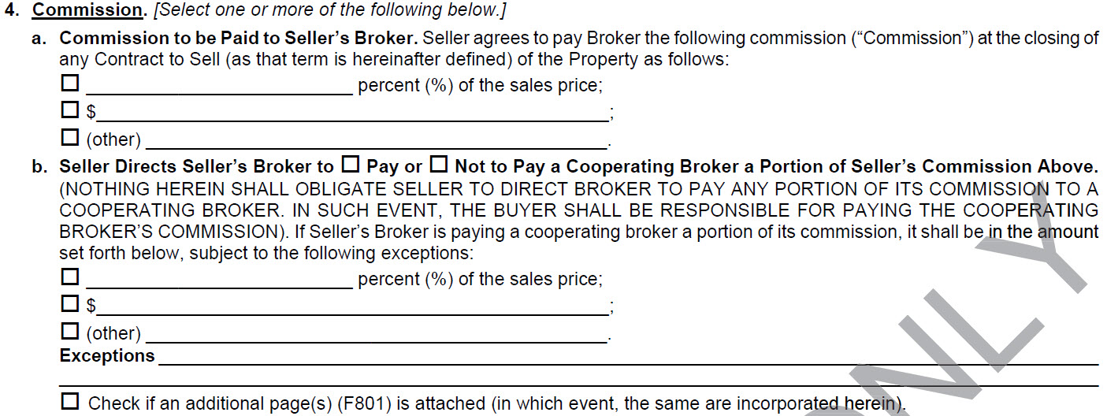
F101 Exclusive Seller Brokerage Engagement Agreement
Section A4 reworded and reformatted
Universal Change: F104

Slide 8
F101 Exclusive Seller Brokerage Engagement Agreement
B4(b) Sharing of Broker’s Commission with Cooperating Broker modified to explain changes in A4
Universal Change: F104

Slide 9
F101 Exclusive Seller Brokerage Engagement Agreement
New! C6(h) FIRPTA Affidavit
Universal Change: F104

Slide 10
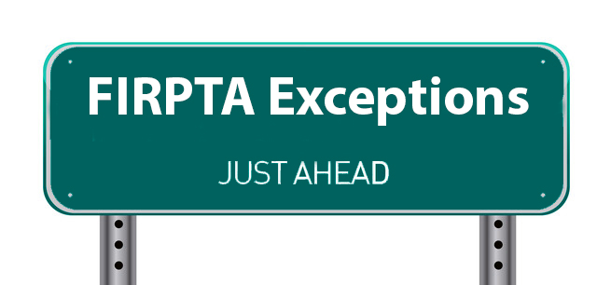
FIRPTA
Practice Tip!
This is a discussion you should have with your Seller BEFORE listing the property.
FIRPTA Solutions can help your client navigate the FIRPTA minefield.

Slide 11
F110 Exclusive Buyer Brokerage Engagement Agreement
A4(a) Capitalized the entire section and changed the last sentence to emphasize that the seller or seller’s broker might not offer commission to the buyer’s broker.
New! A4(e) Commission on Assignment
Universal Change: F113

Slide 12
F110 Exclusive Buyer Brokerage Engagement Agreement
Remember!
The obligation to share commission only exists if there is a prior written agreement between the Brokers or if the commission is offered in an MLS of which both Brokers are members.
B4(a) added language about the Seller’s broker not offering commission
Universal Change: F113

Slide 13
F110 Exclusive Buyer Brokerage Engagement Agreement
New C10 Warning to Buyers regarding identity theft; indemnification; covenant not to sue – Buyer’s agent isn’t responsible for validating the Seller’s identity and Buyer is encouraged to purchase title insurance
Universal Change: F113

Slide 14
F122 Exclusive Leasing Listing Agreement
New! paragraph 3 HAZARDOUS CONDITIONS ON PROPERTY
Remember!
You still must disclose known hazards.

Slide 15
Purchase and Sale Agreements

Slide 16
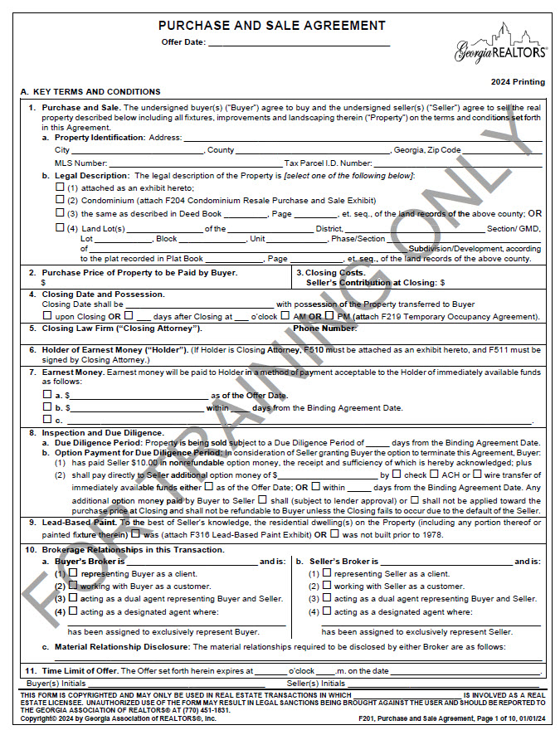
F201 Purchase and Sale Agreement

Slide 17
F201 Purchase and Sale Agreement
A7 Earnest Money removed the options for forms of earnest money payment
B2 Purchase Price to be Paid by Buyer states that “sales price” and “purchase price” as the same
Universal Change: F210, F213, F228, F243

Slide 18
F201 Purchase and Sale Agreement
B4(b) Keys and Openers updated language about community access; and information regarding keys and openers which must be obtained through third-parties
New! B4(c) Devices and Fixtures
Universal Change: F228

Slide 19
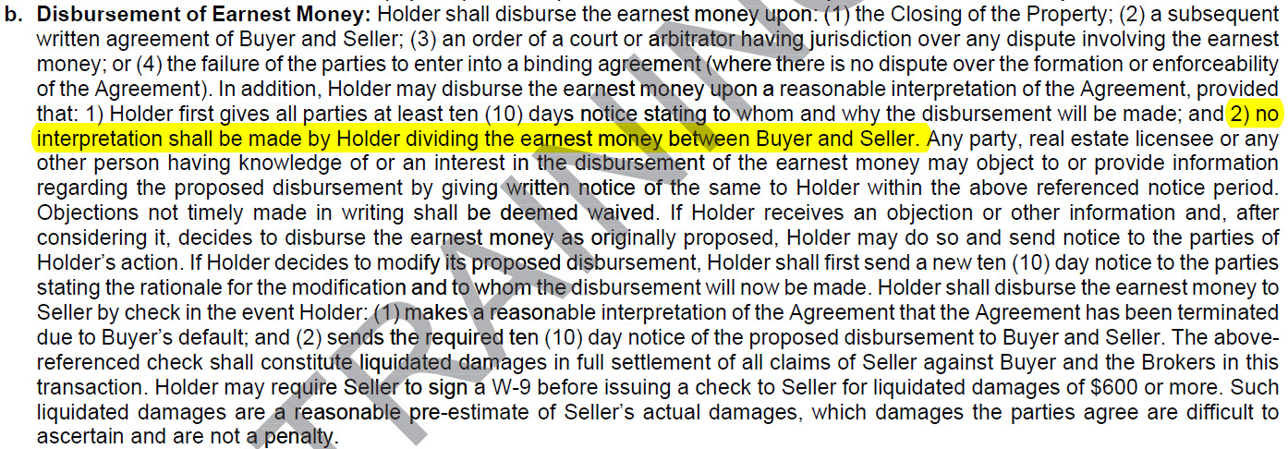
F201 Purchase and Sale Agreement B7(b) Disbursement of Earnest Money added that holder cannot choose to divide the earnest money between Buyer and Seller
Universal Change: F210. F213, F228, F240

Slide 20
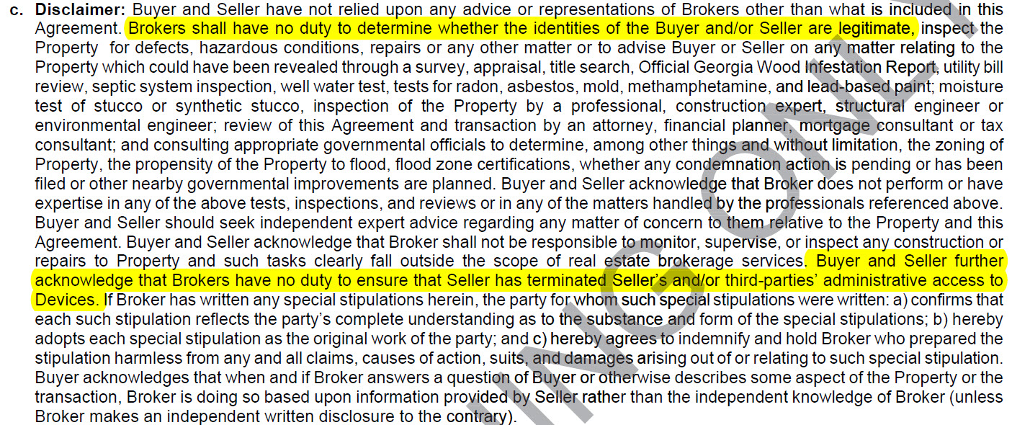
F201 Purchase and Sale Agreement
B10(c) Disclaimer added new language that:
Brokers have no duty to determine if identities of the Buyer/Seller are legitimate; and
Brokers have no duty to ensure that Seller has terminated their access or access by third-parties to the devices remaining in the Property.
Universal Change: F210. F213, F228, F240

Slide 21
F201 Purchase and Sale Agreement
C4(e) Entire Agreement, Modification and Assignment added new language that:
Buyer cannot list the property in an MLS prior to Closing without the written consent of the Seller; and
Assignee is obligated under all the terms of the Assignor’s Assignment (including paying commission).
Universal Change: F210, F213, F228, F240

Slide 22
F201 Purchase and Sale Agreement
C4(m) Rules for Interpreting this Contract
Rephrased number 4 and broke it down into two sections:
Universal Change: F210, F213, F228, F240

Slide 23
F201 Purchase and Sale Agreement
Amendatory Clause
Amendments
Boilerplate Language
Special Stipulations
Handwritten and Initialed Changes
Exhibits and Addenda

Slide 24
F201 Purchase and Sale Agreement
C4(o) Survival of Agreement added additional items that survive closing
Universal Change: F210, F213, F228, F240

Slide 25
F201 Purchase and Sale Agreement
New C5(f) Closing
Universal Change: F210, F213, F228, F240

Slide 26
F201 Purchase and Sale Agreement
New C7. HEIGHTENED IDENTIFICATION PROCEDURES TO HELP PREVENT FRAUD; COVENANT NOT TO SUE
Universal Change: F210, F213, F228, F240

Slide 27
F210 and F213 Lot and Land Purchase and Sale Agreements
Same changes as F201, so what’s different about these sales?
Things we think about:
Houses
Termites, warranties, and encroachments
Improvements
Building or zoning violations
Keys and openers (i.e. possession)
Land & Lots
Zoning, utilities, sewer and water access
Permitting
Environmental Studies
Surveys

Slide 28
Exhibits, Addendums, and Stipulations

Slide 29
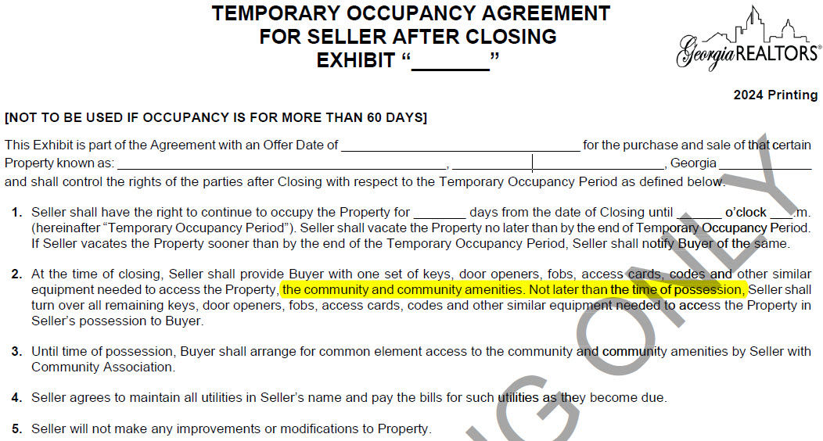
F219 Temporary Occupancy Agreement Exhibit
Updated language in paragraph 2

Slide 30
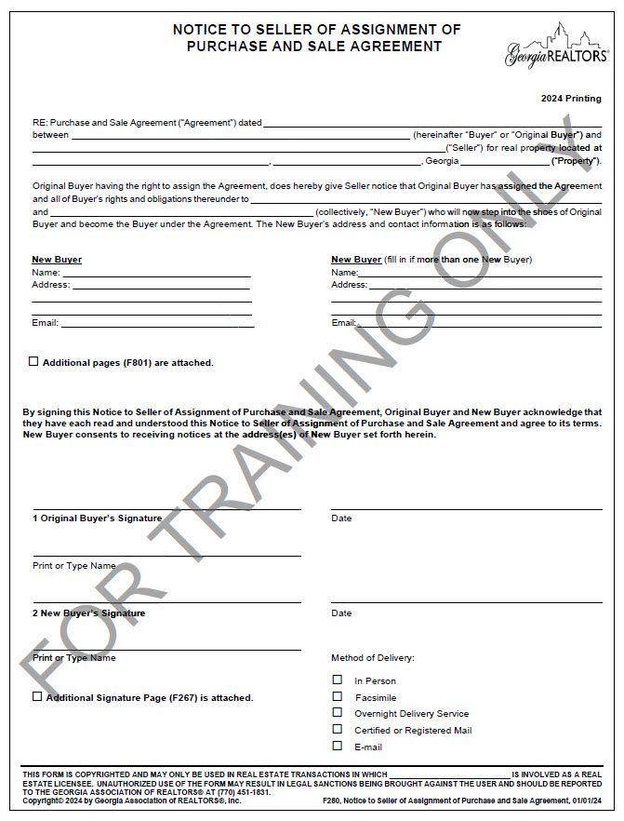
F280 Notice to Seller of Assignment of Purchase and Sale Agreement
New Form!

Slide 31
F290 Agreement to Reinstate Contract
Defined “Reinstatement Date”
New paragraph 4 regarding earnest money

Slide 32
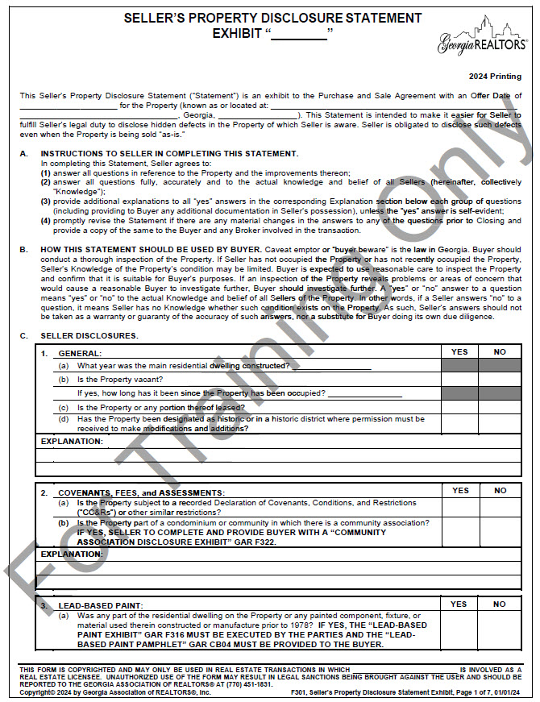
F301 Seller’s Property Disclosure Exhibit

Slide 33
F301 Seller’s Property Disclosure Exhibit
B. How this Statement Should be Used By Buyer clarified how Buyers should interpret “No” answers
Universal Change: F304, F307, F310

Slide 34
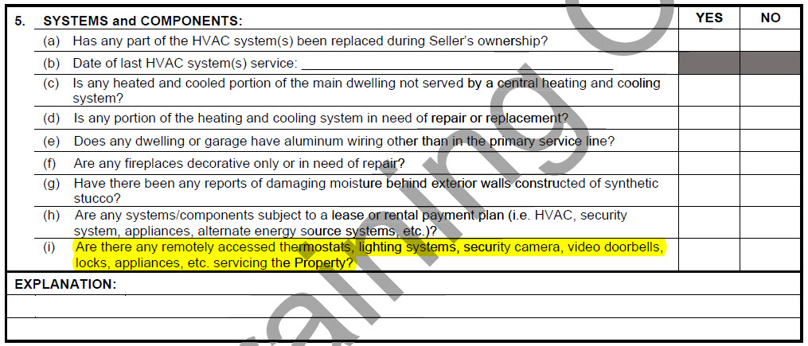
F301 Seller’s Property Disclosure Exhibit
C5. Systems and Components new subsection
Universal Change: F304

Slide 35
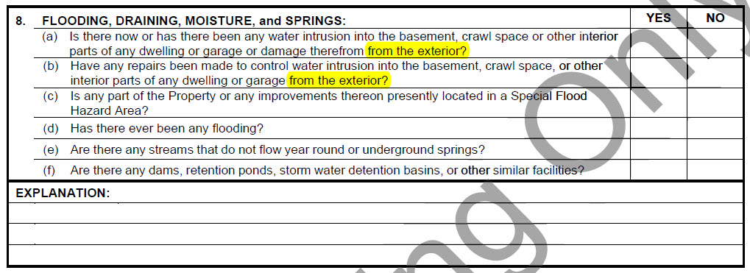
F301 Seller’s Property Disclosure Exhibit
C8. Flooding, Draining, Moisture, and Springs clarifies that these questions pertain to moisture from outside

Slide 36
F301 Seller’s Property Disclosure Exhibit
C9. questions removed and rephrased
Universal Change: F304, F307, F310

Slide 37
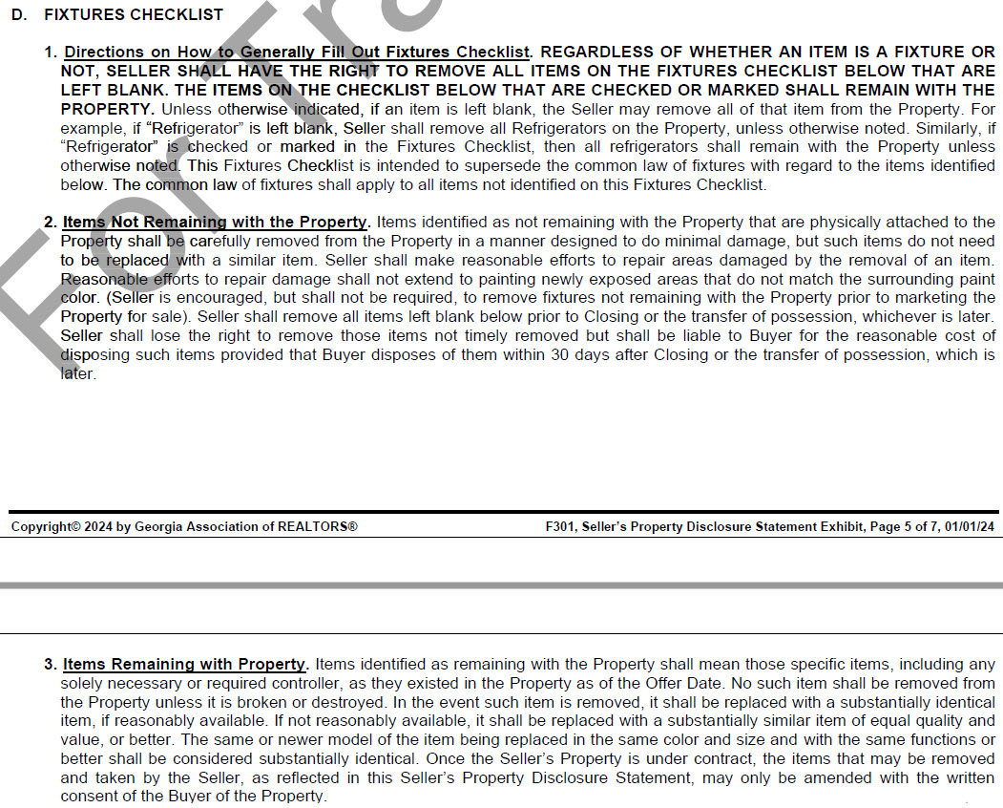
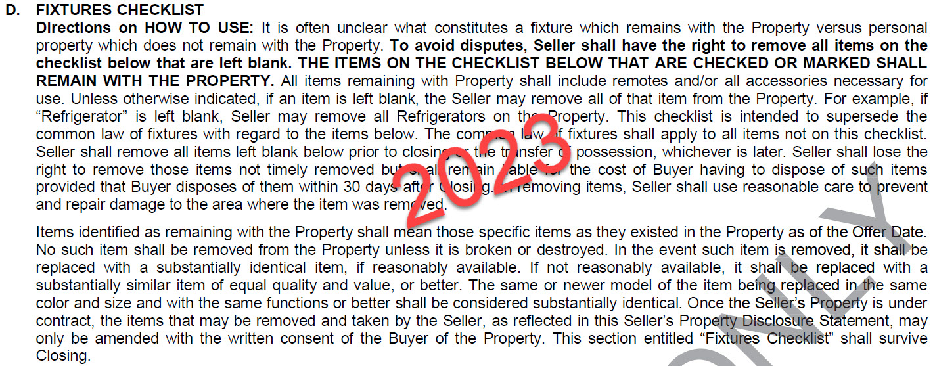
F301 Seller’s Property Disclosure Exhibit
D. Fixtures Checklist the instructions are broken down into three sections
Universal Change: F302, F304

Slide 38
F301 Seller’s Property Disclosure Exhibit
No new items added to the checklist
“Stove” is now “Range”
Practice Tip!
The checklist doesn’t encompass the components of a “smart home” system. If any of the smart home components are remaining, be specific about which components will remain.
Universal Change: F302, F304

Slide 39
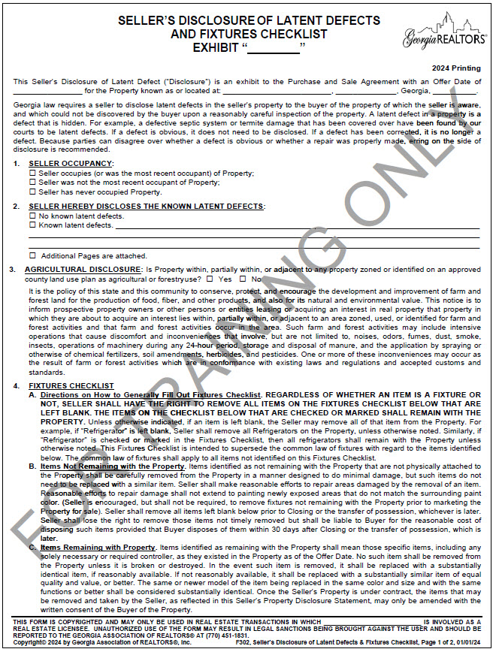
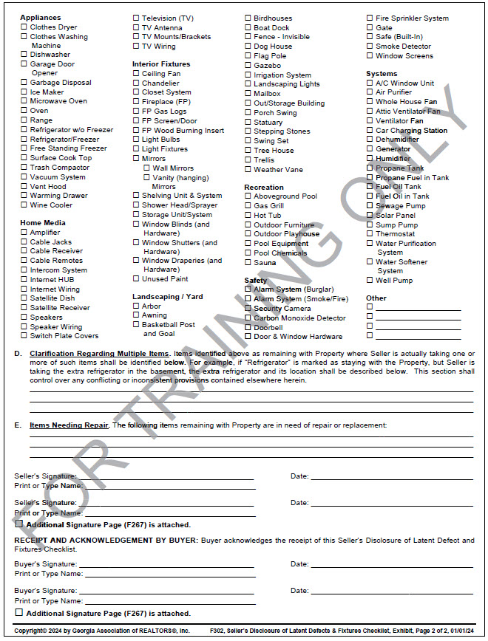
F302 Seller’s Disclosure of Latent Defects and Fixtures Checklist Exhibit
Practice Tip!
If your seller isn’t willing to sign the FG301 or doesn’t have the knowledge necessary to complete it, use F302 instead. F302 provides a place to disclose latent defects and provides a fixtures checklist.

Slide 40
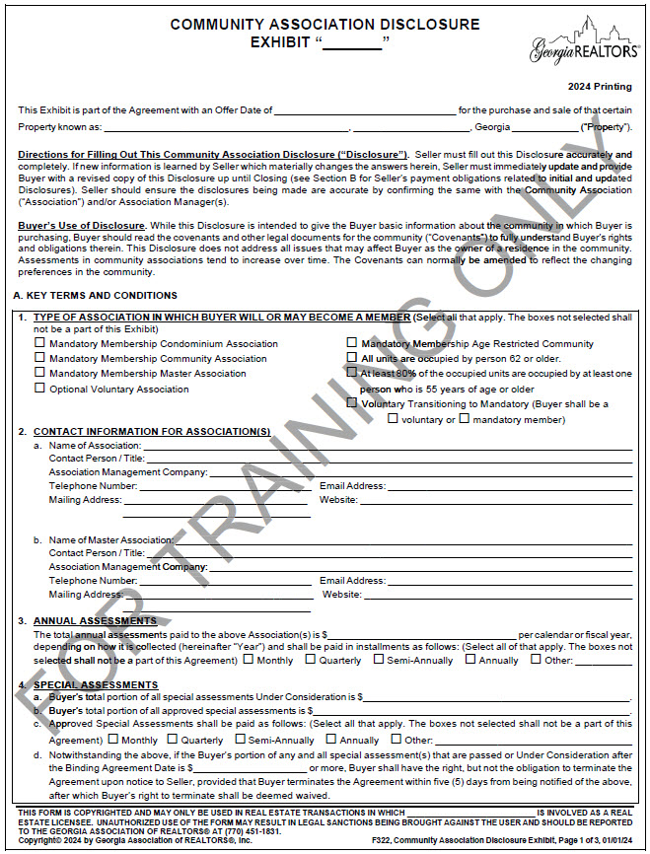
F322 Community Association Disclosure Exhibit

Slide 41
F322 Community Association Disclosure Exhibit
A3. is now titled Annual Assessments and the association “Year” is defined

Slide 42
F322 Community Association Disclosure Exhibit
A6. was previously titled “Utility Expenses”, it is now titled Other Association Expenses

Slide 43
F322 Community Association Disclosure Exhibit
B3. Assessments new language that Seller pays for the assessments that were not disclosed for the Year that the property was contracted to be sold. Note that “Year” is referencing the definition in A3.

Slide 44
F322 Community Association Disclosure Exhibit
Special Assessments
B4(a) Under Consideration added a reminder that there is no obligation to disclose possible special assessments if they do not yet meet the definition of “under consideration”
B4(c) retitled Seller Pays for Undisclosed Special Assessments
Even if the special assessment is due in installments and it is properly disclosed, an HOA may accelerate the payments when the property is sold. In that case, the Seller pays the total balance.

Slide 45
Tips for Completing the CAD
Have your sellers call their management company before listing to get a copy of ALL fees paid at closing – if they don’t ask for all fees management companies will often only quote them the cost of the letter.
NEVER leave the Transfer, Initiation, and Administrative Fees section blank.
It is never a bad idea to pad the amount disclosed
If you ever had any violations on the property, even if they have been fixed, make sure they were actually closed out with the management company!

Slide 46
F404 Conventional Loan Contingency Exhibit
The “Source of Loan” checkbox was removed.

Slide 47
F404 Conventional Loan Contingency Exhibit
“Lender” is not a defined term in the exhibit. “Lender was corrected to “lender”. The appraisal can be ordered by any lender – it does not have to be from one of the approved mortgage lenders.
Remember!
A loan denial letter must be from one of the Approved Mortgage Lenders.
The appraisal can be ordered by any lender.
Clarifies what happens if Buyer does not seek a reduction in sales price.

Slide 48
F407 FHA Loan Contingency Exhibit
New paragraph 13. Further Agreement Pertaining to Amendatory Clause creates a timeline for Seller to agree to the reduced purchase price.

Slide 49
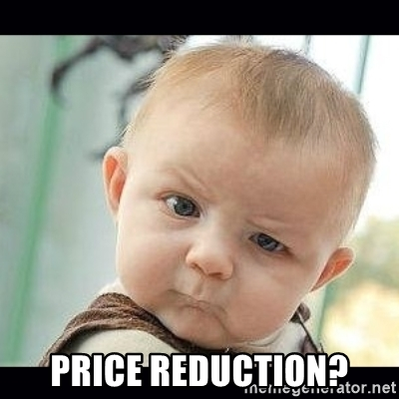
F407 FHA Loan Contingency Exhibit
Remember the reduction in sales price doesn’t happen automatically – an amendment must be signed. The Seller isn’t required to accept the lower price!

Slide 50
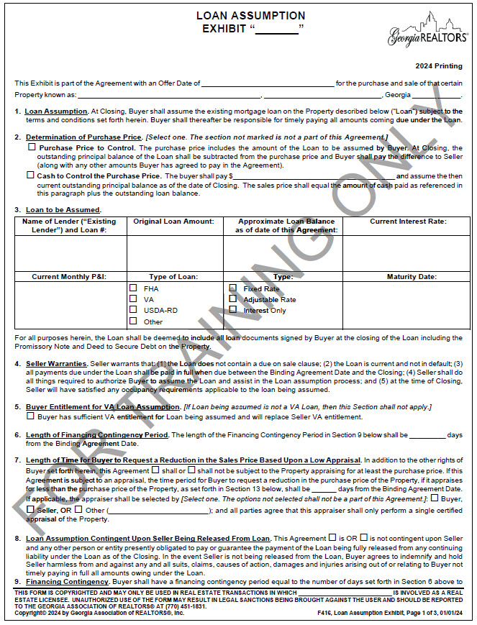
F416 Loan Assumption Exhibit
Since you can’t assume a conventional mortgage, “conventional” was removed as one of the loan type options.
Overhauled the exhibit to be in line with changes made to the other financing exhibits over the last few years.

Slide 51
F601 Sale or Lease of Buyer’s Property Contingency Exhibit
Paragraph 3 added the option for the contingency to run through the Closing Date of the Agreement.

Slide 52
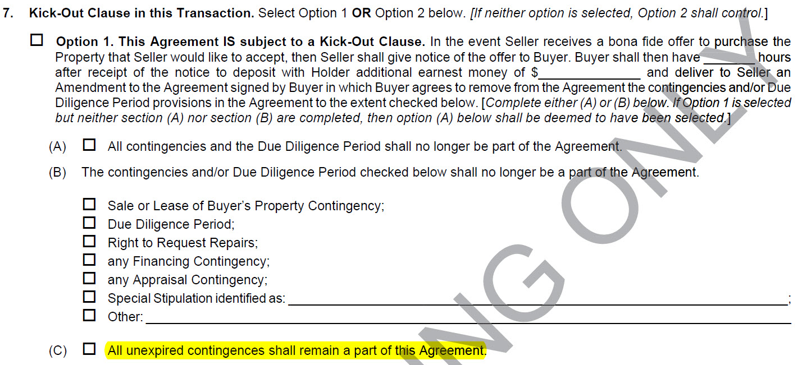
F601 Sale or Lease of Buyer’s Property Contingency Exhibit
Paragraph 7 added option (C) allowing all unexpired contingencies to remain.

Slide 53
Special Stipulations

Slide 54
Special Stipulations

Slide 55
Special Stipulations

Slide 56
Corporate Transparency Act
Who?
Corporations, LLCs, and any other entity created by filing with a secretary of state.
What?
Companies must report beneficial ownership information about: 1) individuals who own 25% or more of their company; or 2) individuals who directly or indirectly exercise substantial control of the company.
When?
All companies registered to do business prior to 2024 must register before January 1, 2025.
Companies created in 2024 must register within 90 days.
Companies created after 2024 will have 30 days to register.
Where? How?
Information must be reported to the Financial Crimes Enforcement Network (FinCEN) through the filing system on their website.
New law passed in 2021 creates a beneficial ownership information reporting requirement.
This is the Federal government’s effort stop money laundering, financial crimes, shell companies, etc.
Information is stored in a secure non-public database accessible only to Federal, State, local, and foreign government officials.

Slide 57
What is substantial control?
Senior officers ( President, CEO, CFO, COO, general counsel, etc.)
Individuals with authority to appoint or remove officers or the majority of directors
Individual is an important decision maker regarding the company’s business, finances, or structure
Individuals with any other substantial control

Slide 58
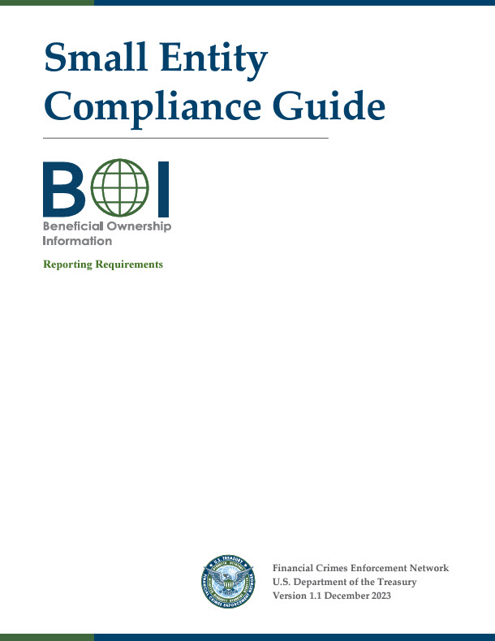
Beneficial Ownership Interest Reporting
What does this mean for you?
You will need to register your companies with FinCEN.
Your clients will also need to register their companies.
What if I want to stay anonymous?
The BOI reporting is not publicly available. You can report your BOI while remaining anonymous to the general public.
The only publicly available information is through your registration with the secretary of state.
The Small Entity Compliance Guide is available online: https://www.fincen.gov/sites/default/files/shared/BOI_Small_Compliance_Guide.v1.1-FINAL.pdf

Slide 59
Navigating Difficult Conversations

Slide 61
Questions?
Attorneys@CampbellandBrannon.com
or
Attorneys@CB.Law

