Slide 1

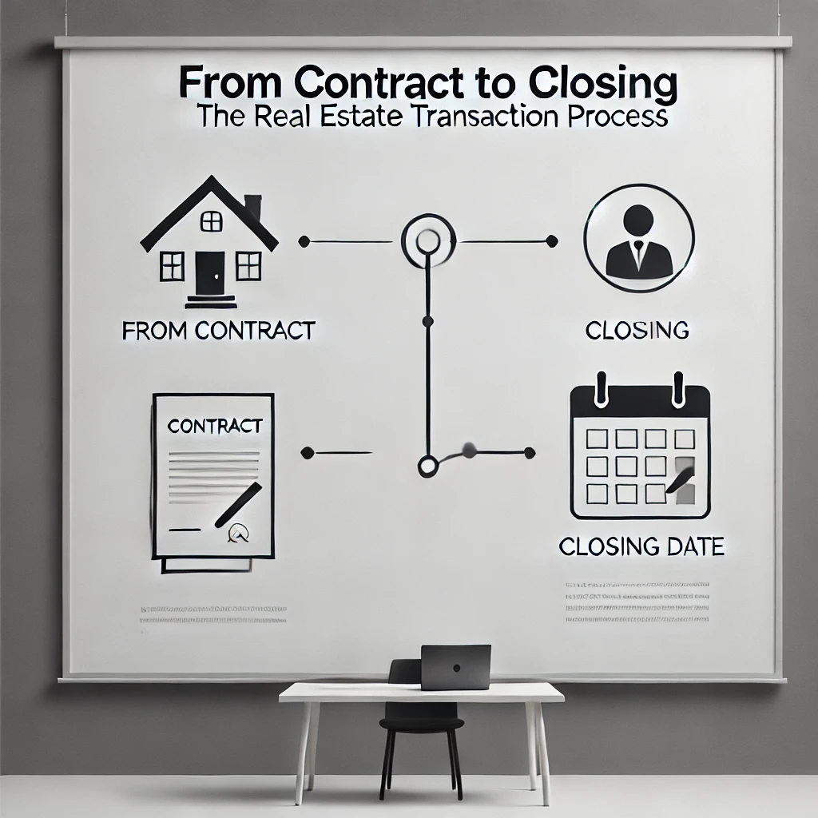
Contract to Close
3 Hour Continuing Education Class
Presented by: Campbell & Brannon

Slide 2
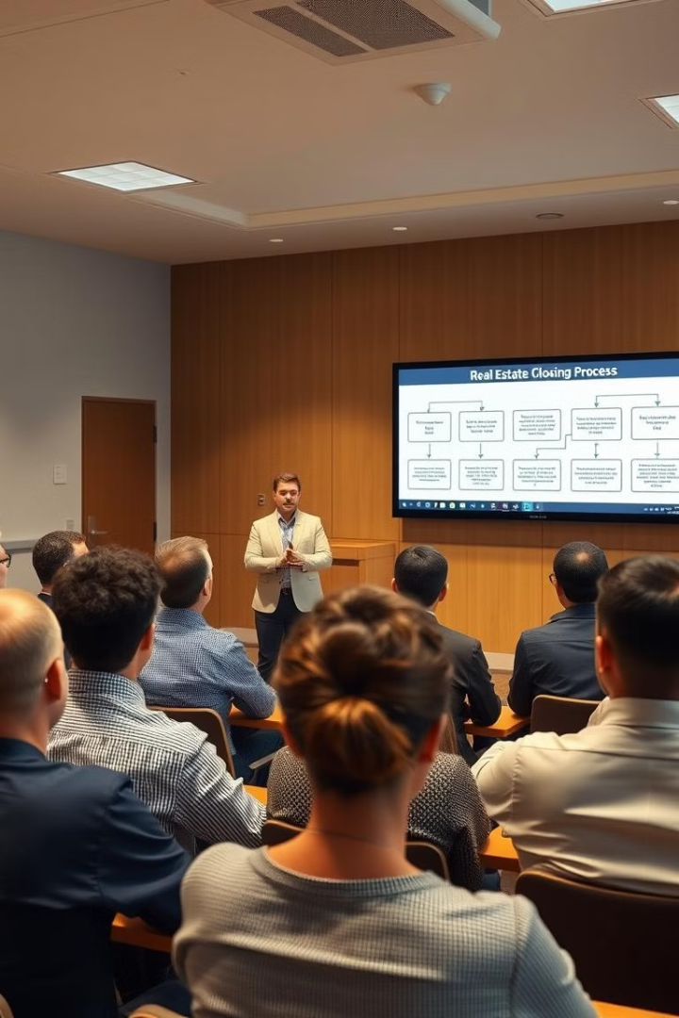



Overview of Today's Class
Behind the Scenes Look
Take a behind the scenes look at the closing process
Team Member Roles
Explore the role of each Campbell & Brannon team member
Process and Procedures
Give insight into our process, procedures, and everything we need for a seamless closing experience

Slide 3
Contacting C&B Team Members
First initial and Last name @cb.law
i.e. John Smith – jsmith@cb.law
Do not include .com after .law!
www.cb.law
www.campbellandbannon.com

Slide 4



Who Makes Up the C&B Team?
Core Team Members
Legal and Financial Experts
Extended Team
File Intake
Title Examiner
Title Curative
Pre-Closer
Closer
Attorney
Funder/Disburser
Recorder/Post Closer
And many many more!

Slide 5
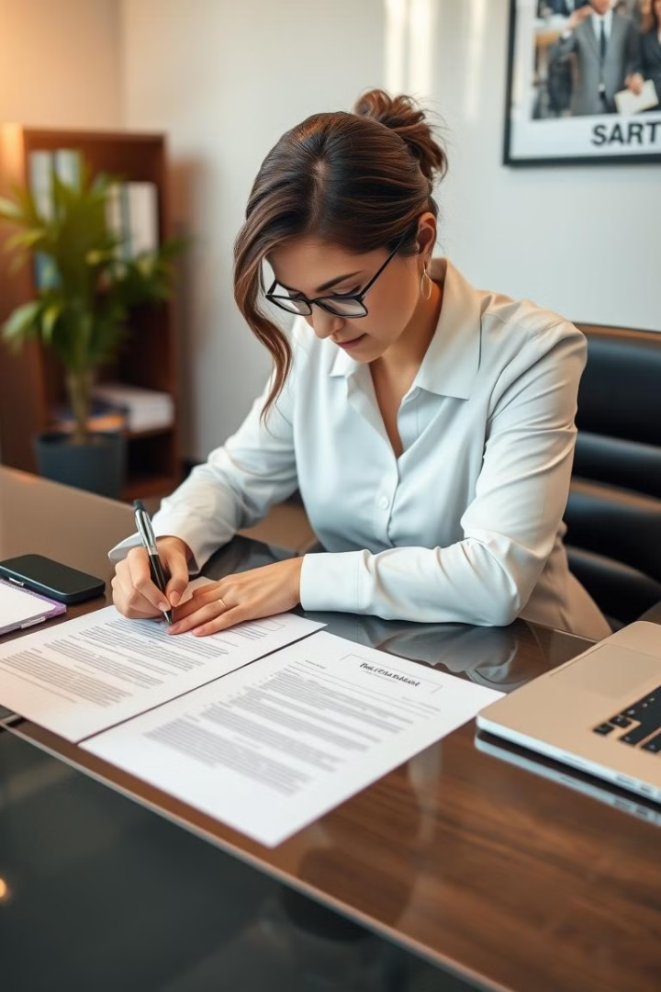
Before Writing Your Contract
Reach Out to C&B
In some cases you should reach out to C&B prior to writing your contract:
Request a legal description – attorneys@cb.law
Confirm ownership! Who needs to sign your listing agreement and contract?
Special stipulations
Why Contact C&B?
Contacting C&B before writing your contract can help ensure accuracy and completeness in your documentation, potentially avoiding issues later in the process.

Slide 6

Red Flags
The faster we know about these red flags the smoother the transaction will be.
Pre-Foreclosure
Divorce
Bankruptcy
Short Sale
Property Liens
Death

Slide 7
File Intake
Send us your contract immediately! We begin working on it right away even if due diligence hasn't ended. Some issues will take several weeks to clear so we need to get started ASAP. Do not wait until after due diligence to submit the contract!
buckorders@cb.law -- Buckhead
alphorders@cb.law -- Alpharetta
cobborders@cb.law –Marietta West and East Cobb
intownorders@cb.law -- Intown
glenorders@cb.law -- Glenridge
woodorders@cb.law – Woodstock
sugarloaforders@cb.law – Sugarloaf
braseltonorders@cb.law – Braselton
northgaorders@cb.law – North GA
oconeeorders@cb.law – Oconee
orders@cb.law –not sure where to send it?

Slide 8
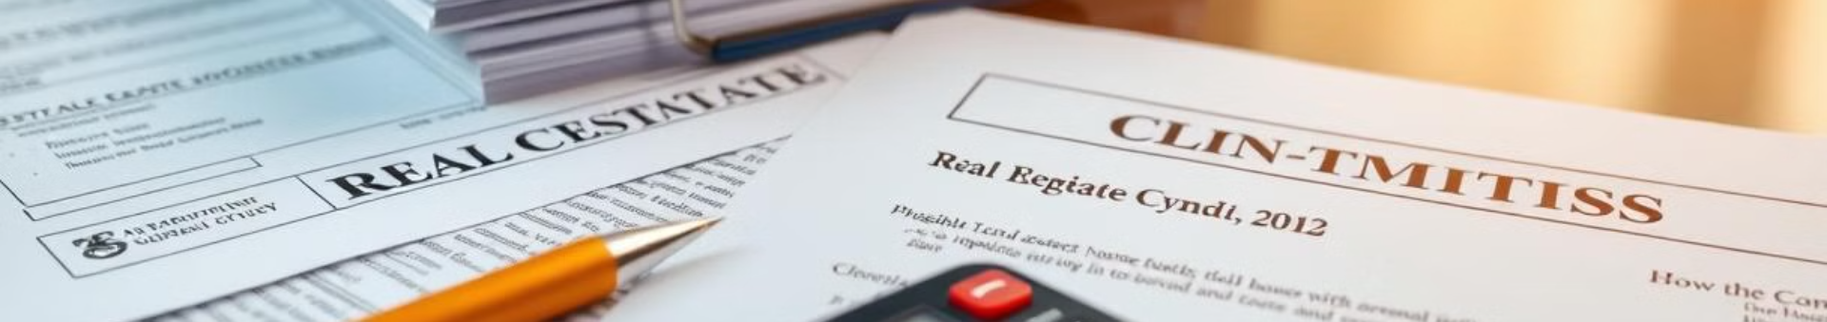
What to Send with Your Contract
Contract and Contact Information
Additional Documents
Full contract and all exhibits, including the counteroffer
Buyer and Sellers email address and phone number
Lender contact
Any extra documents specific to this transaction
Estate documents, divorce settlement agreements, corporate documents, trust agreements, death certificates
Survey Information
Other Important Details
Is the buyer ordering a survey? If so, from whom?
Copy of seller's survey
Termite information

Slide 9
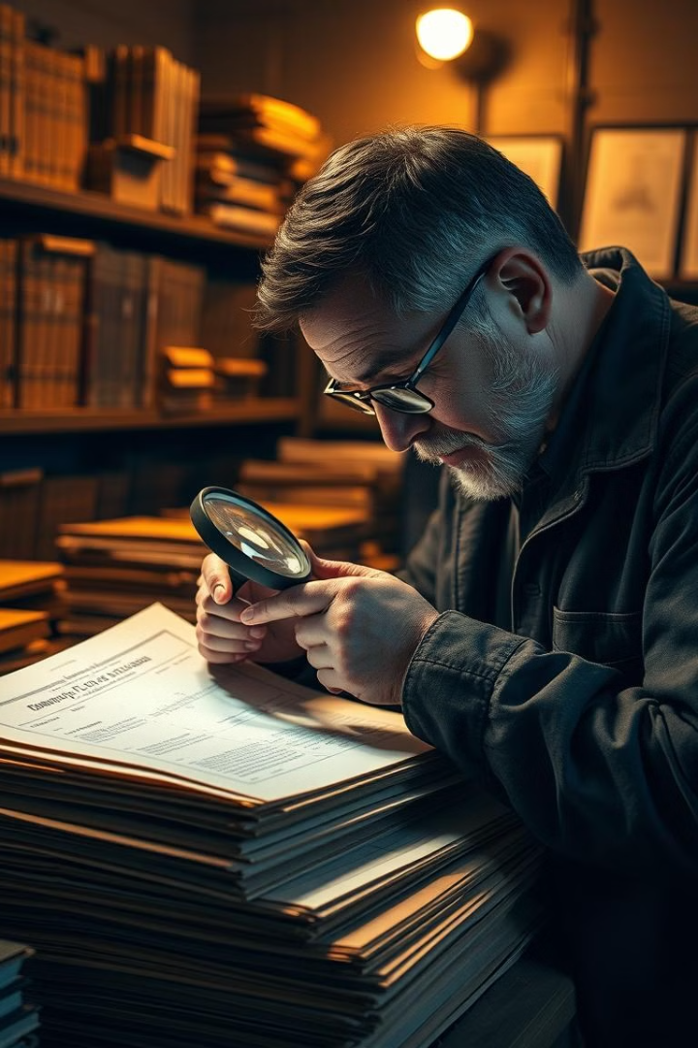
Title Exam Overview
The title examiner searches for all documents related to the property that were recorded in the county records for the last 50 years!
The goal is to uncover all relevant matters in the chain of title so we can insure good and marketable title!

Slide 10
Title Exam Details
Property Information
Financial and Legal Aspects
A title exam will show:
The prior owner's open loans and liens
Ownership
Materialman liens
Open loans
If the property is part of a mandatory HOA
Boundary agreements
IRS liens
Driveway agreements
GA Department of Revenue liens
Encroachment agreements
Property tax liens
Easements
Pending litigation
Missing interests
And more!

Slide 11



Property Tax Report
Tax Information
Tax Status
Confirms the tax parcel ID
Insures there is no outstanding tax bills
Confirms the size and dimensions of the parcel
Lists exemptions currently in place
Shows the most recently paid tax bill
Alerts of any pending tax appeals

Slide 12
Title Exam and Tax Reports
The time it takes to complete a title exam depends on a variety of factors
Where is the property located?
How big is it?
Is it a platted subdivision or acreage?
Does the the county have COVID restrictions in place limiting access to the deed records?
If you know there are special circumstances or have a closing date that is in less than 15 business days, please alert us so we can order the title exam as a rush file.

Slide 13

Pre-Closing: Introductory Email to Buyer
Pre-closing Introductory Email to Buyer

Slide 14
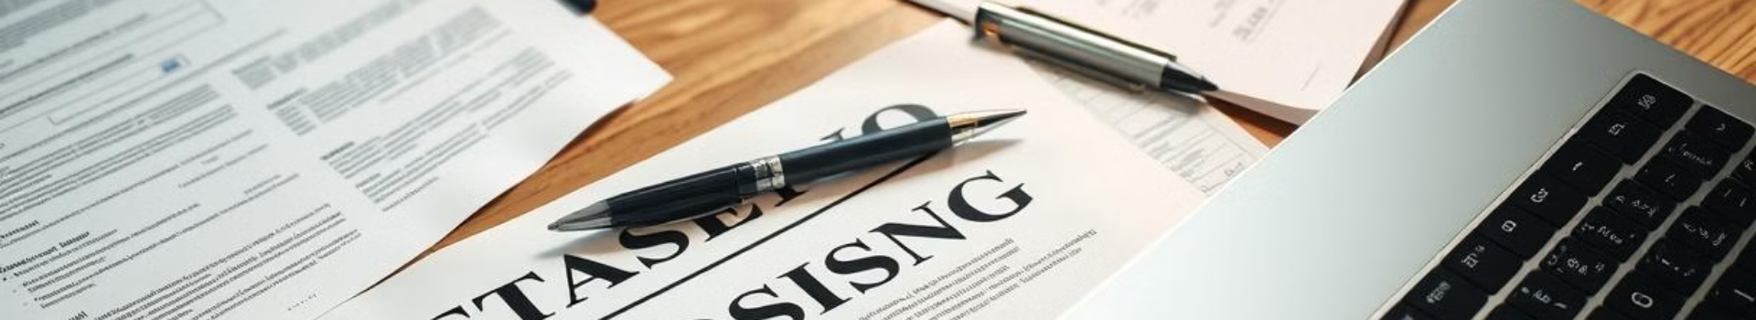
Pre-Closing: Buyer Questionnaire
Essential Information
Personal Details
Street address of property
Buyers' names and contact information
Anticipated closing date
Copy of their photo ID
Do you plan on attending closing?
We encourage all buyers to attend closing personally
This information helps us draft their documents correctly and send wire instructions:

Slide 15
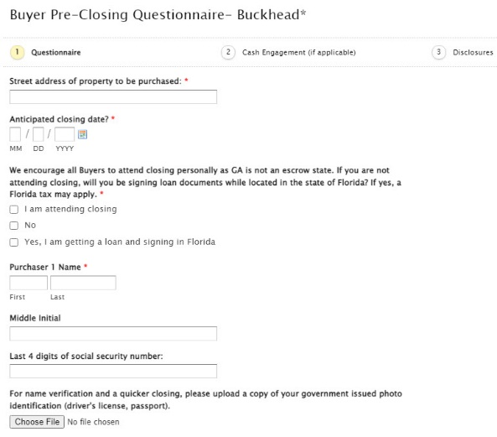
Pre-Closing – Buyer Questionnaire
Buyer Questionnaire: Continued from previous slide
Additional questions for buyers to complete
Important information gathering for closing process
Ensures all necessary details are collected

Slide 16
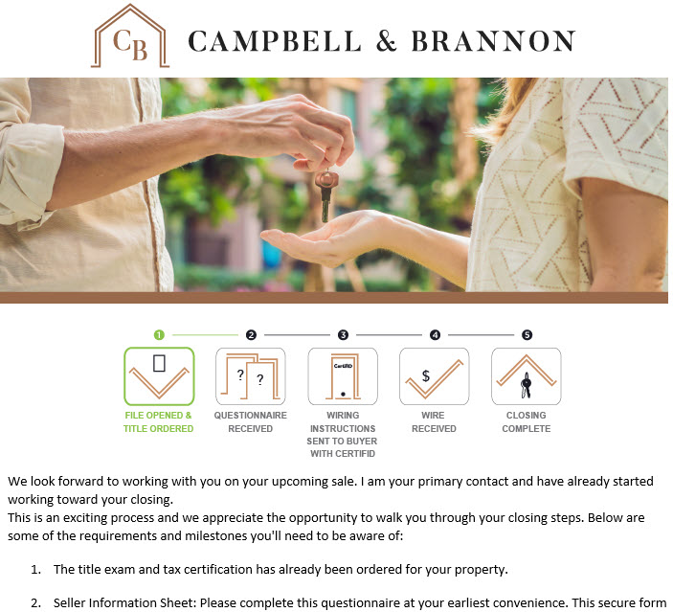
Pre-Closing: Introductory Email to Seller
Pre-closing Introductory Email to Seller

Slide 17
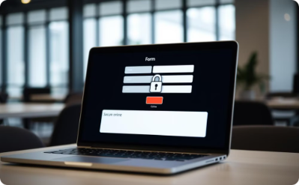

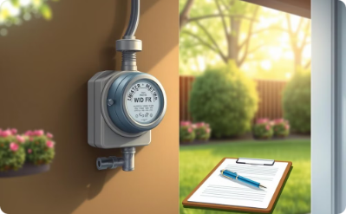
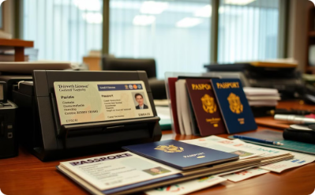
Pre-Closing – Seller Questionnaire
Our secure website allows you to quickly and safely submit information necessary for us to complete your sale.
You will need the following to complete it:
For security purposes this has to be submitted in one sitting – please complete it as soon as possible to avoid any closing delays!
Secure Online Submission
HOA Information
Utility Details
Identification
HOA contact info
Water company information
Sellers' IDs
Copy of your mortgage statement and full loan number

Slide 18
Pre-Closing – Seller Questionnaire: Water Service
Water Bill Payment Options
Additional Options
Who do you pay your water bill through?
Fulton County
Cobb County
Paid through Homeowner's Association?
City of Roswell, Milton or Alpharetta
City of Atlanta Dept. of Watershed Management - Please note: City of Atlanta requires prepayment to process, this will be collected at closing
Gwinnett County
Others

Slide 19
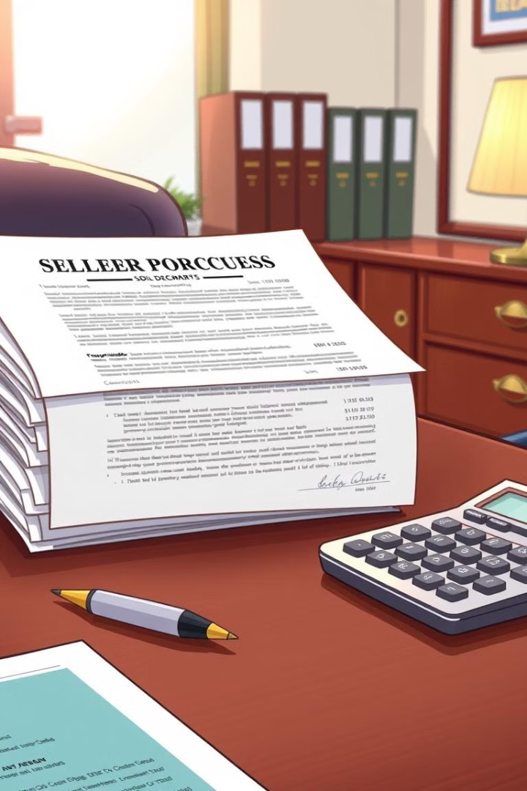
Seller Questionnaire: Seller Proceeds
Wire Authorization Form
If we do not receive the outgoing wire authorization form from the seller in person OR if you do not complete the CertifID wire verification, we must issue a check.
Options for Receiving Proceeds
Check at closing: Please note that some banks may put a hold period on check
Wire after closing
Apply funds to purchase that is being handled by Campbell & Brannon.
If you choose to have your proceeds wired, please do one of the following: Attach your wire instructions, bring your wire information, OR attach a voided check - Send us your wiring instructions via secure email which we will confirm at closing.
Brokerage Accounts
For brokerage accounts (i.e. Charles Schwab, Merrill Lynch or Morgan Stanley), a voided check is not sufficient for wiring. Check with your banker/financial advisor for their official wiring instructions.

Slide 20

Pre-Closing: Seller Questionnaire
Required Information
Contact and Financial Details
Additional Property Information
The seller questionnaire asks for essential details including the address of property being sold, sellers' names, and a copy of your photo ID.
You'll need to provide contact information, Social Security Number (encrypted and required for tax purposes), and your loan number.
The questionnaire also requests HOA information related to the property being sold.

Slide 21

Pre-Closing: Seller Questionnaire - Closing Attendance
Importance of Attendance
Closings run more efficiently when all parties are present. Your presence will reduce closing and funding issues.
Attendance Question
Will all sellers on title attend closing?
Options for Non-Attending Sellers
Split closing: Seller signs in our offices at a different time prior to the buyer. There is a fee for this service.
Email/Mail away: Seller signs documents sent via secure email. At minimum a printer, a witness and a notary public are required. There is a fee for this service.
If the seller is abroad, please let us know ASAP as they may be required to set up a notary appointment with the US Embassy

Slide 22



Pre-Closing – Seller Questionnaire
Power of Attorney (POA)
Do you need a POA prepared?
If you choose a Power of Attorney, you must send wiring instructions in advance so we may initiate the CertifID wire and identify verification process.
Recommendations
If possible, we recommend you use a POA specific to this real estate transaction and drafted by our office.
If providing your own POA, we must approve the document well in advance. Please note that many durable and general POAs are not consistent with Georgia real estate law.

Slide 23
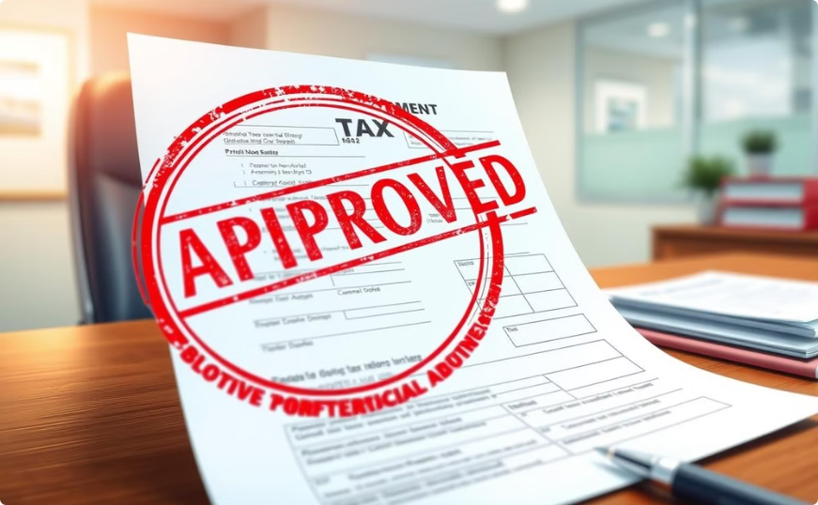
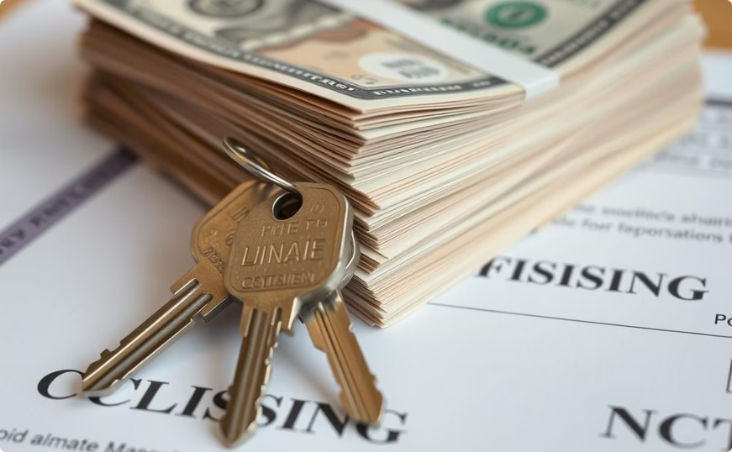
Pre-Closing – Seller Questionnaire
Tax Appeals
Closing Time
If a tax appeal is filed, the tax commissioner issues a bill for unresolved tax appeals at 85% of the maximum amount due based on the assessor's value.
If your tax appeal is still active by closing time, we will need the final bill to disburse funds escrowed at closing for the tax appeal.
Other Tax Matters
Are you filing a joint tax return?
If no, what percentage of the proceeds will each seller receive?
This is required for IRS purposes:
Seller 1: 40%
Seller 2: 60%

Slide 24
Pre-Closing – Seller Questionnaire: Georgia Withholding
Georgia Withholding Details
May be deemed a resident if:
3% of the Net Taxable Gain
Filed GA tax returns for the past two years; AND
Exemptions
Is an established business in GA and will continue to be a business establish in GA or has real property in Georgia at the time of closing of equal or greater value than the tax liability; AND
Georgia Resident (you cannot lose residency until you establish residency somewhere else)
Selling Primary Residence (2 of the last 5 years)
Will report sale on their GA tax return; AND
If seller is a corporation or limited partnership, seller is registered to do business in Georgia

Slide 25

Georgia Withholding
If you are not exempt the DOR withholds 3% of the net taxable Gain
Net taxable gain is determined by:
Sale Price
- Cost Basis
- Selling Expenses
Net Taxable Gain

Slide 26



Pre-Closing – Seller Questionnaire
FIRPTA
Non-Resident Alien Status
Withholding Rates
Are you a non-resident alien?
Sales Price $300,000 or less and buyer acquires as principal residence
If Yes, our office will contact you about the possibility of FIRPTA withholding.
No Withholding
If your seller is a non-resident alien let us know ASAP so we can refer them to individuals who specialize in FIRPTA withholding to determine their tax liability
Sales Price between $300,001-$1,000,000 and buyer acquires as principal residence
10% Withholding
All transactions—Any Sales Price and buyer NOT acquiring as principal residence
15% Withholding

Slide 27
CertifID Overview
CertifID is an application that allows for real-time verification of devices (cell phones), individual identities, and bank account information. Think Big Brother and Big Data!
Wires are insured for up to $1 Million when using wire instructions received through CertifID.
Enables real-time verification of:
  Devices (cell phones)
  Individual identities
  Bank account information

Slide 28
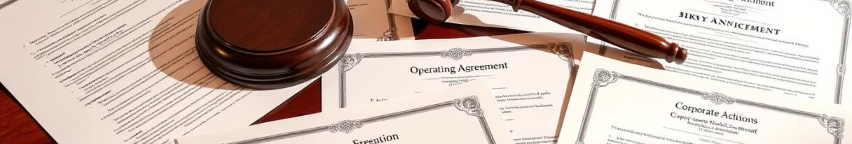
Special Sellers
Trusts
Estates
Trust Agreement
Certificates of Trusts are acceptable.
Last Will & Testament and Letters Testamentary OR equivalent probate.
If Joint Tenants, we only need the Death Certificate.
LLC
INC
Operating Agreement
If Sole Member we accept Sole Member Certification
Corporate Resolution with Signing authority
Articles of Incorporation from Secretary of State website
By-Laws

Slide 29

Pre-Closing: Initial Contract Review
Look for all terms relevant to the closing
Insure we received all exhibits
Termite? Home warranty? Survey? Other items a party is paying for at closing?
Stipulations that will impact closing or the settlement statement

Slide 30
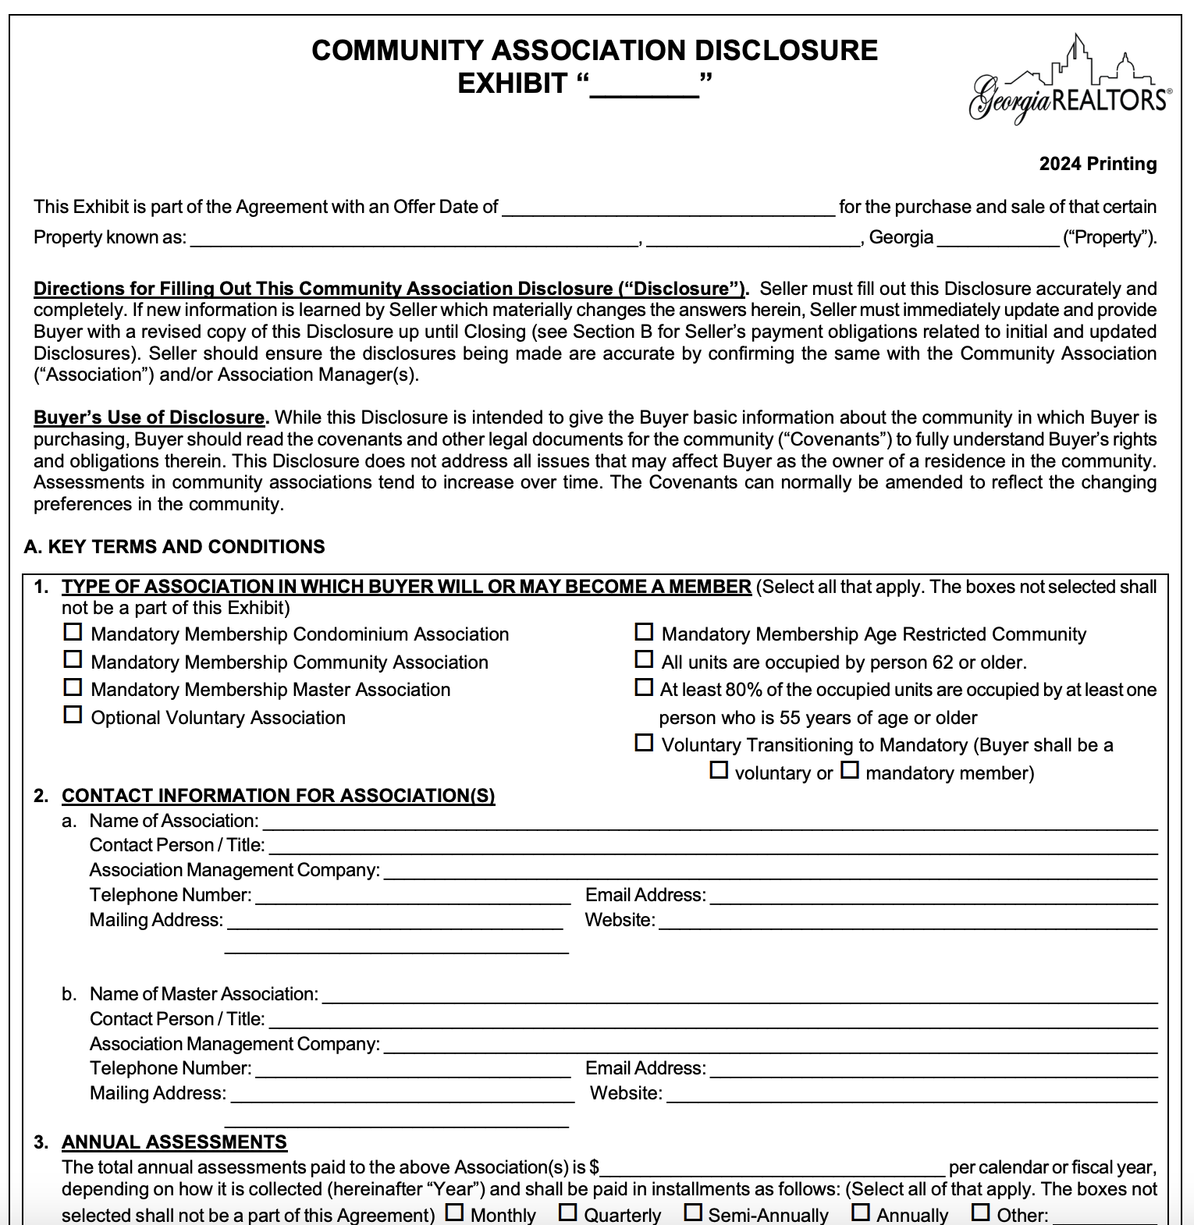
Pre-Closing – CAD
Information on the CAD allows us to order the closing letter

Slide 31
Pre-Closing - Commission
Broker Compensation Agreement Exhibit (F259 ) &
Instructions to Closing Attorney (F255)
Total commission?
Commission Split?
Contributing to closing costs?
Paying for an item on behalf of the client?

Slide 32
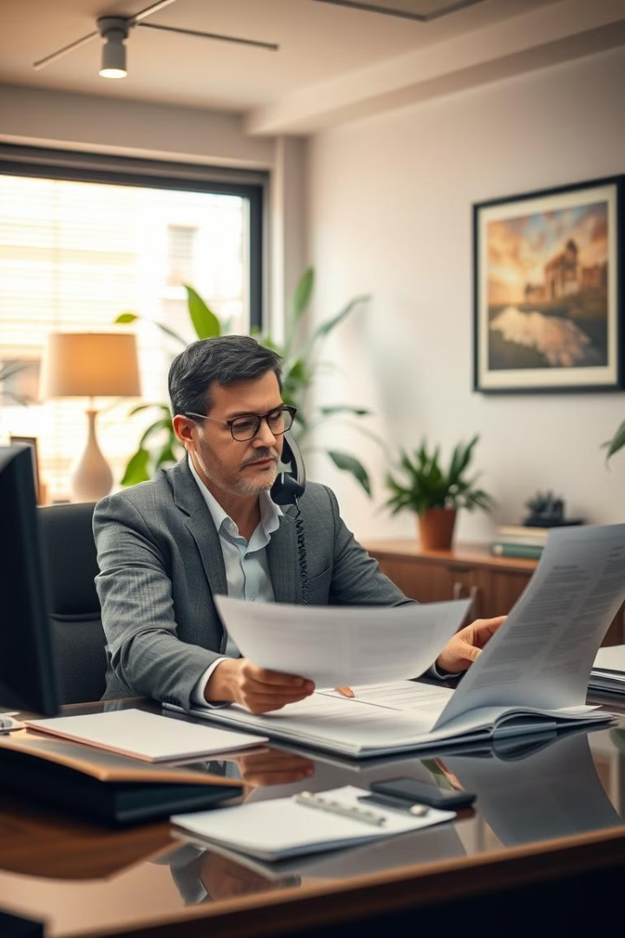
Pre-Closing – The Lender
Send title commitment to lender
Confirms property taxes, HOA fees, transfer/intangible tax, recording fees, etc.
Coordinate with lender's underwriter for any title related questions

Slide 33
Title Insurance
The one-time payment protects you and your heirs for as long as you own the property
Insures Good and Marketable Title – defends title and pays for claims from loss due to a covered risk
PROTECTS YOUR LARGEST INVESTMENT!
The Owner's Title Policy protects against defects that are missed or cannot be discovered in a routine title exam and title problems that are created after the title exam but before closing.
The seller only guarantees that they have not created a title issue. The purchaser has no recourse against the seller for problems created by prior owners. Title insurance provides this protection.
Owners vs. Lenders Title Policy

Slide 34


Enhanced Owner's Title Insurance
Comprehensive Protection
Additional Coverage
Post-Policy Forgery
Post-Policy Encroachments by Neighbors
Post-Policy Adverse Possession
Post-Policy Easement by Prescription
Building Permit and Zoning Violations
Vehicular and Pedestrian Access
Restrictive Covenant Violations
Policy amount increases 10% per year up to 150% of original policy amount
Pays rent/expenses if you cannot live in your home due to a claim

Slide 35
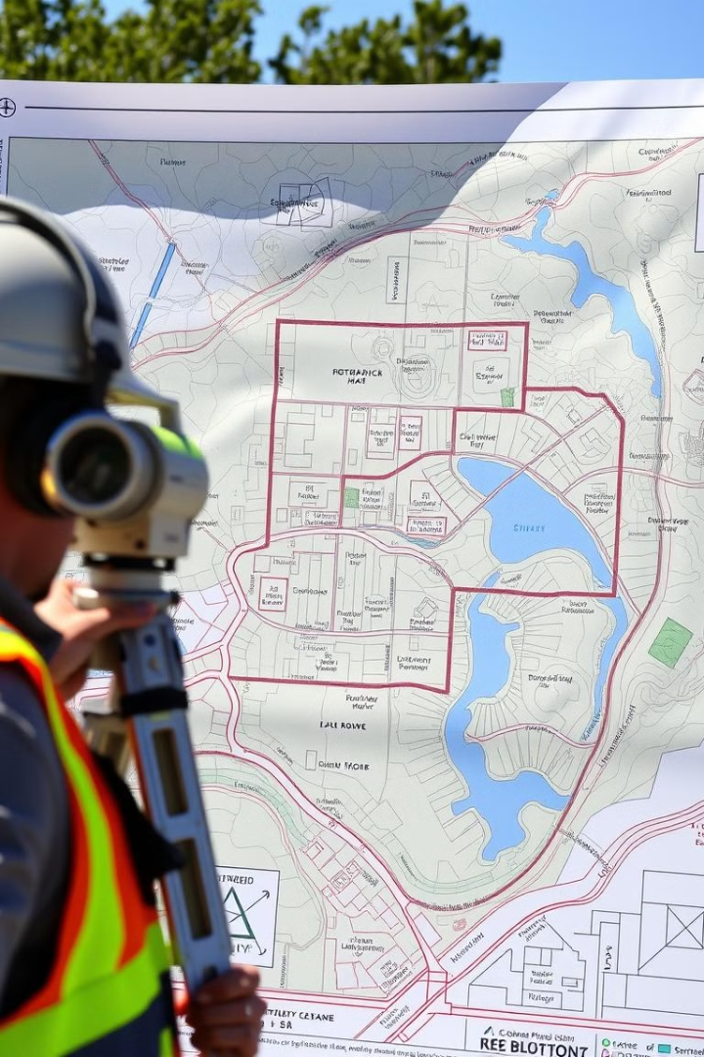
Surveys
Georgia is a buyer beware state – buyer has a duty to inspect
Identifies boundary lines, set back lines, improvements, stream buffers, easements, encroachments, etc. It will also note if the property is in a flood zone .

Slide 36

Don't Rely on Old Surveys
A surveyor's liability runs ONLY to the name(s) on the survey. Only those named on the survey have recourse for a surveying mistake.
An old survey is for information only.
Stream buffers are newer and many older surveys do not show stream buffers. A stream (by the state definition) is difficult to determine by a buyer's visual inspection of the property.
Newer surveys are conducted using more precise equipment.

Slide 37
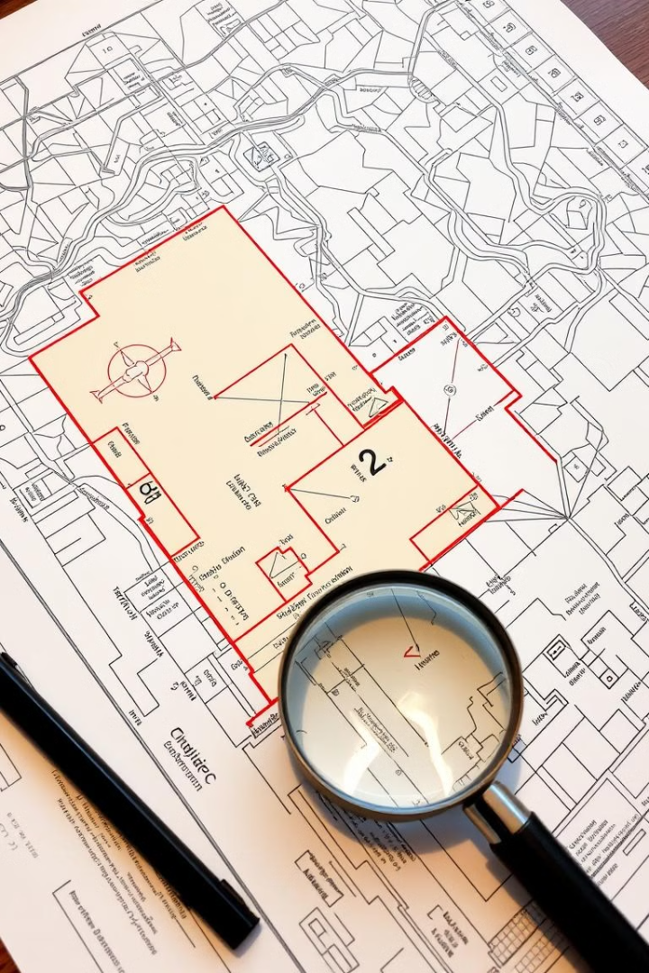
Surveys in Due Diligence
Late Survey Implications
If a survey comes back after the due diligence period, buyers can object to title matters but have no recourse for non-title matters such as:
Stream Buffers
Flood Zone
Easements that limit the possibility of building
Property is not as big as you thought
Special Stipulation for Late Surveys
If the survey won't be back during due diligence you can include a special stipulation for survey matters:
Should Buyer obtain a recent survey of the property, Buyer shall have the right to terminate the Purchase and Sale Agreement without penalty and with full refund of all Earnest Money if in Buyer's sole discretion any matters revealed by said survey are objectionable to Buyer. Buyer shall notify Seller of such termination for matters revealed by said survey no later than ___ days from Binding Agreement Date.

Slide 38
Closer Responsibilities
Closer
Works with Lender to balance the CD and receives the final loan documents.
Balances the closing file and sends the settlement statement in advance to review.
Confirms receipt of all items referenced in the contract: termite, home warranty, HOA letter, insurance, water bills, etc.
Prepares, with the attorney, deeds, affidavits and other documents signed at closing.
Confirms receipt of wires

Slide 39
Closer - Taxes and Escrow
Estimated Taxes:
  For properties with more than homestead exemption or new construction, we ask lender if they need estimated taxes depending on time of year
  Include estimated taxes for the following year on the title commitment
  Review exemptions on tax report for any significant exemptions
  New construction amounts should be based on % of completion as of January 1st
Tax Assessments:
  If assessment is released, use assessment amount for tax prorations prior to bill release rather than prior year

Slide 40
Closer: Parties Not Attending Closing
Seller Mail Away:
  Seller must be available on closing date for potential buyer's loan documents
  Confirm seller can print documents (letter size paper)
  Prepaid FedEx label provided
  Copy of signed documents required for review before drop-off
CASH Buyer Mail Away:
  Documents can be signed via HelloSign
  Originals not required

Slide 41
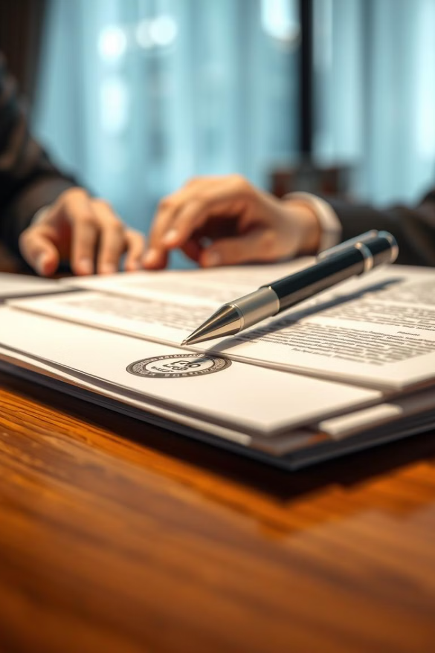
Closer: Loan Buyer Mail Away
We strongly discourage a mailaway with a loan package. A POA is typically a much better option.
The lender must send us the loan package at least 3 days prior to closing in order to receive the originals back before closing.
We will set the buyers up with a mobile notary. The fee for a mobile notary varies and will be collected from the buyer on the settlement statement.
A copy of the signed documents must be returned to the closer to review prior to returning the original package.

Slide 42
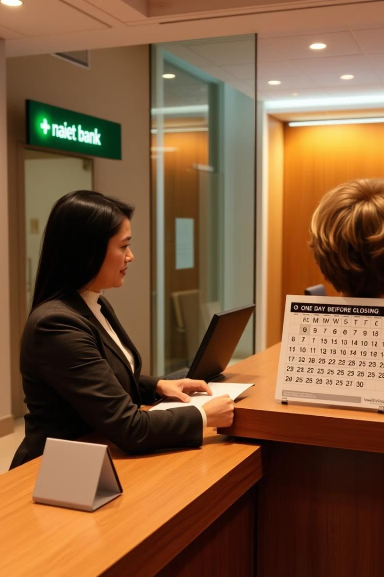
Wiring Funds
Wire funds at least one day prior to closing!
A buyer should contact their bank to confirm wiring procedures - most banks require you appear in person to initiate a wire.
If funds are coming from an investment account the wire may need to be initiated more than one day before closing.
A buyer should only rely on wire instructions provided through CertifID and confirmed over the phone via an independently verified number.

Slide 43
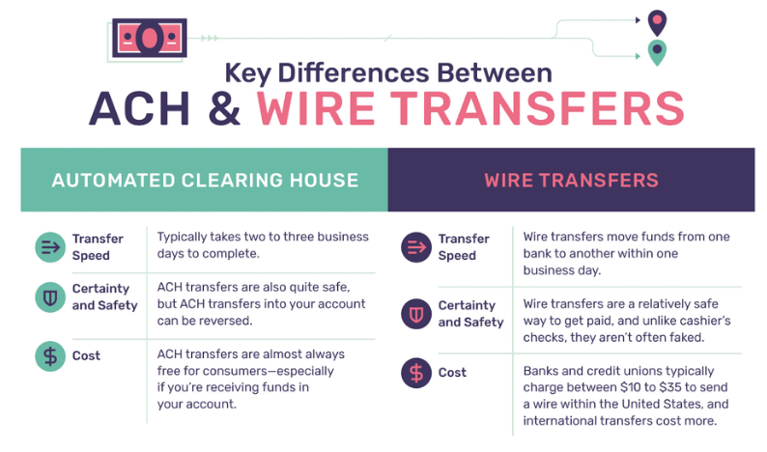
ACH Transfers
NO closing attorney can accept an ACH transfer for closing funds. Our account automatically rejects ACH wires.

Slide 44
Closing Day: Buyers Checklist
Essential Documents
Financial Preparations
Unexpired government issued photo id
Confirmation that funds have been received by Campbell and Brannon
Second form of id (not a credit card)
Original Power of Attorney, if applicable
A check or checkbook

Slide 45
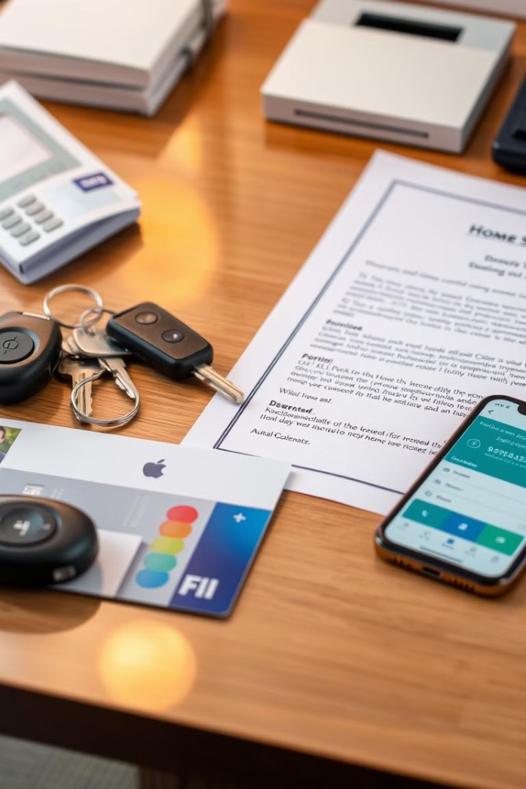
Closing Day: Sellers Checklist
Unexpired Government Issued Photo ID
Sellers must bring a valid, unexpired government issued photo identification to the closing.
Keys and Access Items
Bring keys, garage door openers, amenity cards, and garage codes to hand over to the new owners.
Original Power of Attorney
If applicable, sellers need to bring the original Power of Attorney document.
Wire Instructions
Sellers should have their wire instructions ready for receiving the proceeds from the sale.

Slide 46

Closing Day: Agents Checklist
Client Preparation
Financial Matters
Ensure your clients are aware of office location and closing time
Earnest Money, if needed
Communicate any special needs to Campbell and Brannon (any disability needs, babies, pets, etc.)

Slide 47




Your New Virtual Assistant

Slide 48


Ask
CBee…
GENERAL QUESTIONS
FOR COST ESTIMATES
What is title insurance?
Where is my closing?
When is my closing?
Do you accept checks?
Rates/Fees
Seller Net Sheet
Buyer Cost Estimate
Refinance Cost Estimate
©2023 Campbell & Brannon, All Rights Reserved.

Slide 49
24/7
Ask CBee
ABOUT A CURRENT CLOSING
DOCUMENT RETRIEVAL
Who is my pre-closer?
What are your hours?
Who orders the survey?
How can I send my earnest money?
Are we funded?
Are we recorded?
Show me my active closings
Did you receive the contract?
Show my closed transactions for 2022
Buyer closing package (BUYER ONLY)
Seller closing package (SELLER ONLY)
Signed settlement statement (ALL PARTIES)
Recorded deed (ALL PARTIES)
First payment letter (BUYER ONLY)
Tax proration agreement (BUYER ONLY)
Home warranty (BUYER AND AGENTS ONLY)
HOA letter (SELLER ONLY)
Payoff statements (SELLER ONLY)
1099 (SELLER ONLY)
©2023 Campbell & Brannon, All Rights Reserved.

Slide 50


TIP:
Make sure all contracts include your current cell phone number.
Add CBee
To Your Contacts

Slide 51
Thank You!
We appreciate your time and attention during this presentation. Please feel free to reach out to us with any additional questions or feedback. We're here to support you throughout the closing process.
Email: Attorneys@CB.Law

